Slide 1
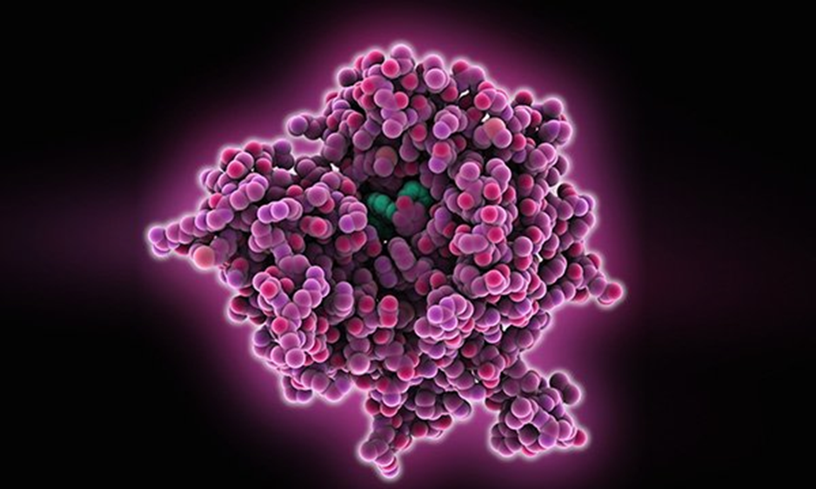
Tumour markers – using in the general practice
Tomáš Zima
Institute of Medical Biochemistry and Laboratory Diagnostics,
1stFaculty of Medicine, Charles University
Prague
Czech Republic
Malawi December 9,2020

Slide 2
TUMOR MARKERS
Substance present in the tumour, produced by the tumour or by the organism as a response to the presence of the tumour
Provide information about biological characteristics of the tumour
Qualitative determination – histopathology, in the tumour tissue
Quantitative determination – in the serum or other biological fluids, dynamic follow-up

Slide 3
TUMOR MARKERS
have a very long research history …..
Discoveries of the best known tumor markers
1928 - Ascheim- Zondek hCG
1936 - Gutman PAP
1957 - Bjorklund TPA
1963 - Abelev AFP
1965 - Gold CEA
1979 - Koprowski CA 19-9
1979 - Wang PSA
1981 - Best CA 125
1983 - Kufe CA 15-3
Notes:
30-ies of the 20th century – hCG (physiologically produced by placenta) discovered in young men with testicular tumours (Zondek)
70-ies of the 20th century - α₁-fetoprotein discovered in liver tumours in mice (Tatarinov), later on described in human hepatomas (Abelev)
Further intensive research and their practical usage of markers in oncology and prenatal diagnostics

Slide 4
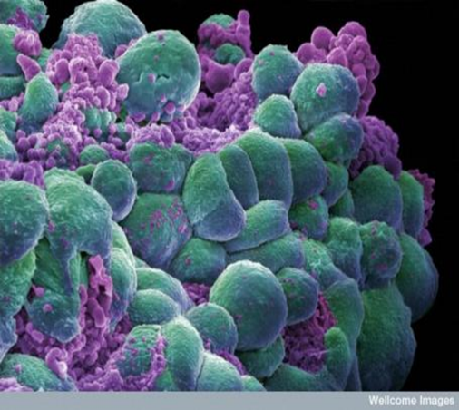
TUMOR MARKERS
Soluble markers – common tumour markers, various chemical substances – enzymes, hormones, cytokeratines, glycoproteins, glycolipids, receptors
Circulating cellular elements – circulating tumour cells, circulating endothelial cells and their precursors
Genetic abnormalities – detection of mutations in oncogenes and tumour supressor genes, protein products of oncogenes, further changes

Slide 5
Measurement of tumor marker ultimately impacts on clinical management of the malignant disease either by
CLINICAL USES OF TUMOR MARKERS
DETERMINE RISK OF DEVELOPING DISEASE
SCREENING FOR DISEASE
ESTABLISH DIAGNOSIS
DETERMINE PROGNOSIS
PREDICT RESPONSE TO THERAPY
MONITOR DISEASE
improving patient outcome
improving quality of life
lowering costs of care
Notes:
A fundamental prerequisite for development of any diagnostic tumor marker lies in the nature of the disease because this must be relatively prevalent, the biology of the disease must be known, and, naturally, an effective treatment should be easily available
Gives the clinician a tool for estimating the risk of disease recurrence and/or cancer-related death for an individual patient following the initial surgical removal of the cancer but without administration of adjuvant therapy.

Slide 6
Specificity and sensitivity
The usefulness of a tumour marker will depend primarily on the specificity and sensitivity of the test:
Specificity: The percentage of normal persons or persons with benign conditions for whom a negative result is obtained. The greater the specificity, the fewer the false-positives.
Sensitivity: The percentage of test results which are correctly positive in the presence of a tumour. The greater the sensitivity, the fewer the false-negatives.
E.g. for colon carcinoma, CEA has
95% specificity - incorrectly marks 5% of examined patients
and
70% sensitivity - it does not detect 30% of patients

Slide 7
Guidelines Recommendations
A number of international groups have released guidelines on the selection and use of tumor markers in the clinic.
These gps include : National Academy of Clinical Biochemistry (NACB), the European Group on Tumor Markers (EGTM), the American Cancer Society (ACS), the American Society for Clinical Oncology (ASCO),and the others.

Slide 8
Most frequently requested serum tumour markers and the current recommendations of the National Academy of Clinical Biochemistry for the appropriate clinical use of these markers

Slide 9
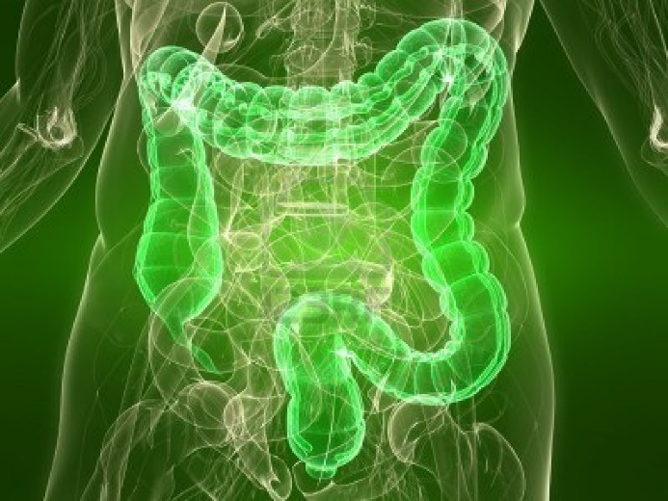
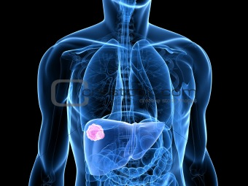
Tumour markers – recommened use according to localization and tumour type
Colorectal
CA 19-9, CEA, CA 72-4
Liver
AFP, CEA
cholangiocellular - CA 19-9
metastases - CEA
Multiple myeloma
B2M, paraproteins
Lymfoma
Hodgkin - B2M, FER, LD
non-Hodgkin - TK, B2M, LD
http://cz.123rf.com/photo_6443693_transparent-body-with-healthy-colon.html

Slide 10
PIVKA-II – new biomarker for hepatocellular carcinoma
Protein induced by vitamin K absence-II (PIVKA-II) is a potential screening marker for hepatocellular carcinoma (HCC).
Release – deficiency of vitamin K and HCCv souvislosti s nedostatkem vitaminu K a za přítomnosti HCC.
AFP – standard Tu marker for HCC
PIVKA-II - chemiluminiscent test Architect 1000i (Abbott)
PIVKA-II better sensitvity (96,9 %) then AFP
Should be for diagnosis between HCC and benign liver diseases and primary HCC and metastasis
Zima - Využití nových tumorových markerů ve sledování onkologických pacientů
ÚLBLD

Slide 11
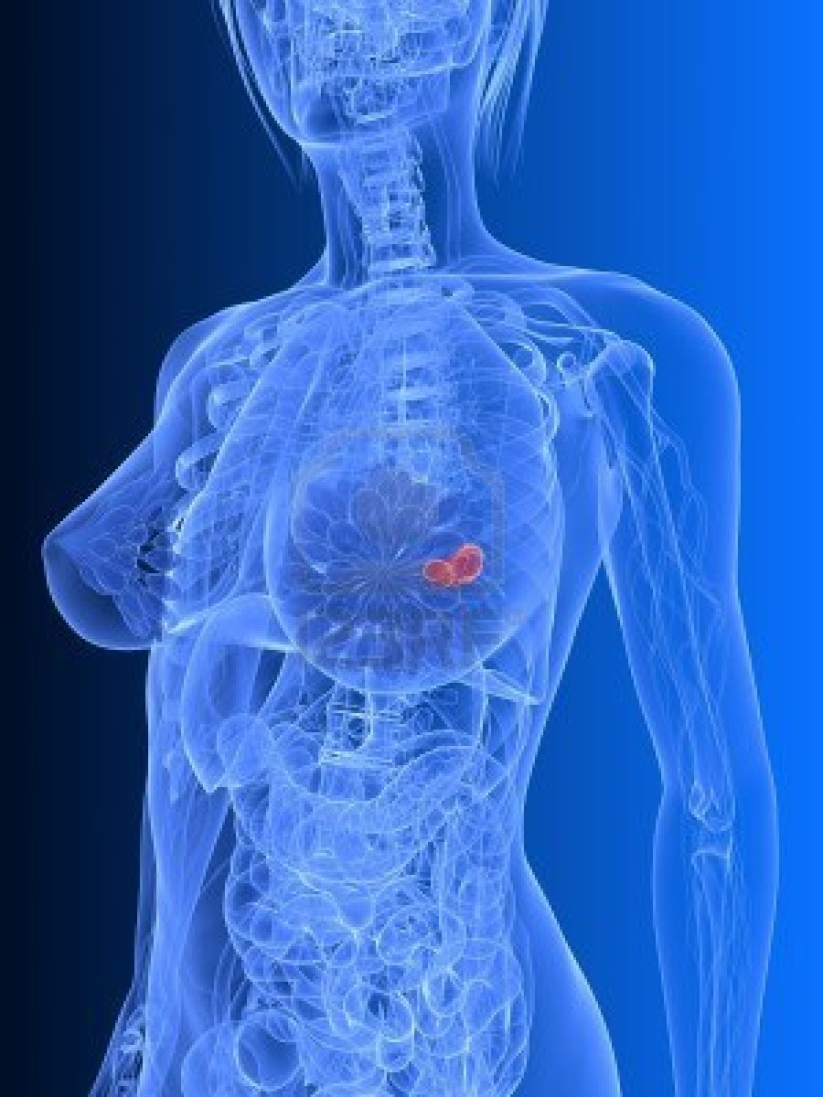
Tumour markers – recommened use according to localization and tumour type
Ovary
non-mucinous - CA 125, HE4 (TPA/S)
mucinous - CA 19-9, CA 72-4, inhibin (CEA)
germinative - AFP, hCG
Cervix
epidermoid - SCCA (CYFRA 21-1, CEA)
adenocarcinomas - CEA
Breast
CA 15-3, CEA (TPA/S)
Corpus uteri
CA 125 (CEA)
http://cz.123rf.com/photo_6530650_transparent-female-breast--breast-cancer.html
Notes:
HE4 (Human Epididymal Protein-4)

Slide 12
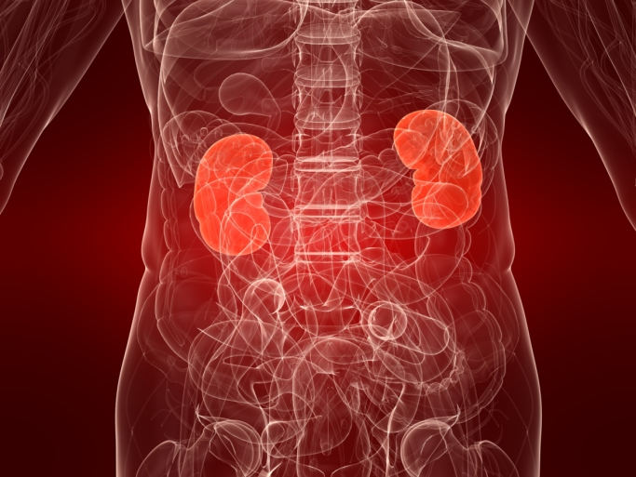
Tumour markers – recommened use according to localization and tumour type
Kidney
TPA/S, FW, CEA (NSE)
Urinary bladder
TPA/S (CYFRA 21-1)
Prostate
PSA, fPSA (CgA)
Testes
seminomas - hCG, AFP (NSE)
non-seminomas - hCG, AFP
http://depositphotos.com/2893854/stock-photo-Human-kidneys.html

Slide 13
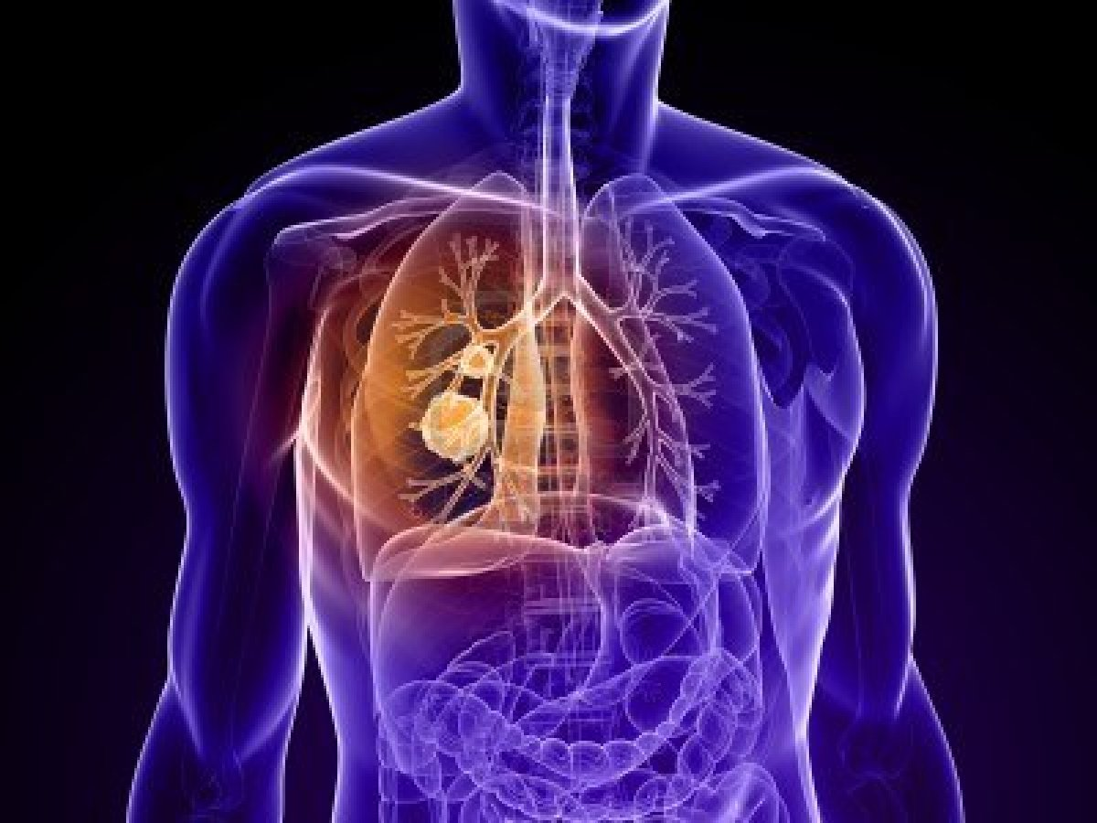
Tumour markers – recommened use according to localization and tumour type
Carcinoid
5-hydroxy 3-indolylacetic acid, NSE, CgA
Thyroid gland
medullar CT, CEA (NSE)
anaplastic TPA/S
Melanoma
NSE, S100beta (TK)
Lung
SCLC - CEA, NSE, ProGRP (TPA/S)
NSCLC - CYFRA 21-1, CEA (SCC)
http://cz.123rf.com/photo_7148847_transparent-human-body-with-cancer-in-lung.html
Notes:
Progastrin-releasing peptide (ProGRP)

Slide 14
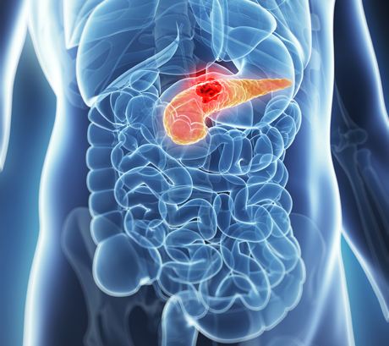
Tumour markers – recommened use according to localization and tumour type
Stomach - CA 72-4, CEA
Oesophagus
Cranial part - SCCA (CYFRA 21-1)
Lower part - CA 72-4, CEA
Pancreas - CA 19-9, CEA
http://www.shutterstock.com/pic-128019500/stock-photo--d-rendered-illustration-of-the-male-pancreas-cancer.html

Slide 15
Frequency of investigation
Before therapy | selection of 1 – 2 TM
After therapy | 1 – 5 weeks (according to biological half live)
6 months after therapy | every month
6 – 12 months after therapy | Every 2 months
12 – 18 months after therapy | Every 3 months
After 18 months | Every 6 months
Biological halflive of TM
0,3 h - SCCA, CT, hormons
1-7 h fPSA, CYFRA 21-1….
mostly 1-4 days - CA 125, PSA, hCG, NSE..
the longer one has CEA – 14 days
In case of an abnormal value, a repeat estimate can be ordered within 2 to 4 weeks irrespective of the initial reading.

Slide 16
Dynamic follow up
Conc. of TM
„cut off“
Time

Slide 17
Dynamic follow up
Conc. of TM
„cut off“
Time

Slide 18
Determination of tumour markers - analytical interferences
Cross reactivity of structurally similar molecules
Hook-effect caused by high concentration of the marker
Carry-over of analyzed marker between samples
Interference of heterophil and human anti-mouse antibodies (HAMA)
Check the same samples by different analytical technology.
No reference material - EQA!

Slide 19
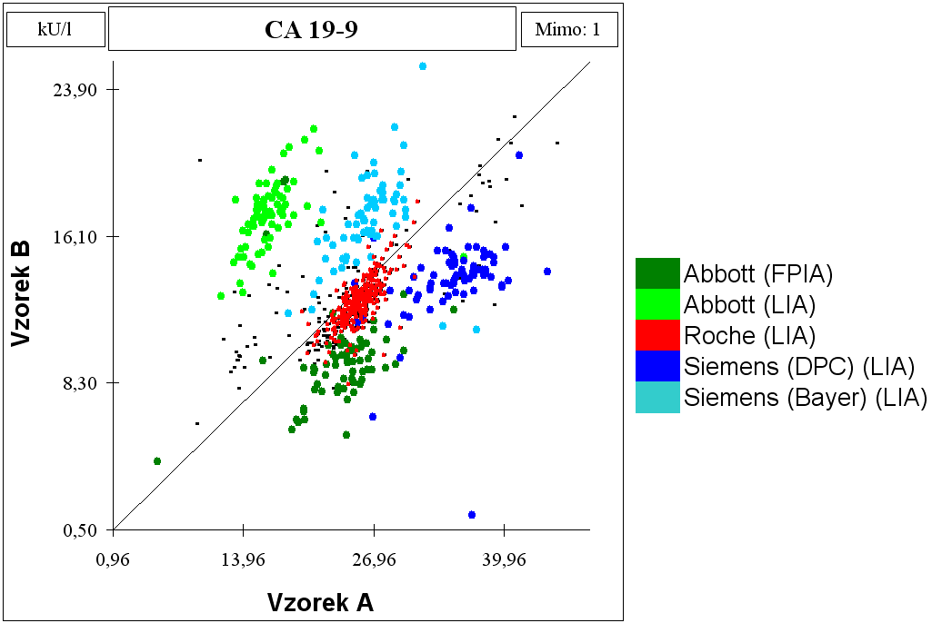
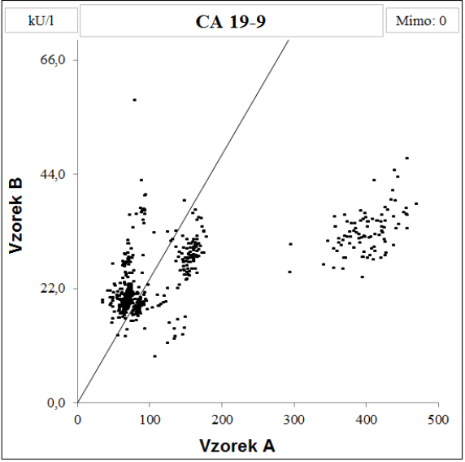
CA 19-9
Relatively large differences were observed in external quality assessment (EQA) between the results that were obtained by different immunoassay technologies.
We compared six routinely employed immunoassay
kits: Architect i2000 and AxSYM, Abbott; Elecsys 2010, Roche Diagnostics; ELSA, CIS-BioInternational; Immulite 1, Diagnostic Products Corporation; and IRMA-mat, Byk-Sangtec Diagnostica.
Using all analytical systems, we measured identical groups of clinical samples complete with selected calibrator and control samples.
Stern P, Friedecky B, Bartos V, Bezdickova D, Uhrova J, Zima T et al. Comparison of different immunoassay for CA 19-9. Clinical chemistry and laboratory medicine. 2001; 39:1278-1282.
Notes:
The behavior of individual systems is quite different for identical control materials and does not necessarily duplicate the calibration for biological samples. The results of determining CA 19-9 cannot be extrapolated from one analytical technique to another, even in cases where the same monoclonal antibody is used. Standardization of CA 19-9 measurement systems is necessary to allow use of the results for the purposes of evidence based medicine.

Slide 20
Cancer Screening
The main goals of cancer screening are to:
Reduce the number of people who die from the disease, or prevent deaths from cancer altogether
Reduce the number of people who develop the disease
Each type of cancer has its own screening tests?
Some types of cancer currently do not have an effective screening method. Developing new cancer screening tests is an area of active research.

Slide 21
Types of screening tests I
Breast cancer
Mammography - a type of x-ray specifically designed to view the breast.
Clinical breast examination
Breast self-examination
Cervical cancer
Human papillomavirus (HPV) testing. Cells are scraped from the outside of a woman’s cervix. Some strains of HPV are more strongly linked to an increased risk of cervical cancer. This test may be done alone or combined with a Pap test
Pap test. This test also uses cells from the outside of a woman's cervix. A pathologist then identifies any precancerous or cancerous cells.
Colorectal cancer
Fecal occult blood test (FOBT). This immunochemical test finds blood in the stool, which can be a sign of polyps or cancer.
Colonoscopy. The doctor check the entire colon for polyps or cancer.

Slide 22
Types of screening tests II
Prostate cancer
Digital rectal examination (DRE). A DRE is a test in which the doctor inserts a gloved lubricated finger into a man’s rectum and feels the surface of the prostate for any irregularities.
Prostate-specific antigen (PSA) test.
Skin cancer
Complete skin exam.
Lung cancer
Low-dose helical or spiral computed tomography (CT or CAT) scan.

Slide 23
The controversy in searching of tumors – screening
prostate cancer – PSA? (Duffy MJ. PSA in screening for prostate cancer: more good than harm or more harm than good? Adv Clin Chem 2014;66:1-23.)
faecal blood test - !! Population screening
risk populations
calcitonin - families with medullar CA of the thyroid gland
CA 125 (HE4) – ovary cancer in risk families
CA 15-3 in BRCA mutations
AFP – hepatocellular cancer – Asia, Africa
- cirrhotic patients

Slide 24
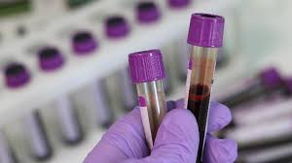
Discover of new tumor markers

Slide 25
Potential new tumour markers
Proteins and oncoproteins – products of mutated
genes which play a role in cell life, their division,
differentiation and metastasing
Regulation of the cell cycle - cyclins
Apoptosis – Bcl-2 protein, sFas, protein-product of mutated gene p53
Signal transduction - c-erbB-2 (Her-2/neu), EGRF, IGF, TNF-α
Adhesion - ICAM-1, VCAM-1
Angiogenesis – inhibitors of angiogenesis - angiostatin, angiogenin, trombospondin
Markers associated with specific characteristics of tumour cells – matrix metalloproteinases, urokinase plasminogen activator (uPA) and its inhibitor (PAI-1)

Slide 26
Liquid biopsy – why ?
Personalized therapies for cancer patients
Molecular characterization of tumors allows progression to personalized medicine form „one fits all“ strategy
Correlation mutation profiles with sensitivity or resistance to therapy is needed
Successful treatment requires monitoring of a disease in real-time
Looking for novel non-invasive biomarkers for
Diagnosis (character of tumor, cancer genome analysis)
Prognosis (clinical decision, outcome monitoring)

Slide 27
Circulating tumor cells
CTCs are extremely rare (1 per 1 ml blood)
CTC can be damaged during the extraction from blood (fragility)
CTC are heterogeneous as tumors
Optimization of CTC isolation and detection is essential
Limitation of technologies (low sensitivity, selection bias, poor specificity)
DOI: 10.1158/1078-0432.CCR-14-0894

Slide 28
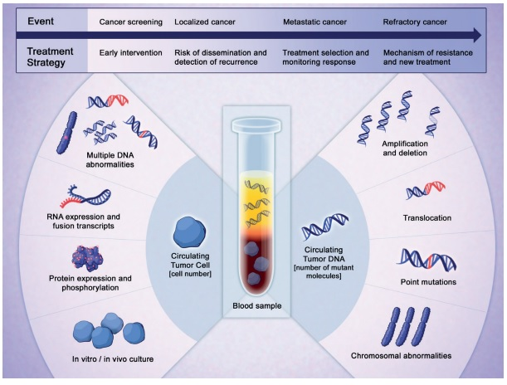
Marc Beishon, CancerWorld

Slide 29
Clinical validity of CTC
DOI: 10.1007/s10147-017-1105-2

Slide 30
Clinical applications of liquid biopsy in personalized medicine
Predict relapse of metastatic process
Monitor therapy efficacy
Understand therapy resistance mechanism
Patients stratification
DOI: 10.1158/2159-8290.CD-15-1483
Notes:
Clinical applications of CTCs and ctDNA as liquid biopsy for personalized medicine. Blood samples can be sampled repeatedly to predict relapse in M0 patients or metastatic progression in M1 patients, monitor the efficacy of therapies and understand potential resistance mechanisms. Before therapy, patients can be stratified to the most effective drugs, whereas after initiation of treatment persistence in increases of CTCs/ctDNA indicates resistance to therapy, and this information may allow an early switch to a more effective regimen before the tumor burden is excessive and incurable. mt, mutation; BC, breast cancer; PC, prostate cancer; CRC, colorectal cancer.

Slide 31
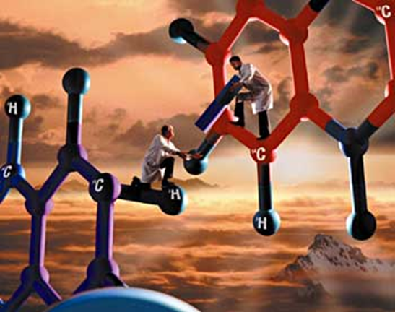
WHAT APPROACHES ARE AVAILABLE
single gene assays
somatic mutations and other alterations (gene amplification)
germ line alterations
multigene arrays and signatures
classification
prognostication
prediction of treatment benefit
next generation sequencing

Slide 32
Human Genome
Establish tissue expression of all human genes by microarray technology
Identify “tissue-specific” genes
Compare “normal” vs “cancer”
Select highly overexpressed genes
Evaluate in detail
Many potential pitfalls

Slide 33
Single gene assay
germline BRCA1 mutations
single gene with many different mutations
dramatically increases risk of breast and ovarian cancer
predisposition to triple negative breast cancer
may impact response to treatment
Notes:
Frequency plot summarizing the specific types of genetic changes occurring in sporadic versus BRCA-associated tumors: LOH (A, pink bars), deletions (B, green bars), uiparental disomy (C, blue bars), amplifications (D, red bars). In each panel, the percentage of cases affected by a specific type of genomic abnormality at each region is represented as a vertical bar along the y-axis. The genomic location is represented along the x-axis with chromosome 1 to the left and the X chromosome on the right.

Slide 34
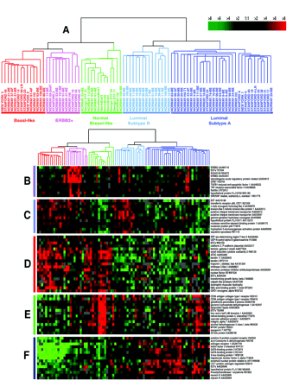
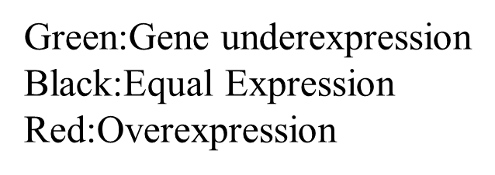
Multigene arrays
combination of expressed and repressed genes within a tumor
information about:
global state of the tumor, revealing information pertaining to cellular
metabolic rates,
proliferative status
molecular interactions between malignant epithelial cells and surrounding cells

Slide 35
Next generation sequencing (massively parallel sequencing)
technology
has revolutionised our ability to characterize cancers at the genomic, transcriptomic and epigenetic levels
is cataloguing all mutations, copy number aberrations and somatic rearrangements at base pair resolution
can be used as a means for unbiased transcriptomic analysis of mRNAs, small RNAs and noncoding RNAs, genome-wide methylation assays and high-throughput chromatin immunoprecipitation assays

Slide 36
Conclusion
Tumour markers is a low-cost test when used correctly.
Appropriate requesting and interpretation are the keys to achieve the desired clinical utilities of TM
The results obtained by different analytical systems are not interchangeable.

Slide 37
Tumor markers are important tools that can aid clinicians in questions regarding early diagnosis, estimation of patient prognosis, prediction of therapy response, and disease monitoring.

Slide 38
Thank you very much

