Slide 1

INTRODUCTION TO IFCC YOUNG SCIENTISTS
Importance of conducting research in Laboratory medicine and selection of an appropriate research project
DR ASHLIN RAMPUL ashlinrampul@gmail.com

Slide 2
AIM
The aim of TF-YS is to ensure that young scientists make a significant and growing contribution to the activities of IFCC and to the promotion of laboratory medicine at the centre of healthcare.

Slide 3
OBJECTIVES
To identify young scientists amongst IFCC Full and Corporate Members
To use modern information technology to establish formal and informal networks to facilitate the communication.
To link with national society young scientist initiatives.
To encourage YS to share experience of laboratory medicine and other healthcare practice around the world
To disseminate and promote innovation and high quality scientific and clinical practice standards
To facilitate opportunities for young scientists to train in modern, state of the art laboratory practice
To enable young scientists to participate in scientific, clinical and educational meetings and other learning sessions
To make young scientists aware of the existence and role of IFCC and to encourage their participation in IFCC activities

Slide 4
STRUCTURE

Slide 5
CORRESPONDING MEMBERS (43)

Slide 7
RECENT ACTIVITIES
TF-YS members meeting
Education
Web-based activities
Training
Networking

Slide 8
RECENT ACTIVITIES
TF-YS members meeting
Education
Web-based activities
Training
Networking
-Define TF-YS objectives
-Review of activities and projects, including educational program and workshop content
-New initiatives

Slide 9
RECENT ACTIVITIES
TF-YS members meeting
Education
Web-based activities
Training
Networking
-Continuing education and training

Slide 10
RECENT ACTIVITIES
TF-YS members meeting
Education
Web-based activities
Training
Networking
-Use of ICT to support TF-YS activities and visibility

Slide 11
RECENT ACTIVITIES
TF-YS members meeting
Education & Trainig
Web-based activities
Training
Networking
-Sharing experience between YS

Slide 12
RECENT ACTIVITIES
TF-YS members meeting
Education & Trainig
Web-based activities
Training
Networking
-Increasing participation in TF-YS and IFCC activities and promote exchange of information

Slide 13
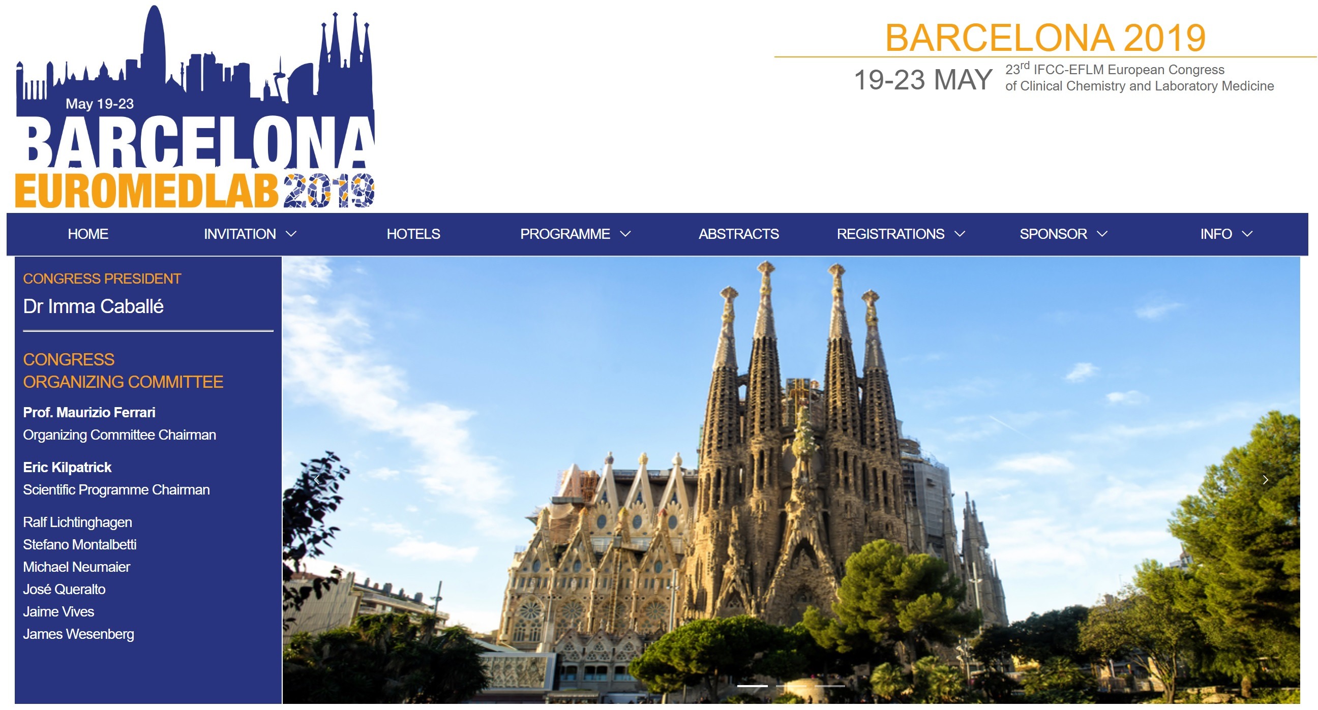

Slide 14
EuroMedLab 2019,19-23 May 2019
“Laboratory Medicine training in Europe - In partnership with the IFCC TF-YS symposium”
“Young Scientist session”
Participated: Pradeep Dabla, Guiliane Boursier, Claudia Elizabeth Imperiali, Josep Miquel Bauca, Juan Robles Bauza and Rojeet Shrestha

Slide 15
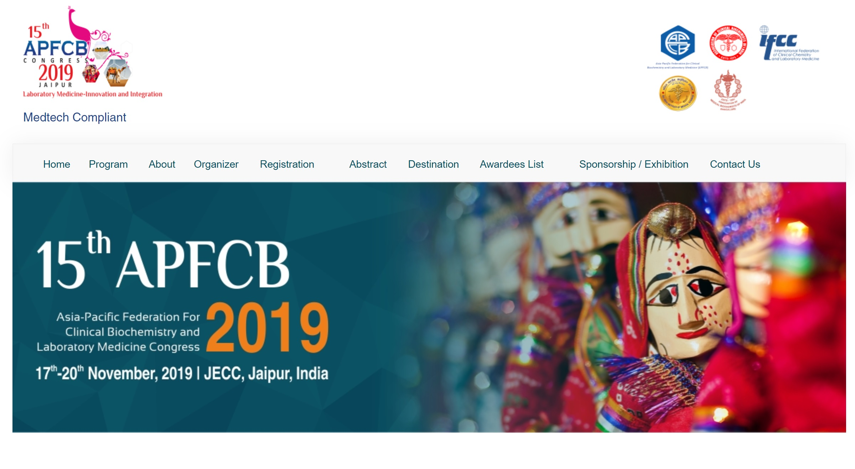

Slide 16
APFCB, 17-20 Nov 2019
“Building Tomorrow's leaders by the young generation (IFCC-CCLM / IFCC-TFYS)”
TF-YS symposium “Clinical Chemistry to Clinical Laboratory Science - Future Challenges”
Participated: Pradeep Dabla, Ashlin Rampul, Joe El Khoury, Marie Lenski and Santiago Fares Taie

Slide 17
33th National Congress of the Tunisian Society of Clinical Biology (STBC) on 25-27 April 2019
Young Scientists Session:
“IFCC TF YS: A short presentation”
“New technology in pre-analytical phase”
"Advances in analytical phase“
"Advances in post analytical-phase"
Presented: Manel Chaabane, Giulia Sancesario, Sedat Abuşoğlu and Pradeep Kumar Dabla

Slide 18
Egypt, AFCC, 22nd and 23rd of February 2019
Egypt, Annual International Conference of The Chemical Pathology Department, Medical Research Institute - Alexandria University, in collaboration with The African Federation of Clinical Chemistry (AFCC).
The Young Scientists session organized by Ramy Assaad Khalil.

Slide 19
3rd Annual Conference of the Italian YS, on December 20th, 2019 in Rome- supported by Italian Society Organisation, SiBioC

Slide 20
Ambicon 2019 Dec 13-15, Ludhiana, India (TFYS session at Conference)
Participated: Pradeep, Priya, Charu

Slide 21
MENTORSHIP PROGRAMME
The mentoring program is intended to educate IFCC Young Scientist members on any current mentorship program in the laboratory research area. The program focuses on “how, when, what and why” about the existing mentor and mentee relationship and tips on how others can learn from their relationship.

Slide 22
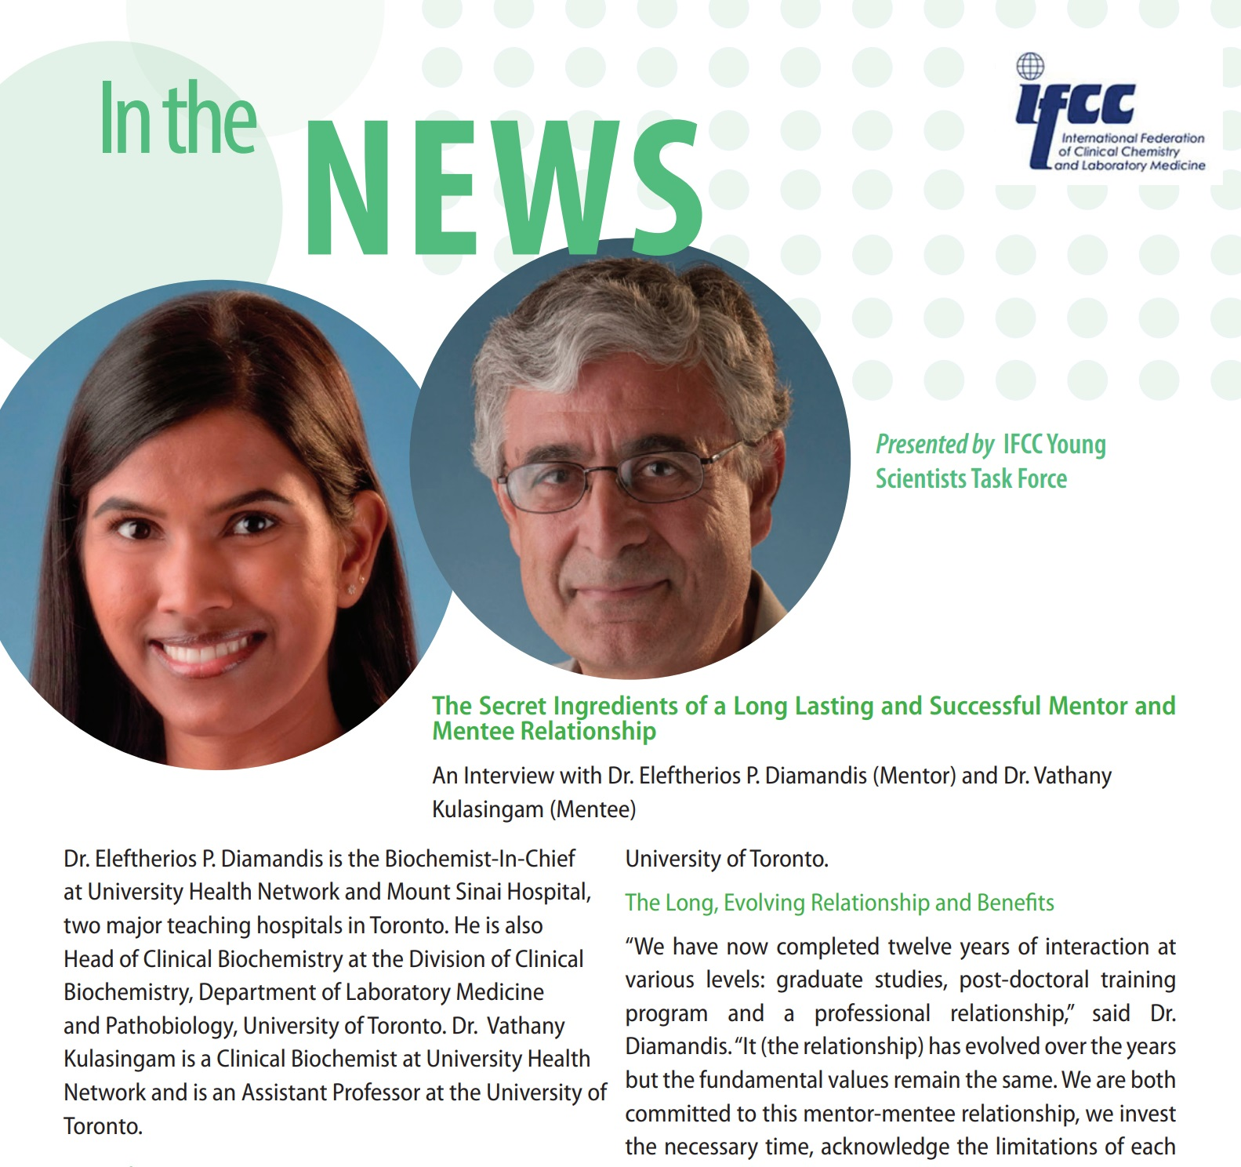

Slide 23


Slide 24
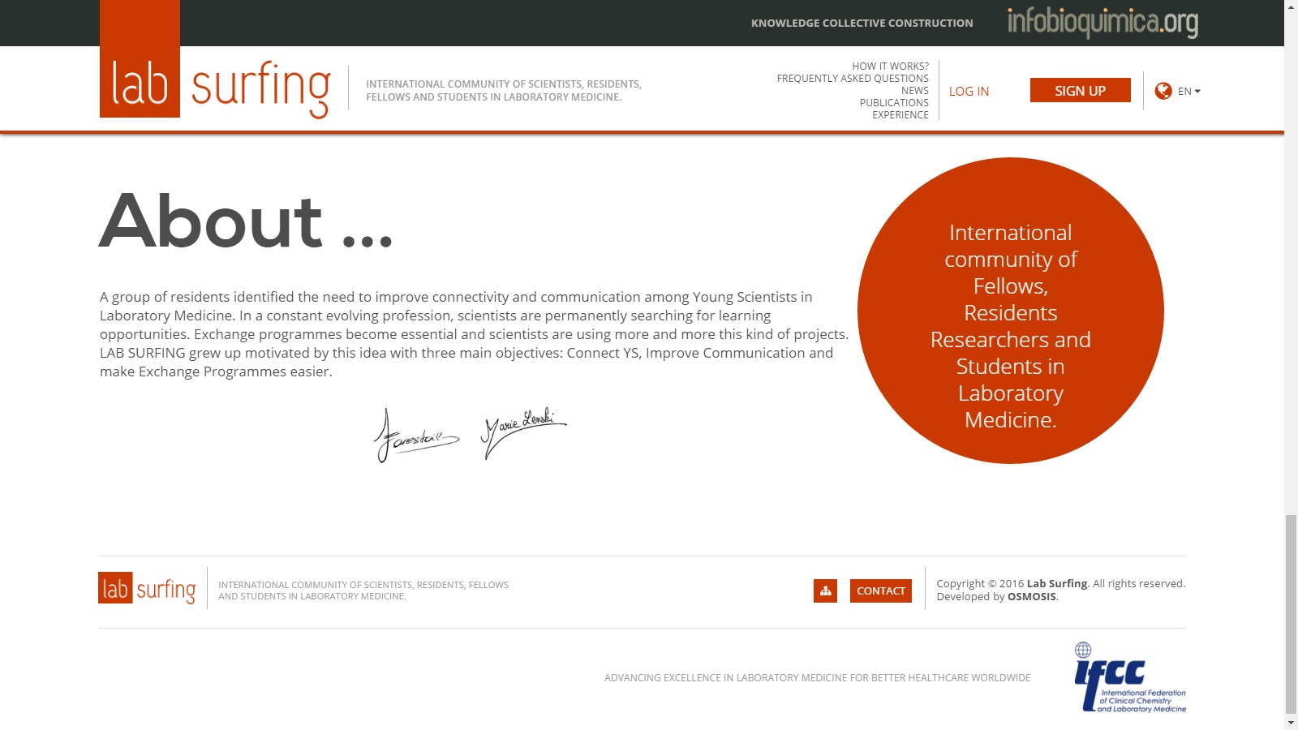
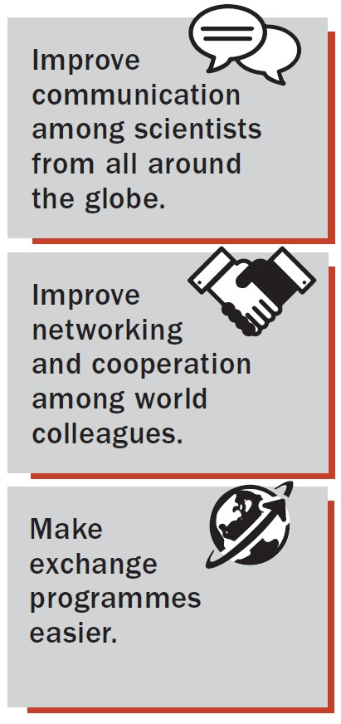

Slide 25


Slide 26
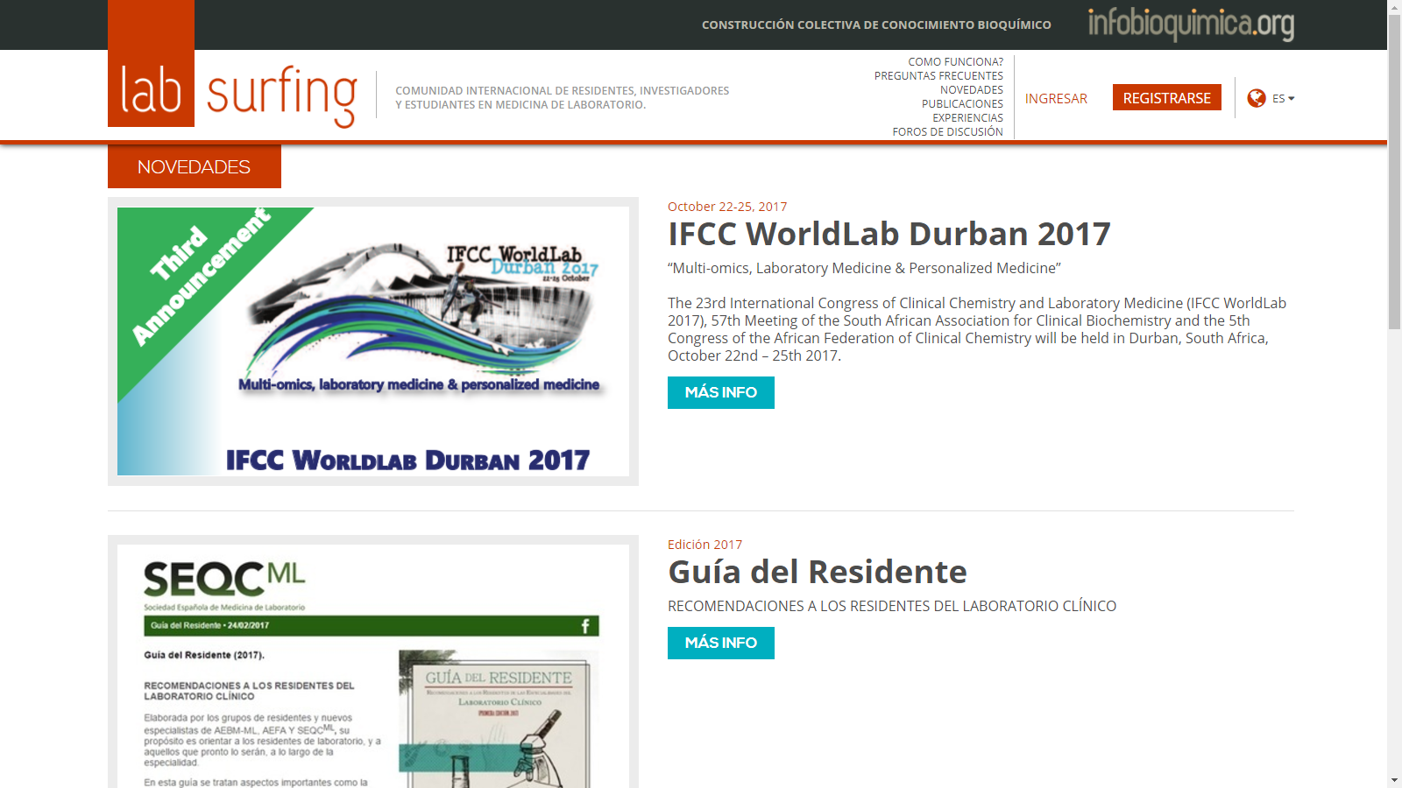

Slide 27
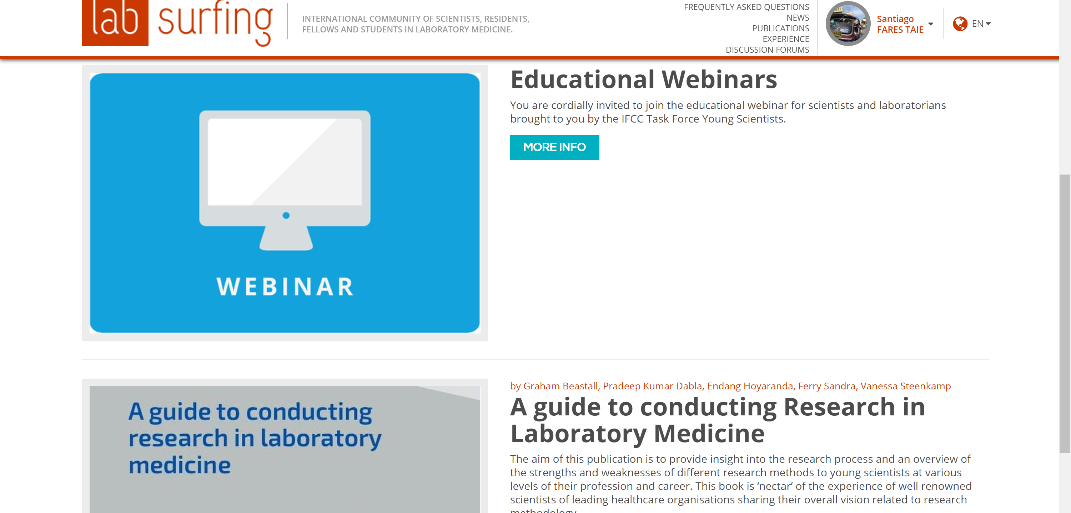

Slide 28
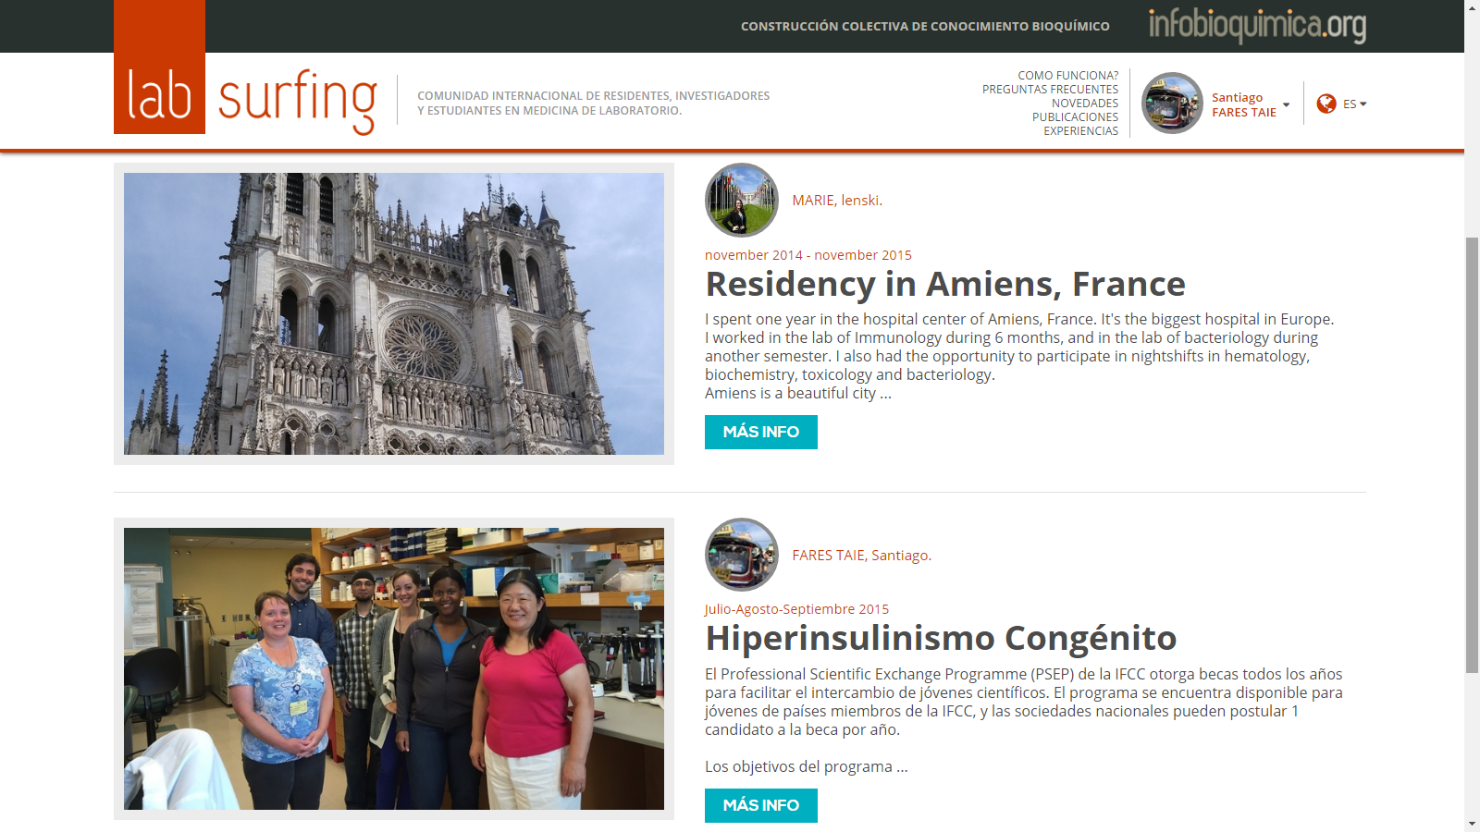

Slide 29
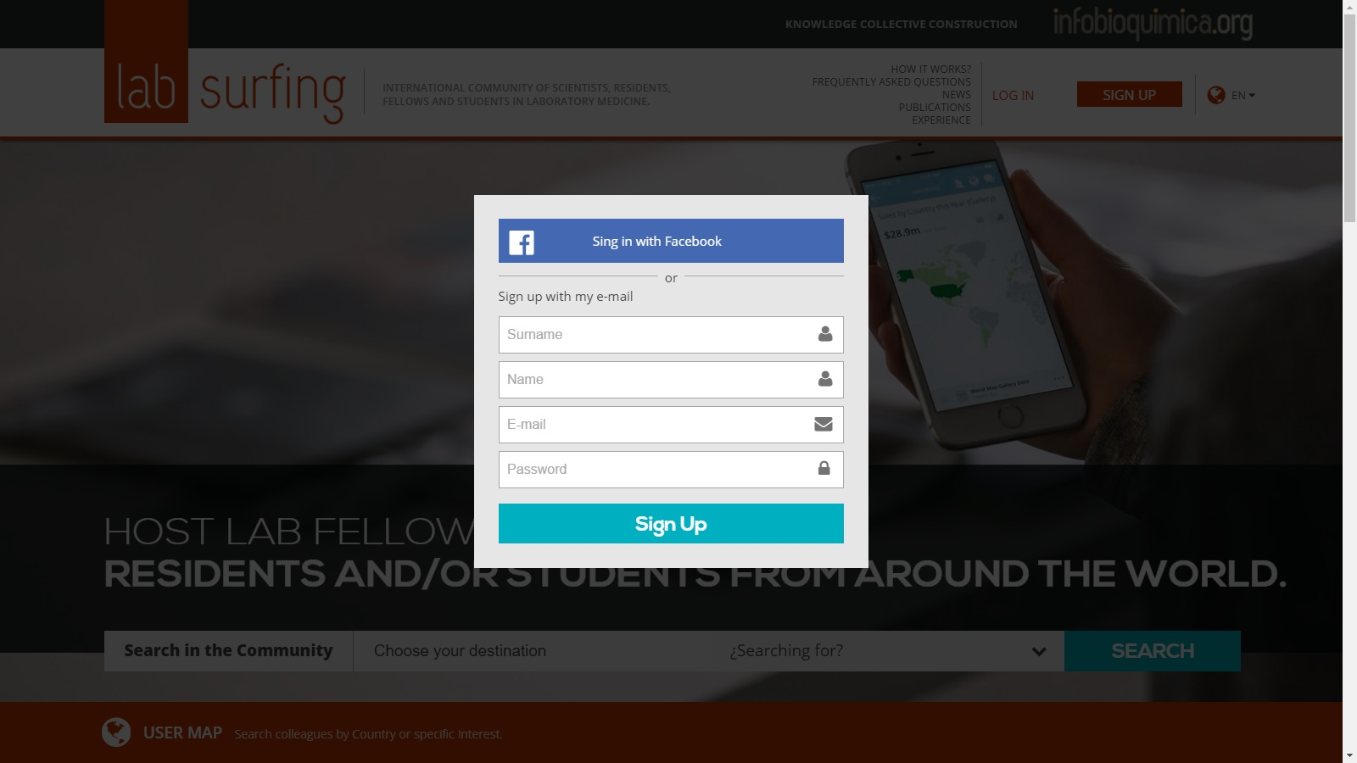

Slide 30


Slide 31
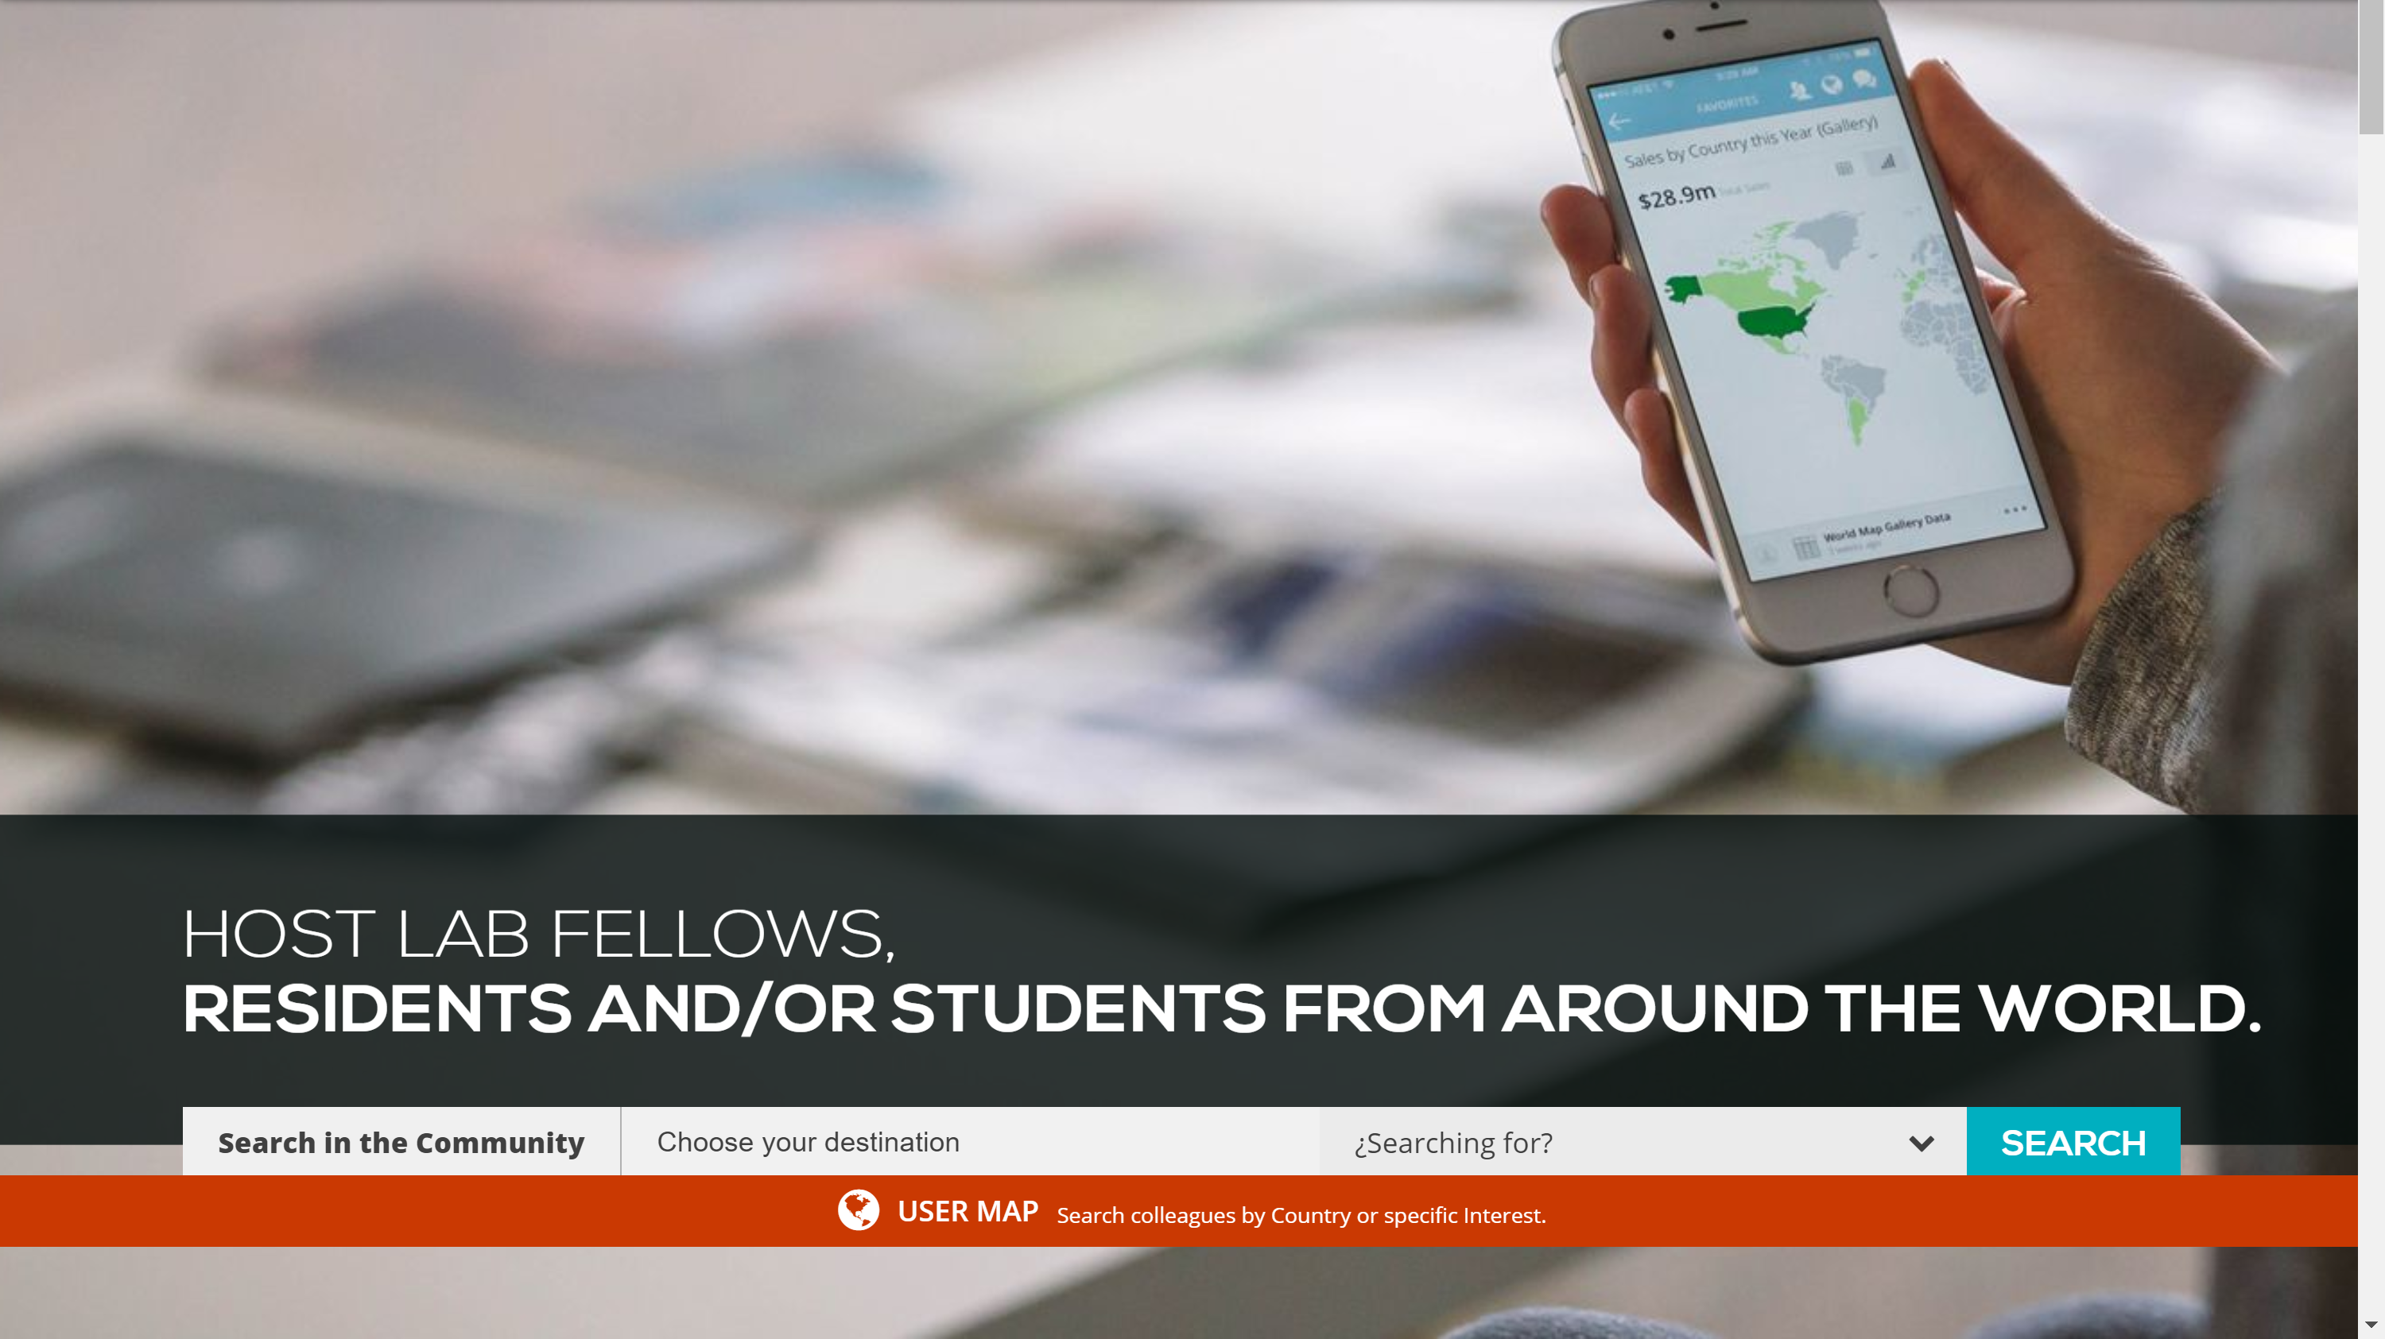

Slide 32
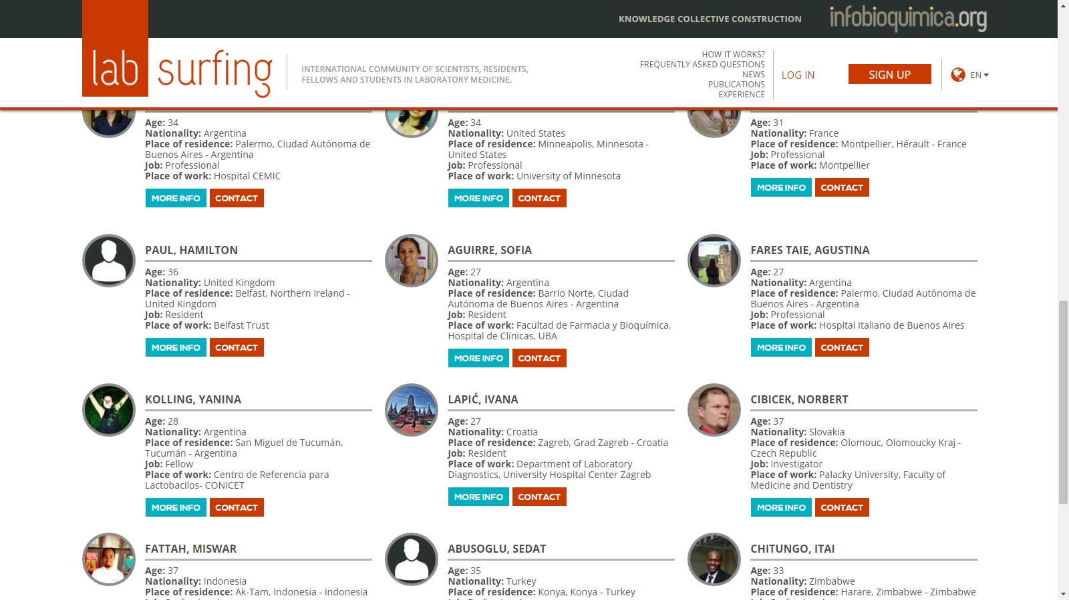

Slide 33
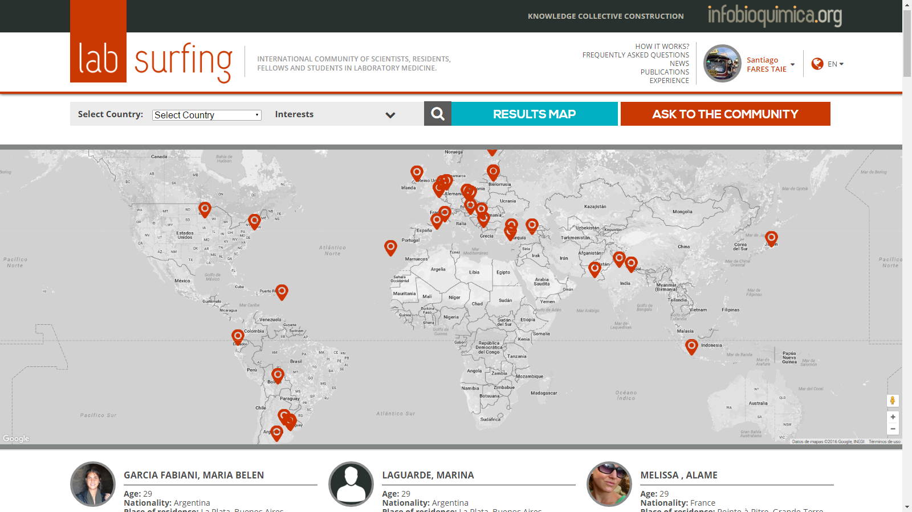
2016

Slide 34
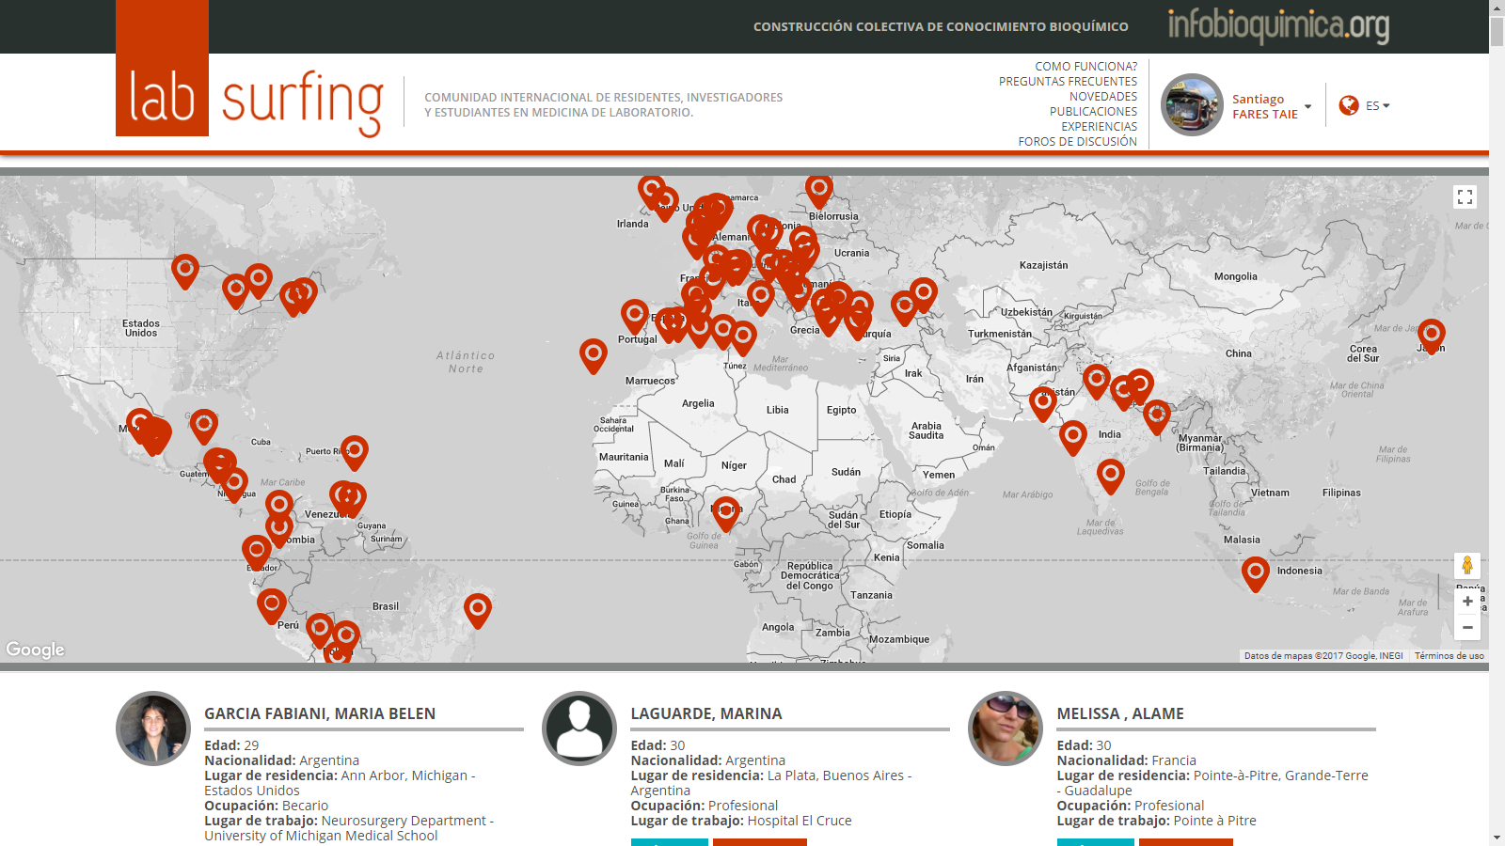
2017

Slide 35
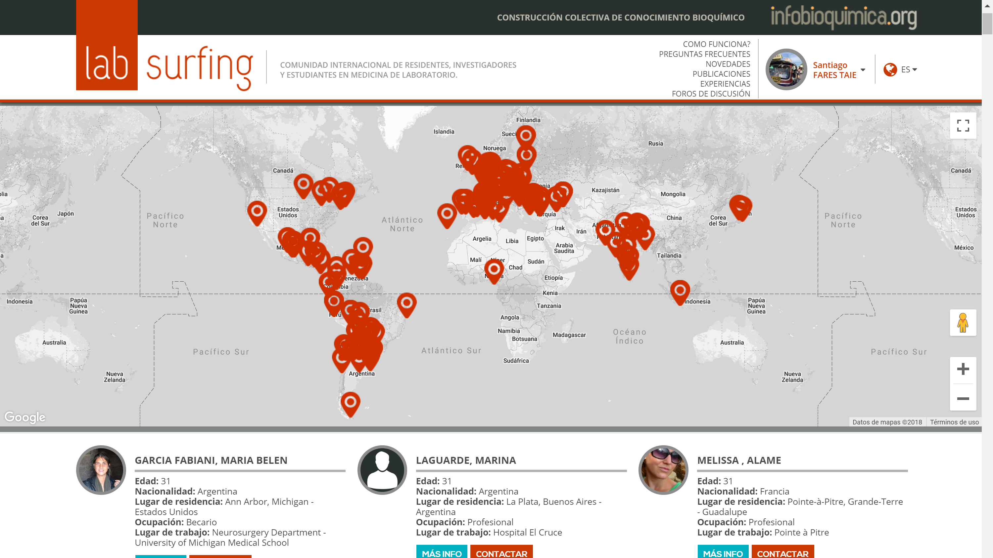
2018

Slide 36
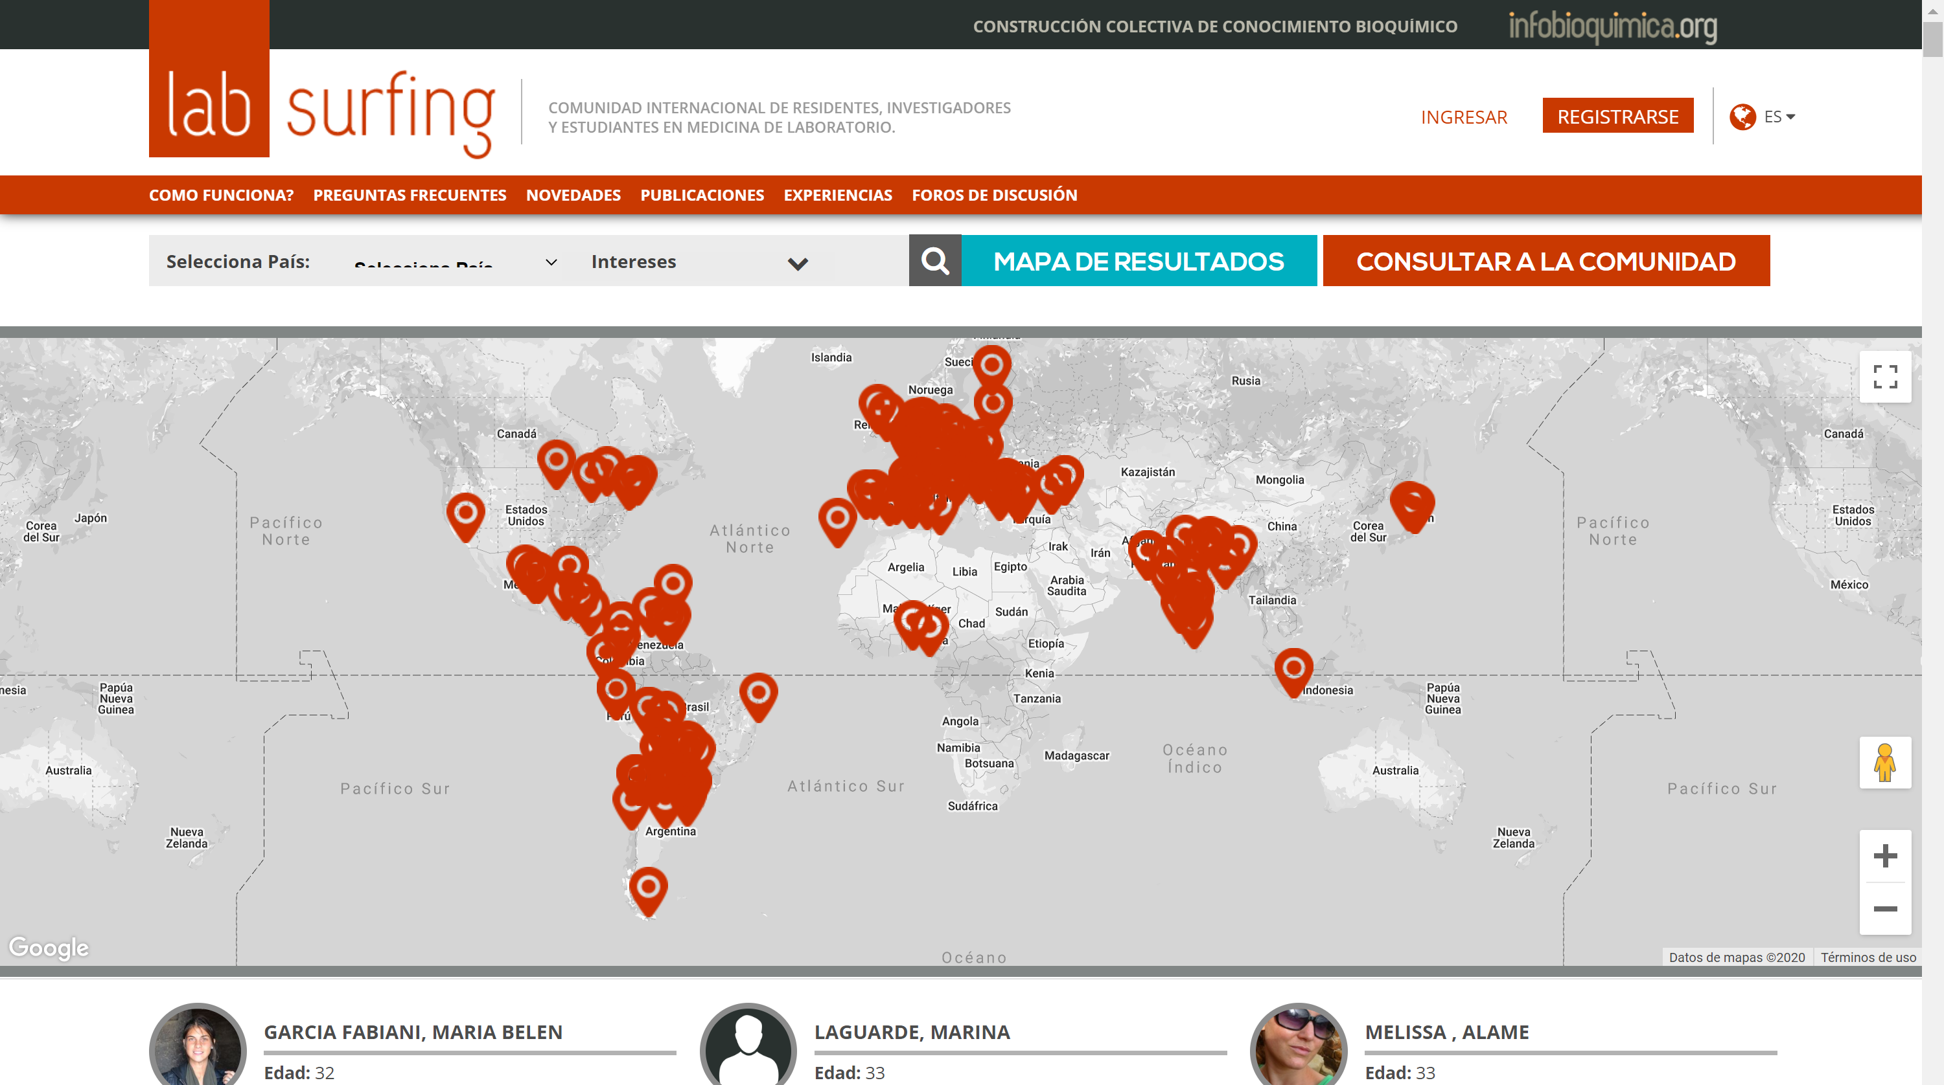
2019

Slide 37
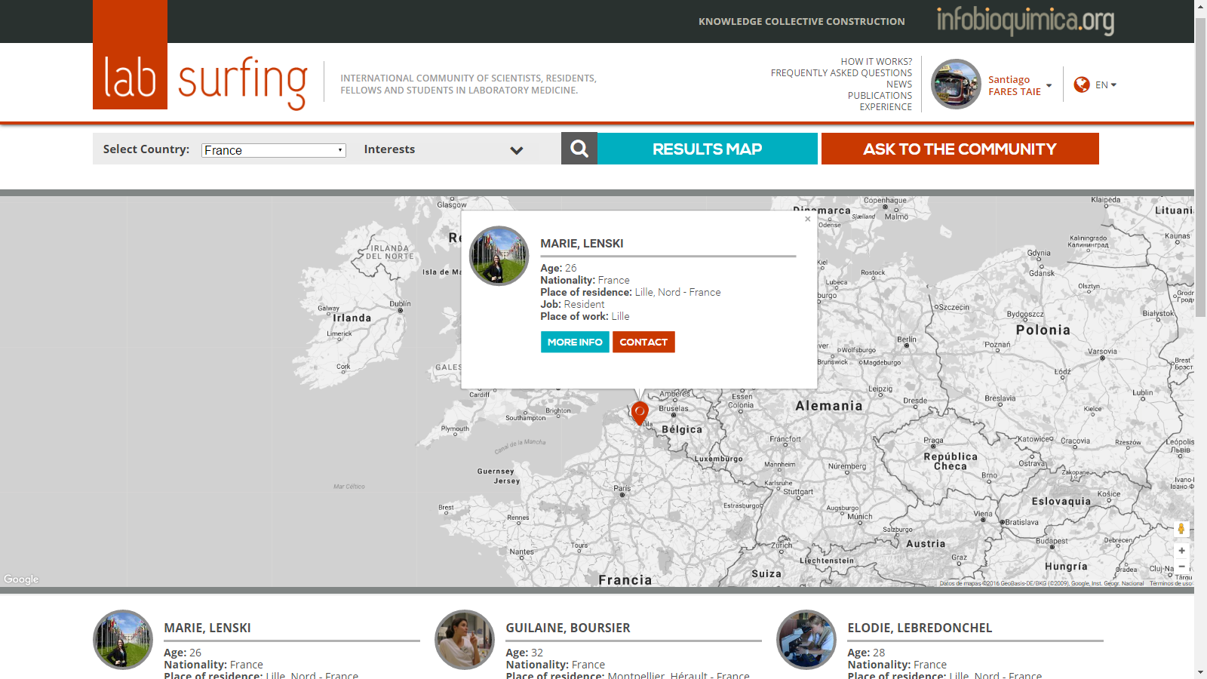

Slide 38
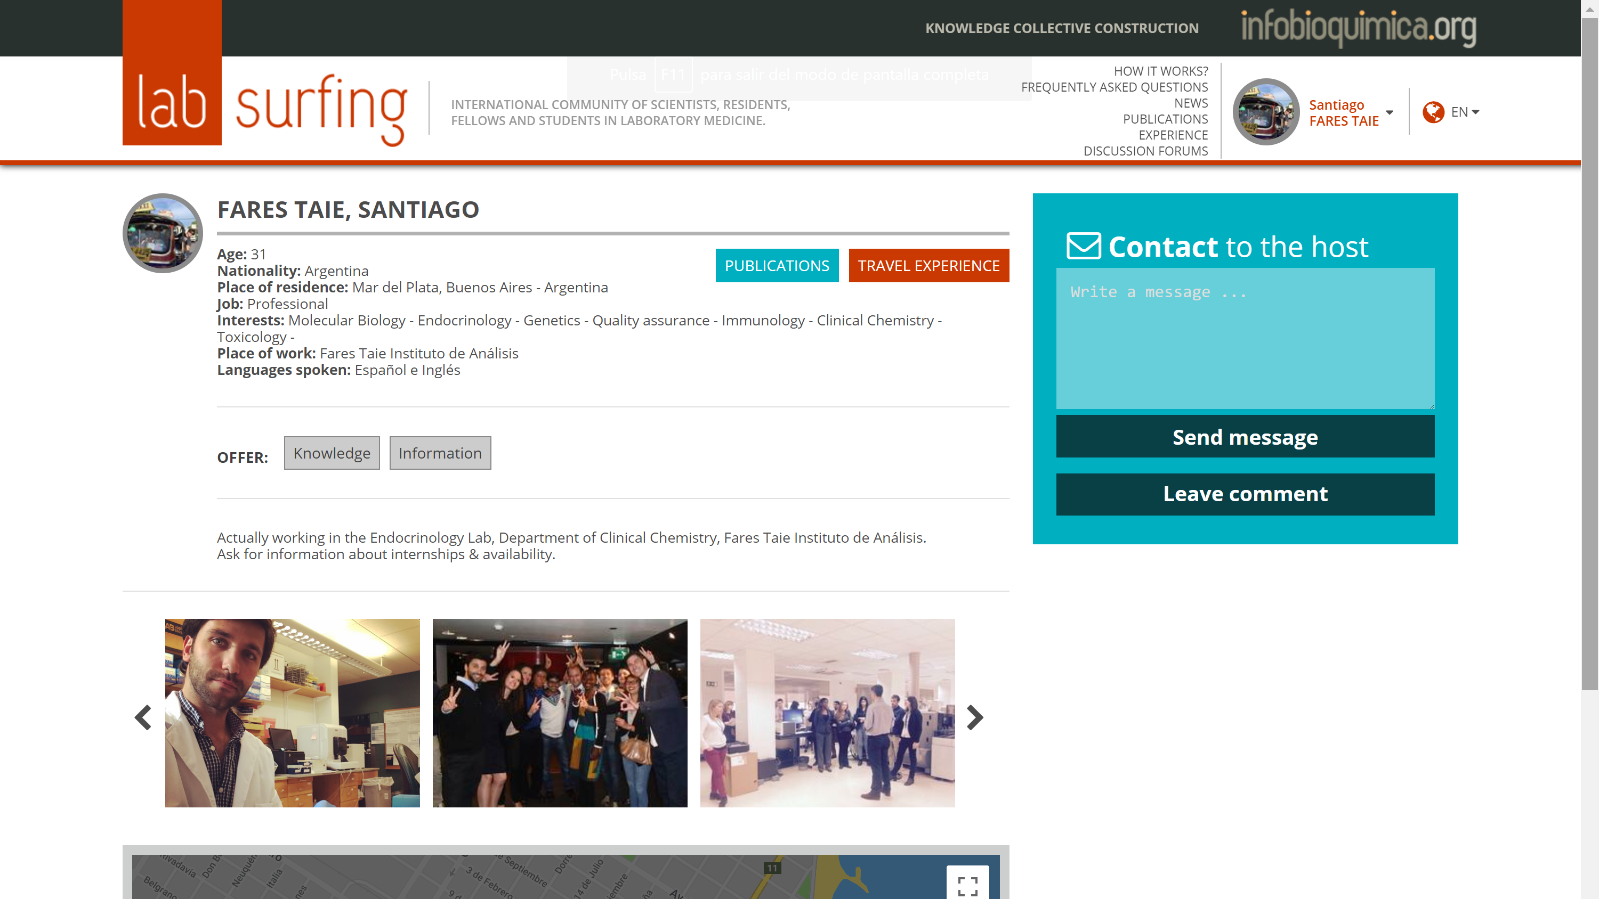

Slide 39
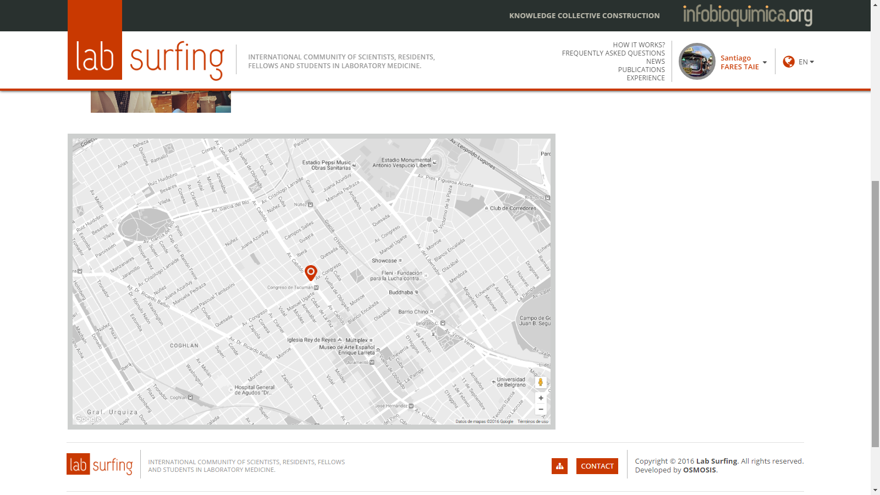

Slide 40
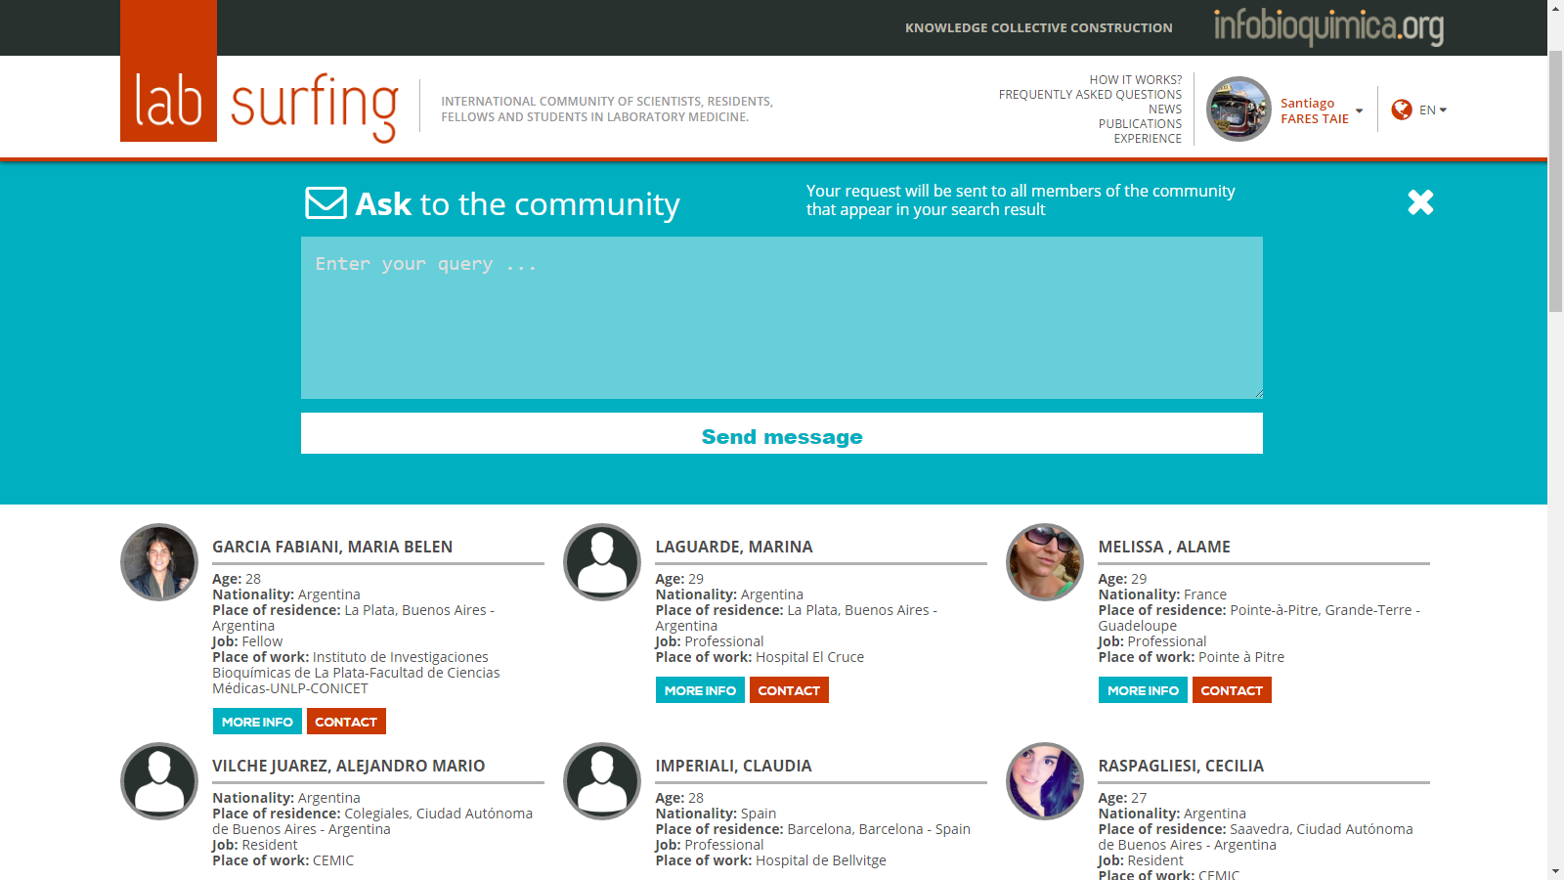

Slide 41
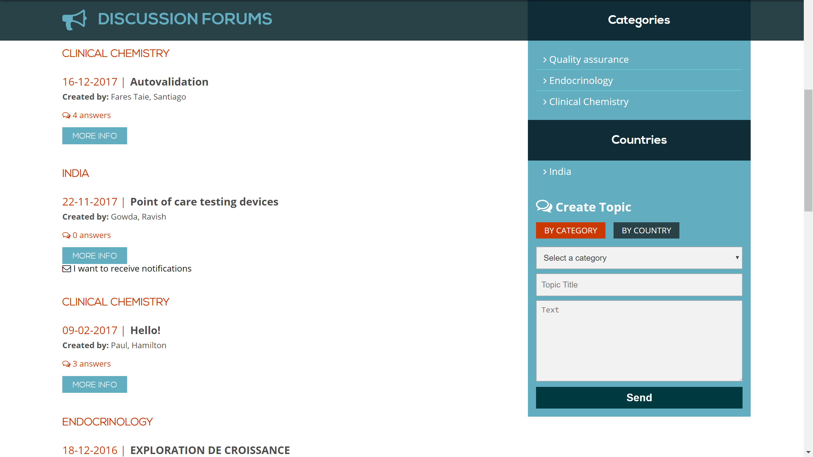

Slide 42



Slide 43
LAB-SURFING IN NUMBERS

Slide 44
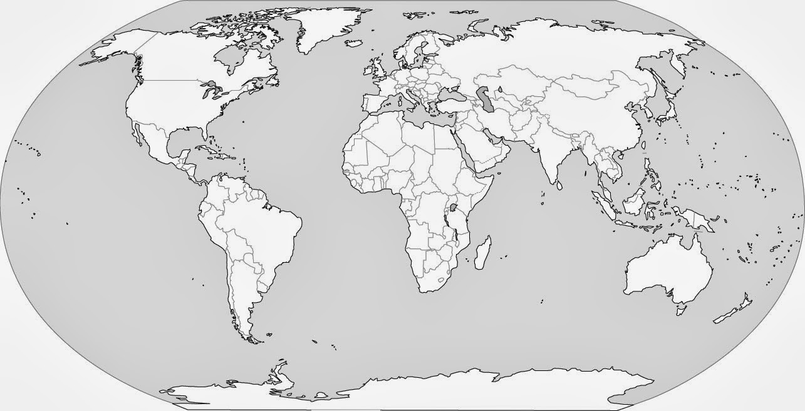

WORLD USERS DISTRIBUTION
721
vs 635 (2018)

Slide 45
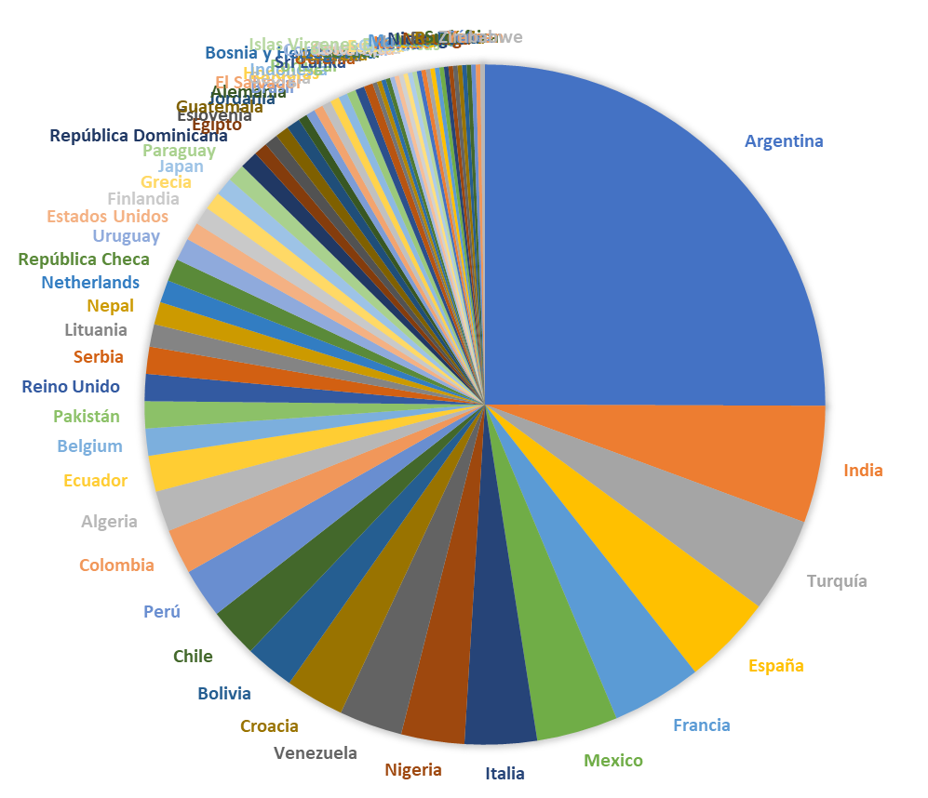
NATIONALITY
69 Countries
721 YS

Slide 46
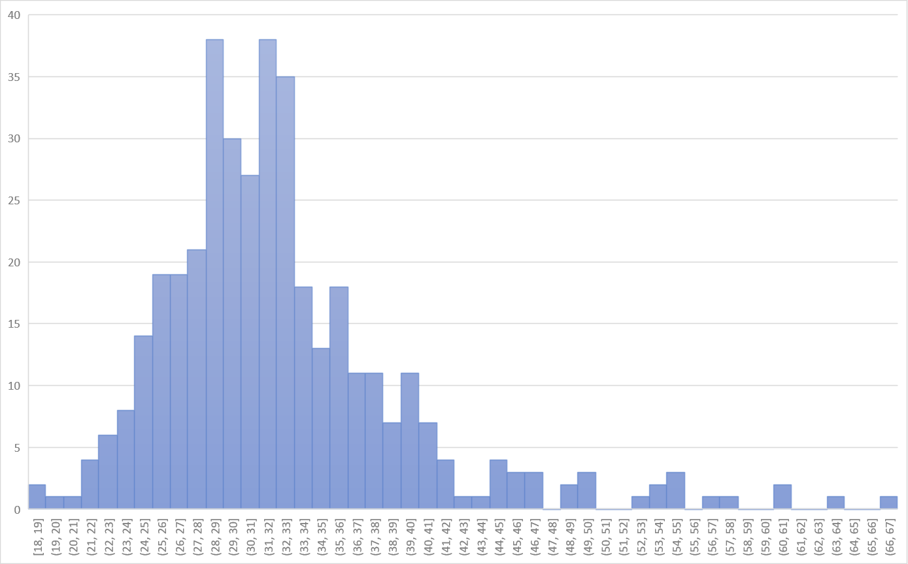
AGE
90%
75%
10%

Slide 47

2018
92%
80%
8%
Advancing excellence in laboratory medicine for better healthcare worldwide

Slide 48
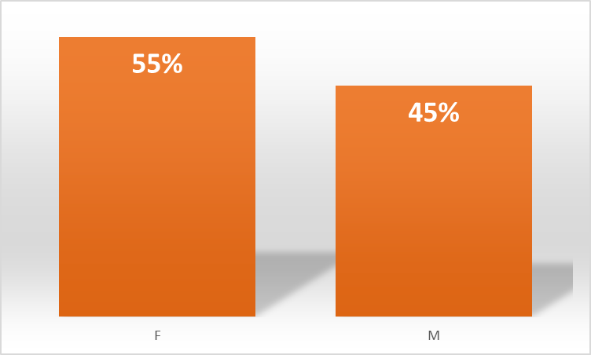
GENDER

Slide 49
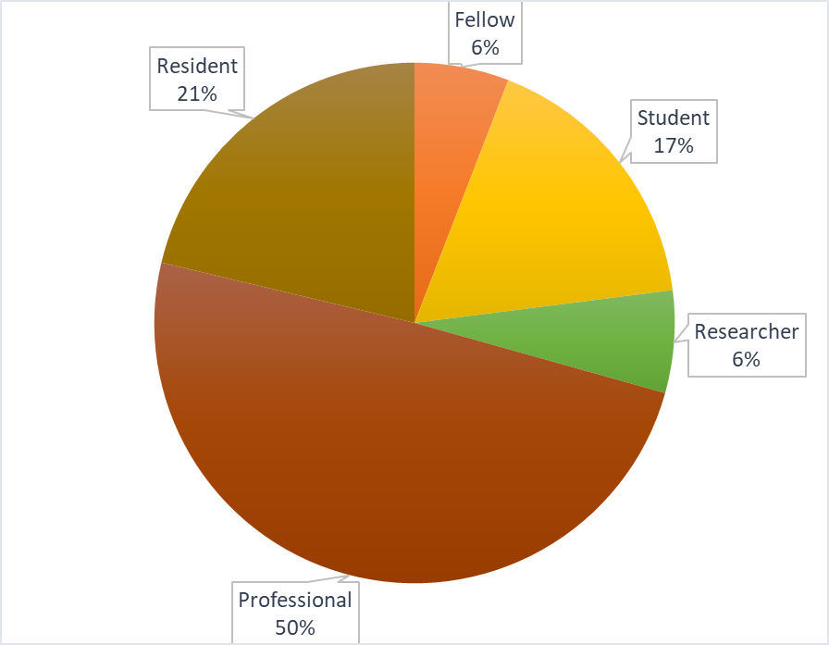
OCUPATION

Slide 50
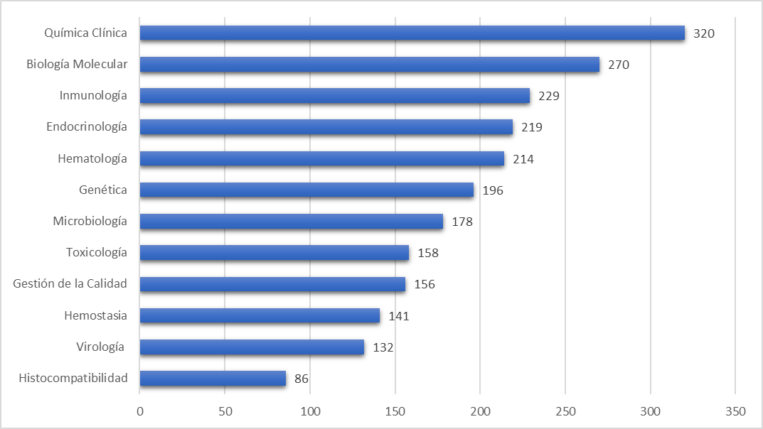
INTERESTS

Slide 51
WEBINARS
TFYS Conducted 3 webinars during 2019:
Biochemical Genetics in Functional Diagnosis and Monitoring of Inborn Errors of Metabolism. Speaker: Prof. Khosrow Adeli
Circulating Tumor DNA: A Promising Biomarker in the Liquid Biopsy of Cancer. Speaker: Prof. Maurizio Ferrari and Dr. Guiliane Boursier
Essential Skills to Structure a Paper. Speaker: Dr. Anthony Newman

Slide 52
OTHER PARTICIPATIONS
IFCC E-news
Radio “El Microscopio”
Revista DIV

Slide 53
NEW INITIATIVES
Capillary Programme: This programme intend to increase the participation of TFYS corresponding members during national meetings.
Clinical Case Study: We plan to develop a clinical case study with Q&A for the YS to increase participation and opinion exchange. Expert participation will be required for the clinical case interpretation and explanation.
TF-YS Survey: Josep Miquel Bauҫa is coordinating a global survey on Residency Training to understand the differences in Laboratory Medicine training around the world. The goal of this survey is to publish the results.

Slide 54
PLANS FOR 2020
TF-YS educational sessions & networking
IFCC WorldLab Seoul
Young Scientists volunteer programme
IFCC YS FORUM at IFCC WorldLab Seoul
6th Slovenian Congress of Clinical Chemistry and Laboratory Medicine , Slovenia
TFYS Symposium & YS Awards at ACBICON-2020, Calcutta, India
Young Scientist symposium at CALILAB, Argentina.
Young Scientist Session at Congresso Nazionale SIBioC YOUNG SCIENTISTS, Italy.
TFYS Symposium at AMBICON-2020, India

Slide 55
PLANS FOR 2020
WEBINARS
Next 3 webinars series to be continued with L3 Healthcarefor organizing and technical help.
Suggested Topics: “analysis of extravascular body fluids”, “CRISPER – Sherlock”, “Mobile health and chronic diseases”, “Biomarkers for neuro degenerative diseases”, “Auto-verification in LIS”, “Latest innovations in Laboratory Medicine” and as per need and suggestion of young colleagues.

Slide 56
PLANS FOR 2020
LAB-SURFING
Actualization of the webpage
  New images
  New links (LinkedIn)
  Discussion Forums (more dynamic)
New sections:
  Hospital/Lab information
Newsletters weekly/monthly
Improve diffusion with google-groups
Communication in congresses

Slide 57

Why is medical research important ?
The aims of medical research are also broad, including:
Understanding normal physiology and the pathophysiology of disease
Understanding the impact of genetic and external factors on human health
Keeping populations and patients well for longer
Diagnosing and managing disease in populations and patients
Designing and evaluating new therapeutic interventions
Health economics

Slide 58
What about the importance of research in the laboratory?
For the patient:
High quality results delivered and reported in a timely manner
Adoption of patient centred care and a move towards personalised medicine
Compliance with local, national and international clinical guidelines
Improved patient safety that can facilitate improved clinical outcomes

Slide 59
For the users of the health service labs:
The introduction of new biomarker tests
More rapid turnaround time for results
Improved reporting of results, including calculated or estimated parameters
Innovation in the availability of testing, including point of care testing

Slide 60
Importance to the international community
Increases the global body of knowledge
Reduces duplication of effort
Facilitates value for financial investment Encourages international collaboration between research groups with similar interests

Slide 61
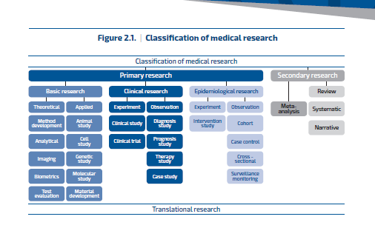

Slide 62
Choosing a suitable research topic
General factors
Most medical research starts with a question or a practical problem for which there is no available answer. These questions or problems may arise from several different sources, including:
A matter that is topical in the media or national / international research community
An intellectual challenge
An area perceived to be important to healthcare
An area of practice, which has been identified as in need of improvement
Follow-on from previous research observations or findings
A priority area identified by government or funding agencies, including research charities

Slide 63
Personal Factors
It may be a daunting task for the new researcher to assimilate all of the general factors listed above. Therefore, he/she should consider whether personal factors or interests may help to refine their choice of project. A research project which has strong personal appeal to the researcher is likely to cause him/her to be more motivated and committed to seeing it to a successful conclusion. Personal factors that may influence choice include areas:
• Of interest derived from family or personal experience
• Of local significance or interest
• Identified from reading literature or scientific media
• Suggested by peers and/or the local research team
• Suggested by users of the local laboratory medicine service

Slide 65
Other questions to ask when choosing a project
Will my research project move forward knowledge and understanding of the topic?
Is my research topic financially viable?
Do have have adequate facilities to do the type of research?

Slide 66
Do I have a supervisor with experience in my topic/research area?
Mentorship is important
Finally ethical permission criteria for research area

Slide 67
Concluding slide
Please remember that you are never alone make collaborations with experts in the fields of research through the YOUTH TASK FORCE
Please network with us as we will help as much as we can
A team is described as a group of people working through collective endeavour toward a common goal, developing the young scientist

Slide 68
THANK YOU
Email: ashlinrampul@gmail.com
Log on to our website make and impact as a young scientist in your country
Lets make AFRICA great!!!!!

