Slide 1
Leadership for the changing world of laboratory medicine
Graham H Beastall
(Glasgow, UK)
gbeastall@googlemail.com

Slide 2
Outline of talk
Setting the context
Drivers for change in laboratory medicine
Leadership for the changing world of laboratory medicine

Slide 3
Central role of laboratory medicine
Laboratory medicine influences
a high percentage of all clinical
decisions. Therefore, it is has
a central role in healthcare
Identify risk factors
& symptoms
Evaluate
response
LAB
Diagnose
disease
Determine
appropriate
treatment
With this influence
comes responsibility!
Notes:
g:\hod\icb\slides\key pathology drivers - reading may 06
3

Slide 4
Laboratory medicine review: in every country?
Laboratory medicine
Quality
Clinical effectiveness
Cost
effectiveness
Analytical quality
Quality assurance
Accreditation
Clinical outcomes
Patient focus
Timeliness
Total cost
Value for money
Appropriate use

Slide 5
Laboratory medicine: future priorities
Continuous laboratory quality improvement
Develop
‘Added Value’
Improvement in efficiency and cost effectiveness
Improvement in clinical outcomes
Development will be ‘outside’ as well as ‘inside’ the laboratory

Slide 6
Laboratory medicine: leadership priorities
Continuous laboratory quality improvement
Develop
‘Added Value’
Improvement in efficiency and cost effectiveness
Improvement in clinical outcomes
Development will be ‘outside’ as well as ‘inside’ the laboratory

Slide 7
Mega-trends in healthcare: implications for laboratory medicine
Aging population
Chronic disease
Rising costs
Inadequate budgets
Technological advance
Personalised medicine
Medical tourism
Travel abroad for treatment
Innovation and demand
Emerging countries
Payers influence decisions
The ‘informed’ patient
Evidence based medicine
Clinical practice guidelines
Philanthropy
Developing countries
Environmental challenges
Water, air, food, congestion
Non-MDs providing care
Global pandemics
Prevention
Wellness screening
Adapted from Harvard Business Report http://hbr.org

Slide 8
Outline of talk
Setting the context
Drivers for change in laboratory medicine
Leadership for the changing world of laboratory medicine

Slide 9
Drivers for change in laboratory medicine
Globalisation
Integrated
diagnostics
Driver
Technological advance
Patient-centred
care
Smarter working
Adding value to improve outcomes

Slide 10
Globalisation of laboratory medicine
Instant global communication
Quality
standards
Laboratory
practice
Clinical applications
Should facilitate uniformity to aid improved outcomes
Globalisation also highlights differences

Slide 11
Technological advance
Genomics
Nanotechnology
and POCT
Example
Proteomics
metabolomics
Automation
robotics
Bioinformatics
Mass
spectrometry
Impact on skills training and operational requirements

Slide 12
Smarter working
Ageing
population
Medical
advances
Rising
workloads
Pressure on healthcare budgets
Improved
efficiency
Workload
management
Shared
resources
Impact on staffing levels and skill mix

Slide 13
Integrated diagnostics
Laboratory
medicine
Imaging
Endoscopy
Integrated patient pathways
Informatics
&
knowledge management
Erosion of traditional boundaries of laboratory medicine

Slide 14
Patient-centred care
Patient-centred care
The individual patient
The ‘informed patient’
Personalised care
Aims to optimise response
Patient focused care
Aims to engage the patient in his/her care

Slide 15
Adding value cycle to quality laboratory medicine services through the application of ‘SCIENCE’
Education of others
Standardisation/
harmonisation
S
E
Cost
effectiveness
Clinical
effectiveness
C
Quality
laboratory
medicine
C
Novel
applications
Innovation
I
N
E
Evidence-based
practice
Beastall GH. Adding value to laboratory medicine: a professional
responsibility. Clin Chem Lab Med 2013;51:221–228

Slide 16
Outline of talk
Setting the context
Drivers for change in laboratory medicine
Leadership for the changing world of laboratory medicine

Slide 17
Leadership and management: both are needed
Leadership in laboratory medicine
Is required at international, national and local level
Leaders:
Possess vision and strategic direction skills
Have excellent interpersonal skills and can inspire others by their example
Listen to, digest and act on the views of key stakeholders
Are decisive but flexible – willing to change direction if required
Are capable of delegation as part of empowering others
Can initiate and direct projects to a conclusion, evaluating results and planning follow-up
Management in laboratory medicine
Involves the operational delivery of agreed plans, protocols and procedures
Managers (who are usually different from leaders) have acquired skills to manage:
Resources (staff, equipment, consumables, fabric)
Teams of people, both inside and outside the traditional laboratory
Projects to a conclusion, resulting in reports with recommendations

Slide 18
Leadership in laboratory medicine
Requirement
Means to meet requirement
Knowledge
Future directions for laboratory medicine
New applications and developments
Performance management
Quality
Effectiveness
Resources
Formal education and training
Continuing professional development
Shared experience with peers / colleagues
Skills
Vision
Planning and organisation
Audit and critical appraisal
Communication
Formal education and training
Continuing professional development
Shared experience with peers / colleagues

Slide 19
Assuring quality in every laboratory
Professional staff
Environment
Organisation
Equipment
Records
Audit
Development
Training / CPD
Quality management
Availability
Appropriateness
Accuracy
Reproducibility
Timeliness
Clinical advice
Governance
Cost effectiveness
QUALITY
The responsibility
of everyone !
Patient/user
satisfaction

Slide 20
Laboratory medicine: quality ladder
5. Obtain laboratory accreditation
4. Adopt quality management
3. Improve external quality assessment
2. Improve internal quality control
1. Agree laboratory organisation

Slide 21
Education & training fit for purpose
Knowledge & information - taught
Technical
technology / applications
Communication
needs / methods
Scientific
principles / innovation
Leadership / management
vision / resources
Delivered and assessed by ‘peers’
Update regularly
&
Lifelong learning
Clinical
pathology / applications
Professionalism
Behaviour / governance
Practical experience – in the workplace

Slide 22
Communication challenge in laboratory medicine
Communication has never been easier. Modern communications is:
Global
Instant
Inexpensive
Readily shared
Multi-media
We all suffer from communication overload.
The trivial can often obscure the important. Remember effective communication involves:
Correct information to
Correct recipient in
Correct timeframe and in
Correct format

Slide 23
Communications that should be ‘person to person’
Patient related
Pre-analytical problems
Critical values
Urgent results
Reflex testing
Clinical discussion of patient
Follow-up strategy
Other
Specific safety issue
Appropriateness of testing
Complaints
Errors
Person to person communications in laboratory medicine can be achieved by various methods.
The urgency of the communication will determine the optimum method

Slide 24
Communications available for users to access
Patient related
Repertoire
Sample requirements
Scheduled results
Turnaround times
Operational procedures
Investigative protocols
Reference intervals
Clinical guidelines
Other
Strategic plan
Quality performance
Access to scheduled or ‘always available’ information in laboratory medicine can be enabled in various ways.
Laboratory medicine specialists should audit how often key information is accessed.

Slide 25
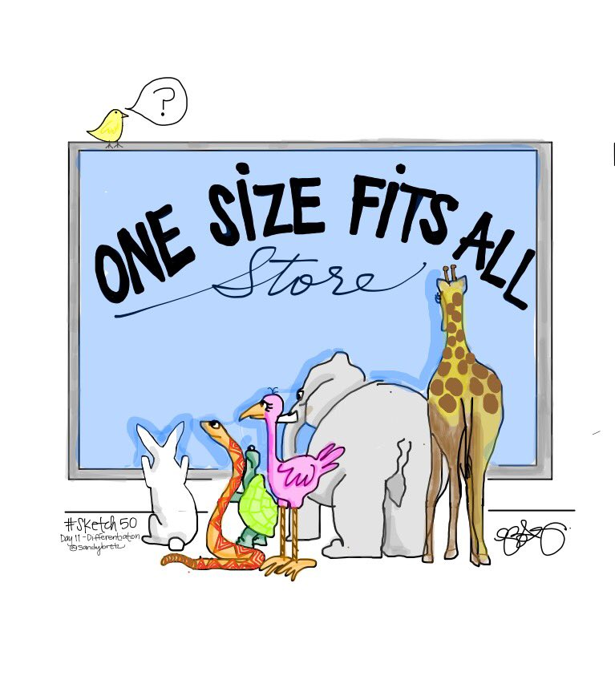
What does this mean for my lab and for MAMLS?
All labs and all national societies are different
They must evolve to meet local circumstances / needs
One size (off the shelf) solutions do NOT fit all!
Leadership is required to agree local plans / policies
Agreement involves key stakeholders, including users
Possible leadership plans may provide a starting point
The next two slides are provided in this context

Slide 26
Possible leadership plan for local laboratories
Introduce programmes to measure and improve the quality of the service provided, including:
Performance evaluation of internal quality control (IQC) and external quality assessment (EQA)
Structured quality management working towards laboratory accreditation (SLIPTA)
Develop and implement programmes to improve two-way communication between the lab and:
Users of the service (clinicians, healthcare workers, patients)
Hospital management and colleagues in other laboratories
Accept the need for and adopt new ways of working, including:
Providing services outside the laboratory (POCT), including directly with patients
Expanding the repertoire and adopting new technologies as resources allow
Introduce systems to measure clinical effectiveness and cost effectiveness, including:
Regular audit of services delivered against clinical need
Developing staff and matching their skill mix to the services they provide

Slide 27
Possible leadership plan for MAMLS
Promote the contribution of laboratory medicine to healthcare and the essential role of the medical laboratory scientist
Promote the importance of postgraduate education and training and continuing professional development (lifelong learning)
Promote the importance of quality in laboratory medicine and facilitate participation in external quality assessment and laboratory accreditation
Develop effective communication with members through social media, regular news releases and a website
Develop effective communication with government and other professional organisations as part of promoting the importance of laboratory medicine in healthcare
Promote the developing science and clinical applications of laboratory medicine to members through a regular national conference, online webinars and harmonisation initiatives
Support opportunities for MAMLS members through promoting service and job opportunities and by encouraging involvement in MAMLS activities

