Slide 1
Importance of QC / EQA
Dermot Devlin
Business Development Executive
Sub Saharan Africa

Slide 2
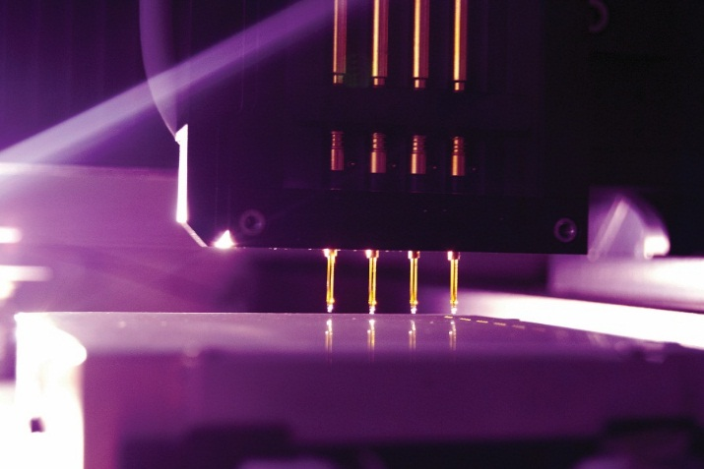
History
Founded in 1982 in the County Antrim, United Kingdom
A World leading manufacturer of diagnostic solutions
Now employs over 1,500 people
400 scientists and engineers

Slide 3
Key Facts
18th position out of an estimated 1,850 diagnostic companies worldwide
5th largest manufacturer of clinical chemistry reagents in the world
Randox manufacture 10% of the worldwide cholesterol tests
3rd largest in Quality Control and calibrators
The World’s Number One proficiency provider
The world’s largest toxicology test menu spanning over 400 drug assays

Slide 4
Key Facts
Every year over 350 million patients are diagnosed using our technology
Every second of every day 80 Randox tests are used across the world
We have more new tests in development than any other diagnostic company
Highly patented technology

Slide 5
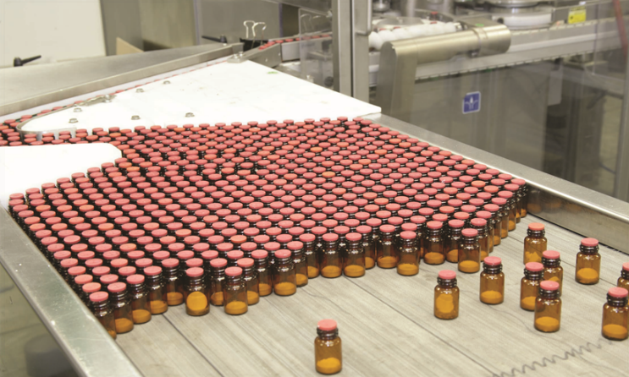
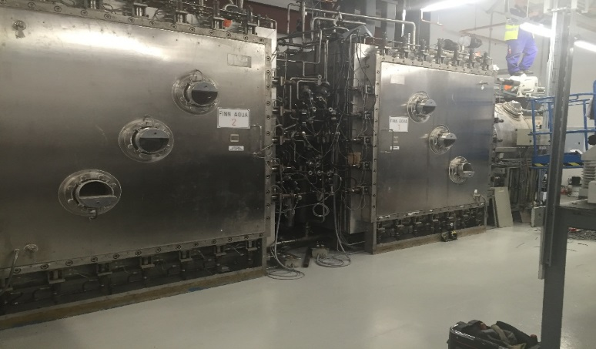
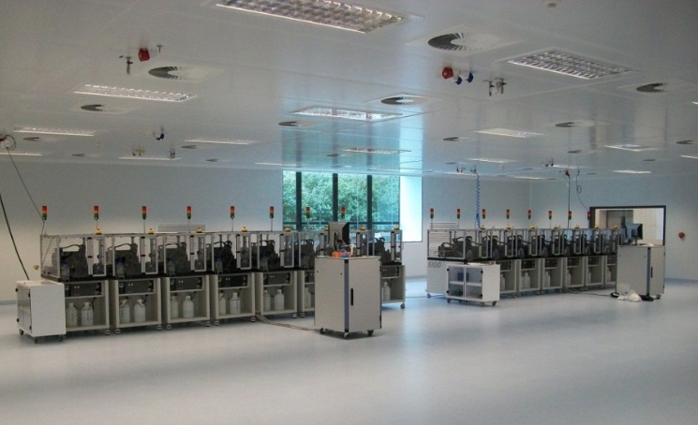
Randox Manufacturing
Randox HQ, Co. Antrim
Randox Teoranta, Co. Donegal
Randox India, Bangalore
Randox USA, West Virginia
Randox Science Park, Co. Antrim

Slide 6
Randox Products
Provide a wide range of Quality Control Solutions
Acusera QC serum, RIQAS EQA and 24.7 Live Online peer group software
Develop, manufacture and support diagnostic reagents
Highest quality reagents on the market
The RX series of clinical chemistry analysers
A robust range of analysers for all types of laboratories
Biochip Array Technology
The Gold standard of multiplex testing

Slide 7
Global Randox
Customers and customer support in 145 countries
Randox products are made available in 3 ways
Direct Randox sales offices
Randox Distributors
OEM Manufacturing
Primary manufacturer of innovative diagnostic products
We supply products to hospitals, clinical, veterinary and research laboratories
Over 100,000 end user clients using Randox products

Slide 8
Sub-Saharan Africa Business
NIGERIA | UGANDA
ETHIOPIA | SEYCHELLES
KENYA | CAMEROON
SUDAN | ZIMBABWE
GHANA | ZAMBIA
GAMBIA | SAO TOME
MAURITANIA | GUINEA
TANZANIA | CHAD
IVORY COAST | LIBERIA
GABON | RWANDA
SENEGAL | Democratic Rep.of Congo
BURKINO FASO | SIERRA LEONE
NIGERIA | NAMIBIA
ETHIOPIA | BOTSWANA
KENYA | ZIMBABWE
MALAWI | TOGO

Slide 9
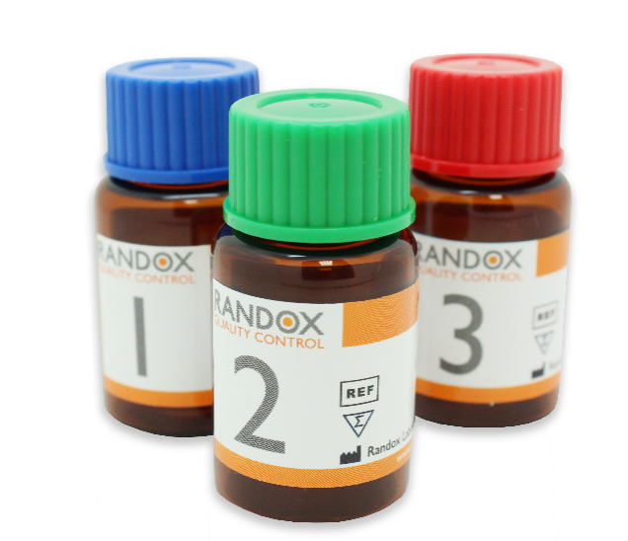
Third Party Quality Controls

Slide 10
What is a Third Party Quality Control?
The term “Third Party" is used to describe a control material that:
Has not been designed/optimized for use with a specific reagent or instrument
Is designed for use with any reagent or instrument
Provides a matrix similar to the patient
Is manufactured independently of reagent and calibrators
Provides an unbiased assessment of performance

Slide 11
What are the Regulatory Requirements?
ISO 15189
“Laboratory shall use quality control materials that react to the examining system in a manner as close as possible to patient samples. Use of independent third party control materials should be considered, either instead of, or in addition to, any control materials supplied by the reagent or instrument manufacturer.”
CLIA
“For each test system, the laboratory is responsible for having control procedures that monitor the accuracy and precision of the complete analytical process.”

Slide 12
Why use Third Party QC?
Westgard explains that the first ‘right’ implies performing IQC with the correct number of control measurements, and the second ‘right’ refers to selecting the appropriate control materials ‘appropriate’ mean in this context?
The entire purpose of QC is to test analytical performance prior to patient sample testing, in order to ensure results generated by the test system are reliable
An ‘appropriate’ QC would have a similar matrix to the patient sample, and be free from any sources of bias which could negatively affect results

Slide 13
How Does Third Party QC Differ?
Third Party controls:
Are manufactured independently of any reagent or instrument, giving unbiased performance assessment
Have target values assigned using thousands of independent laboratories with multi-method and multi-analyser data. This will incorporate lab-to-lab variability, giving target values which are much more accurate and reliable (Badrick, 2003)²
Have a longer shelf life, allowing for long-term performance assessment – giving the ability to detect shifts with new reagents and calibrators

Slide 14
RANDOX ACUSERA

Slide 15
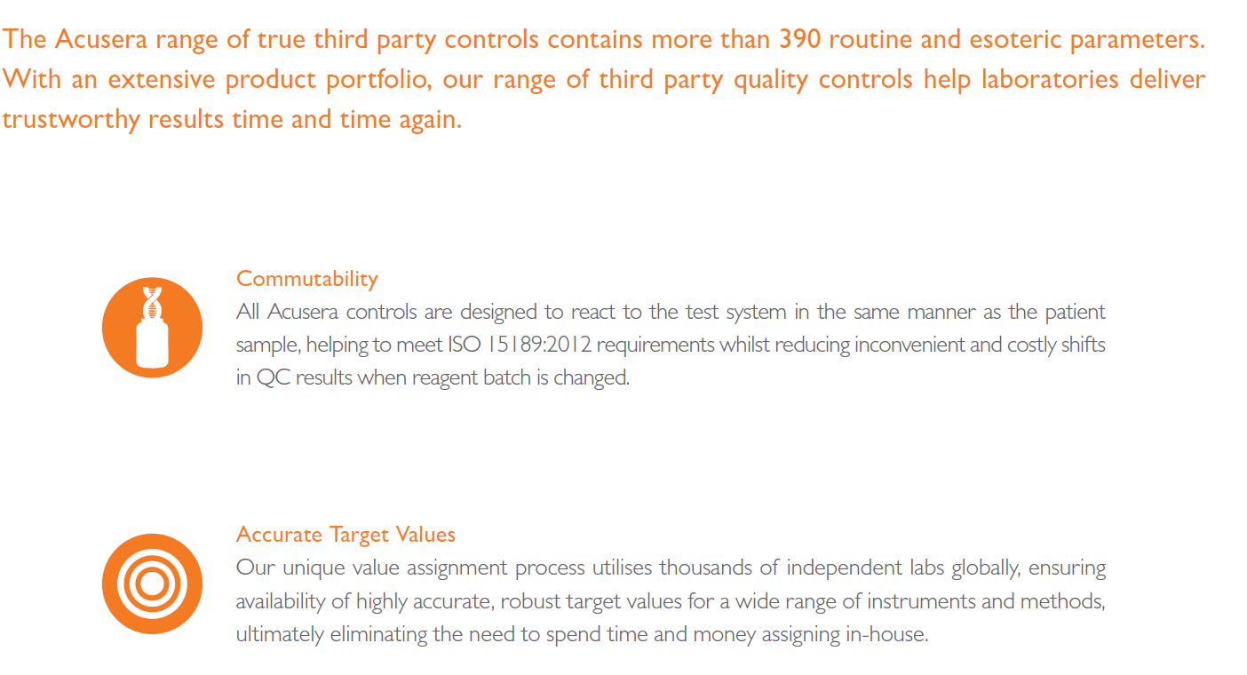
Acusera Third Party Controls Benefits

Slide 16
Acusera Third Party Controls Benefits

Slide 17
Randox International Quality Assessment Scheme

Slide 18
KEY FACTS of RIQAS
Boasting over 45,000 participants and more than 360 parameters across 32 comprehensive & flexible EQA programmes, RIQAS is the largest international EQA scheme.
Designed to cover all areas of clinical testing, each of our multi-analyte programmes is designed to reduce the number of individual programmes required, saving precious laboratory time and money.
In addition, each programme benefits from a wide range of concentrations, frequent reporting, rapid feedback and informative yet user-friendly reports.
Register up to 5 instruments per programme at no extra cost and receive a complimentary multi-instrument report for comparative performance assessment.

Slide 19
KEY FACTS of RIQAS
Programmes accredited to ISO/IEC 17043, helping you to meet ISO 15189:2012 requirements.
Simple one page per parameter report format enables at-a-glance performance assessment, saving time spent analyzing results.
Rapid report turnaround within 72 hours from the submission deadline ensures any corrective actions can be taken quickly, minimising the number of sample repeats required.
Register up to 5 instruments per programme at no extra cost and receive a complimentary multi-instrument report for comparative performance assessment.

Slide 20
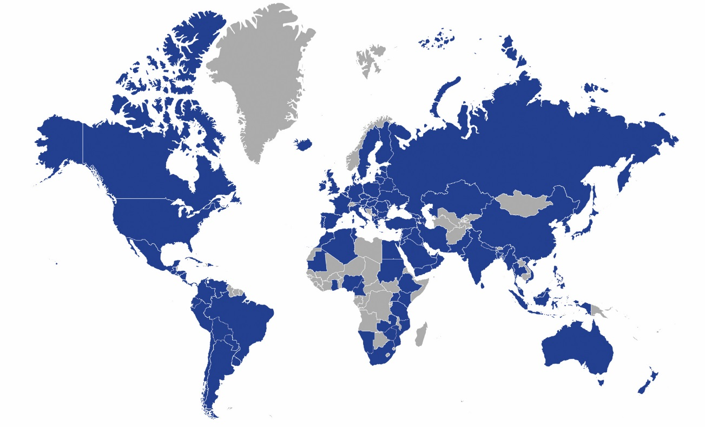
Benefits of RIQAS
Over 45,000 laboratory participants
More than 145 countries worldwide
Larger peer groups more statistically relevant data
Wider range of instruments and methods covered

Slide 21
THANK YOU

