Slide 1
What is the best strategy to achieve compliance with QMS- and QC-requirements in the clinical laboratory? Prof. Dr. Egon Amann Hochschule Hamm-Lippstadt University of Applied Sciences Hamm, Germany egon.amann@hshl.de DQCML Malawi program, Blantyre & Lilongwe, Feb. 26 & 28, 2018

Slide 2
What is the Goal of this Workshop?
To enhance the participants’ understanding of strategies for dealing with several important aspects of QC before running patient tests and the key steps to establish an effective QMS.
To have the laboratory specialists and technical coworkers more effectively address the problems in implementing continuous quality improvement efforts in the clinical laboratory.

Slide 4
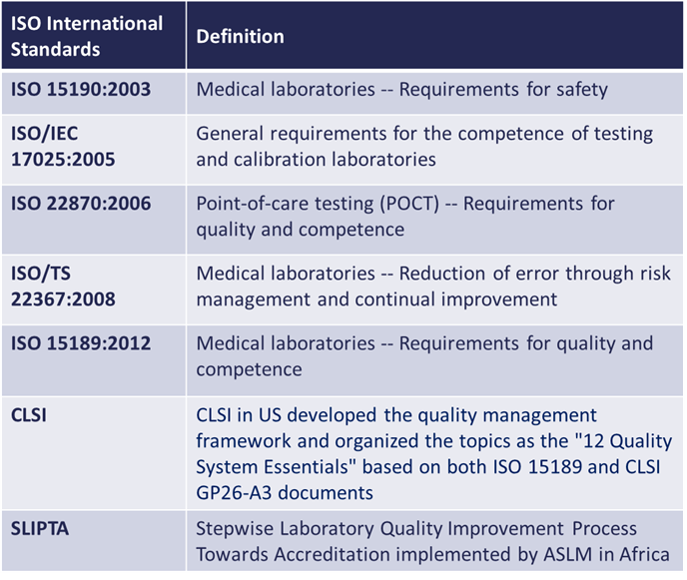
What We will Cover Today
Quality Management System (QMS)
Stepwise plan for implementing a QMS
To implement the QMS in a logical way, the activities are divided over 4 phases of implementation, with each phase having a specific focus.
The requirements in each phase are defined by international standards.

Slide 5
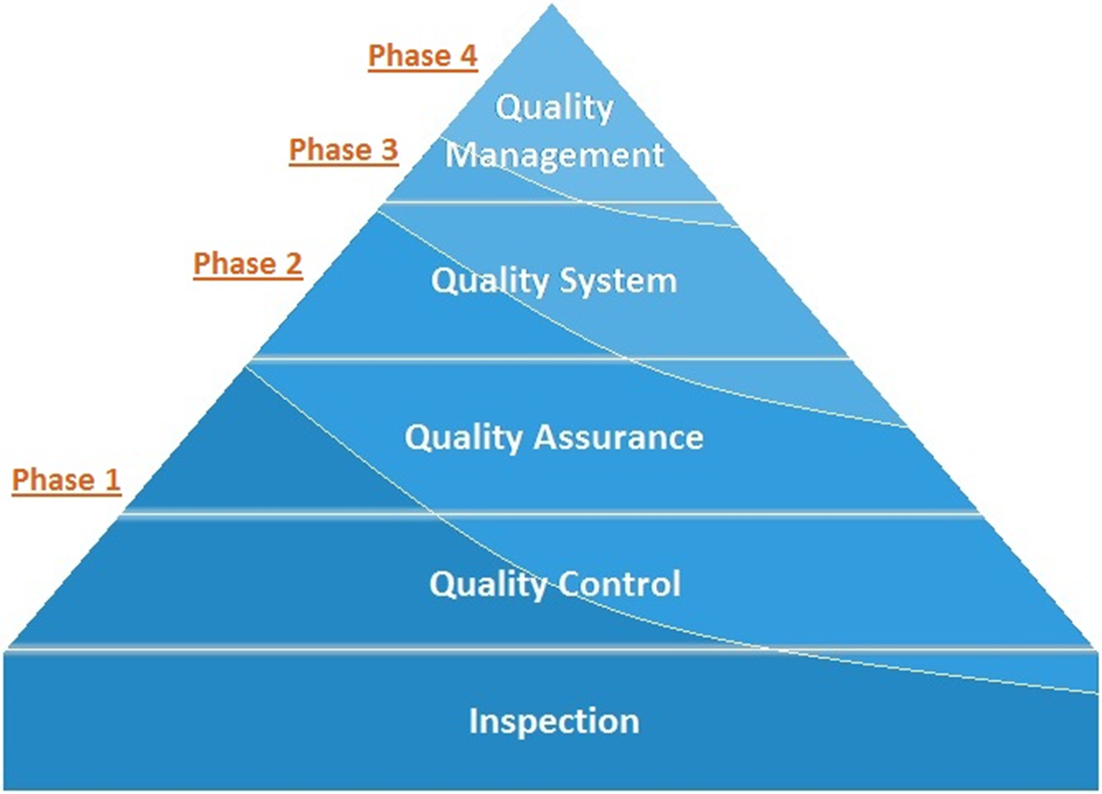
Laboratory Quality Stepwise Implementation Tool (LQSI)
https://extranet.who.int/lqsi

Slide 6
Focus of the Phases of the LQSI Tool
Phase 1: Ensuring that the primary process of the laboratory operates correctly and safely.
Phase 2: Controlling and assuring quality and creating traceability.
Phase 3: Ensuring proper management, leadership and organization.
Phase 4: Create continuous improvement and prepare for accreditation.

Slide 7
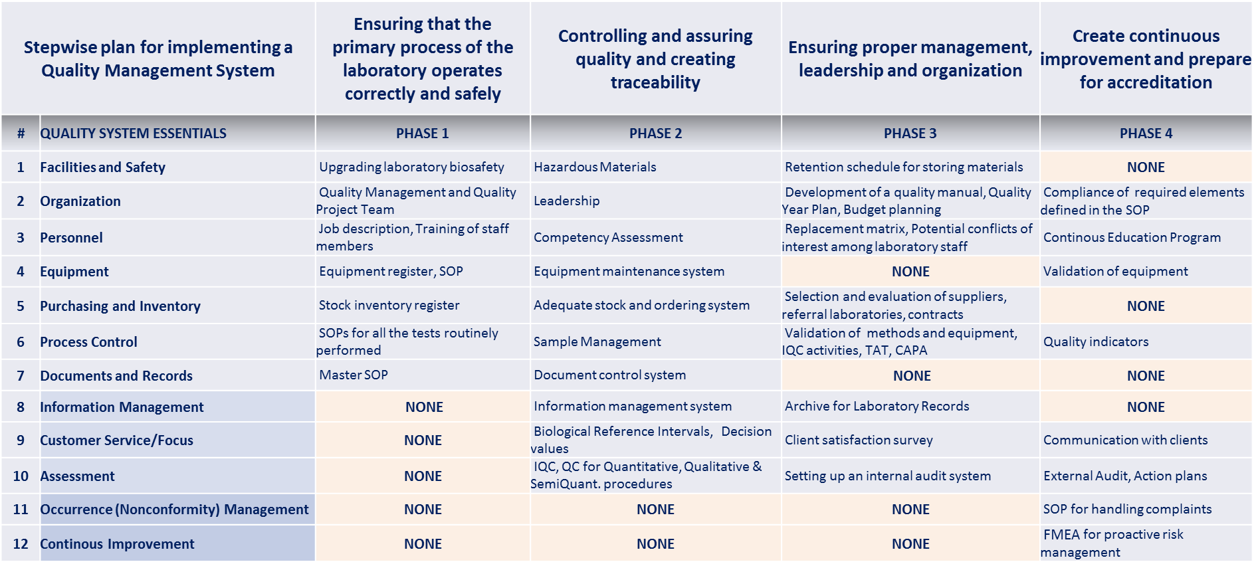
Focus of Phases of the LQSI Tool

Slide 8
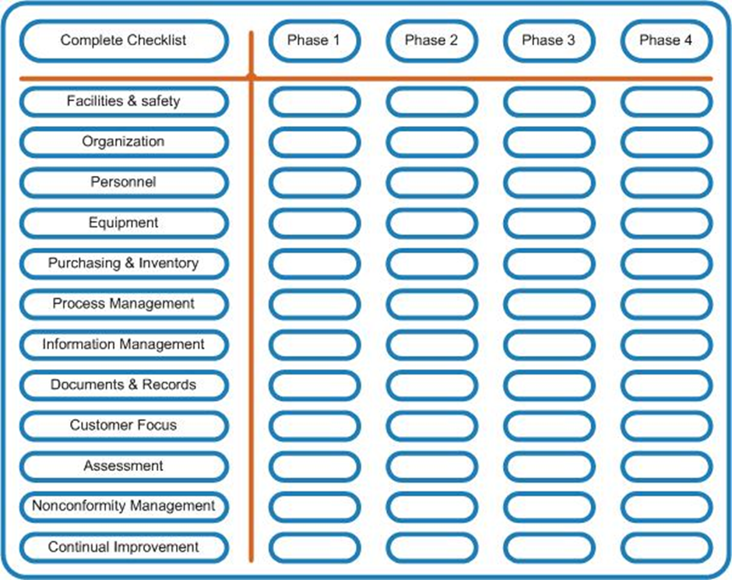
Checklist

Slide 9
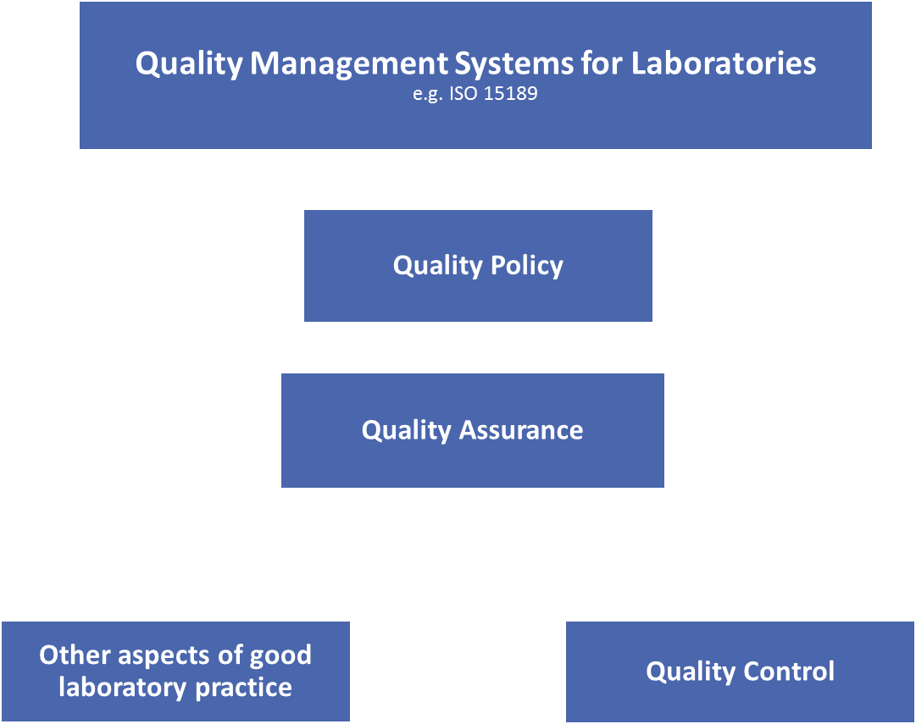

Slide 10
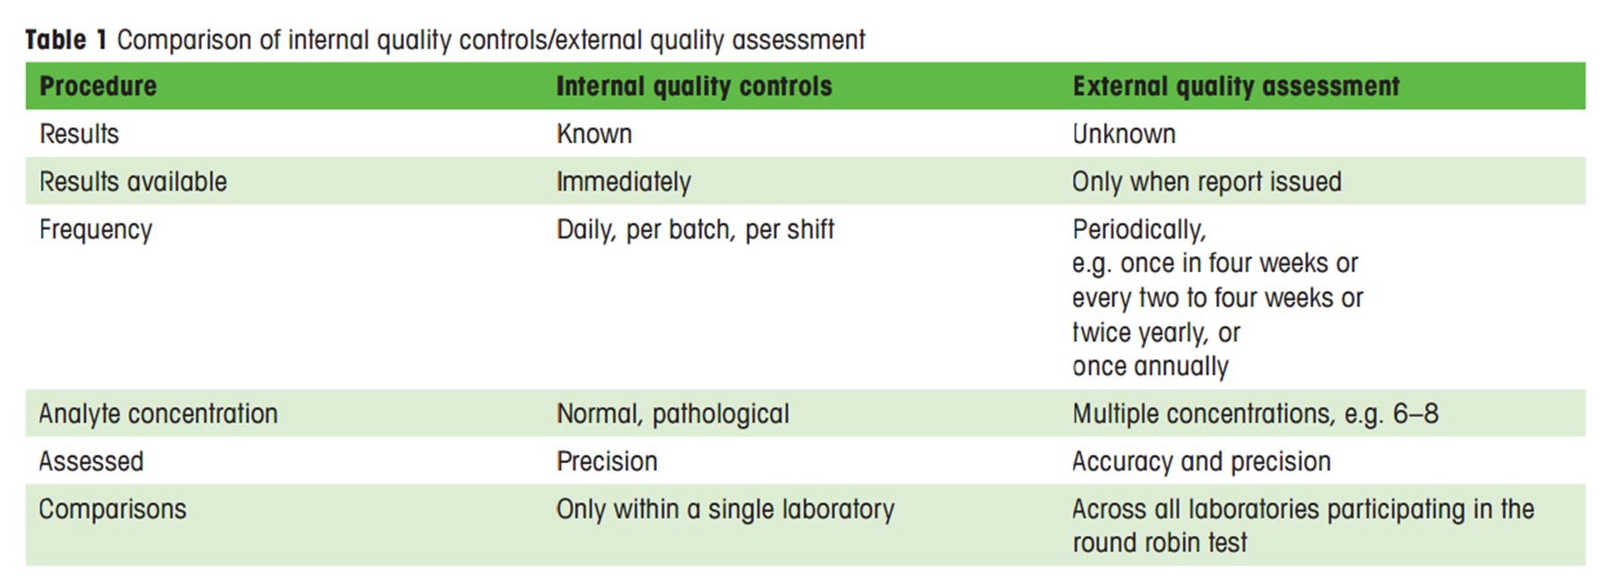
IQC / EQC
Amann E. Quality assurance in medical laboratories. Paths to global competence standards. www.q-more.com/en/ | q&more 01.15

Slide 11
Steps to adopt any voluntary QM standard
Read the document – e.g. ISO 15189:2012
Does it meet your needs? – Time, Effort, Energy, Money
Perform a Gap Analysis
Prepare the Laboratory – Information, Education, Guidance, Culture
Develop an implementation plan – Gantt Chart your plan
Repeat the Gap Analysis
Determine your state of readiness
Make the accreditation decision – Do you want quality or accreditation or both?
Commit to the standard – 1st Achievement, 2nd Accomplishment

Slide 12
Questions and Answers

