Slide 1
IQC: Building Blocks of Quality Local Systems of Quality Control (Good laboratory practice and patient safety)
Prof. Dr. Egon Amann Hochschule Hamm-Lippstadt University of Applied Sciences Hamm, Germany egon.amann@hshl.de

Slide 2
Agenda
What is QM and what is a QMS?
Ways to implement a QMS
Laboratory Quality Stepwise Implementation (LQSI)
Stepwise Laboratory Improvement Process Towards Accreditation in the Africa Region (SLIPTA)
Quality Control & Quality Assurance
Error and Mistakes
Imprecision & Accuracy
Simple QC rules

Slide 3
Understanding Basic Quality Control
What is a Laboratory?
Equipment
People
Procedures

Slide 4
The Quality Management System depicted as a pyramid

Slide 5
Quality system essentials (QSEs): A set of building blocks

Slide 6
What are quality standards and guidelines?
A technical committee that consists of an international group of experts of the International Organization for Standardization (ISO) has formulated requirements for quality and competence in medical laboratories.
These requirements were recorded in a document and published as the ISO 15189 quality standard.
This standard is internationally recognized and used as the standard for accreditation of medical laboratories: if laboratories have implemented a quality management system that complies with all the requirements formulated in the ISO 15189 standard it can be accredited.
The accreditation bodies that assess the compliance of laboratories with ISO 15189 are united in the International Laboratory Accreditation Cooperation (ILAC).
As ISO 15189 is an international quality standard, countries can also choose to formulate national quality standards based, or not based on ISO 15189, which can either be stricter or less strict compared to ISO 15189.

Slide 7
Certification, Accreditation, Licensing
Certification:
The organization is only technically assessed. An example of a question the assessor tries to answer is: "Are procedures for examinations existent within the quality management system?“
Accreditation:
An organization's competency is also assessed. A question the assessor tries to answer now is: "Are procedures for examinations existent within the quality management system that are performed correctly, by persons that are demonstrably competent to perform the procedures?“
Licensing:
The difference between accreditation and licensing is considerable. Licensing of the laboratory is often done by national or regional government institutes. The government can institute a required licensing system for laboratories. This is a way of ensuring a certain level of quality of the laboratories by setting minimal requirements with which laboratories must comply before they are allowed to call themselves laboratories.

Slide 8
International organization for accreditation bodies (ILAC)
ILAC is the operating in accordance with ISO/IEC 17011 and involved in the accreditation of conformity assessment bodies including calibration laboratories (using ISO/IEC 17025), testing laboratories (using ISO/IEC 17025), medical testing laboratories (using ISO 15189) and inspection bodies (using ISO/IEC 17020)
https://ilac.org/about-ilac/

Slide 9
Quality Systems - 1
A QS is defined in ISO 15189 as including the following:
Quality policy,
Staff education and training,
Quality Assurance,
Document control,
Records, maintenance and archiving,
Accomodation and environment,
Instruments, reagents and/or relevant consumables management,
Validation of examination procedures,

Slide 10
Quality Systems - 2
A QS is defined in ISO 15189 as including the following:
Safety, transportation, consumables, and waste disposal,
Validation of results,
Quality Control (including inter-laboratory comparisons),
Communications and other interactions with patients, health professionals, referral laboratories, suppliers, and internal audits.

Slide 11
Worldwide
Africa

Slide 12
Focus of the Phases of the LQSI Tool
Phase 1: Ensuring that the primary process of the laboratory operates correctly and safely.
Phase 2: Controlling and assuring quality and creating traceability.
Phase 3: Ensuring proper management, leadership and organization.
Phase 4: Create continuous improvement and prepare for accreditation.

Slide 13
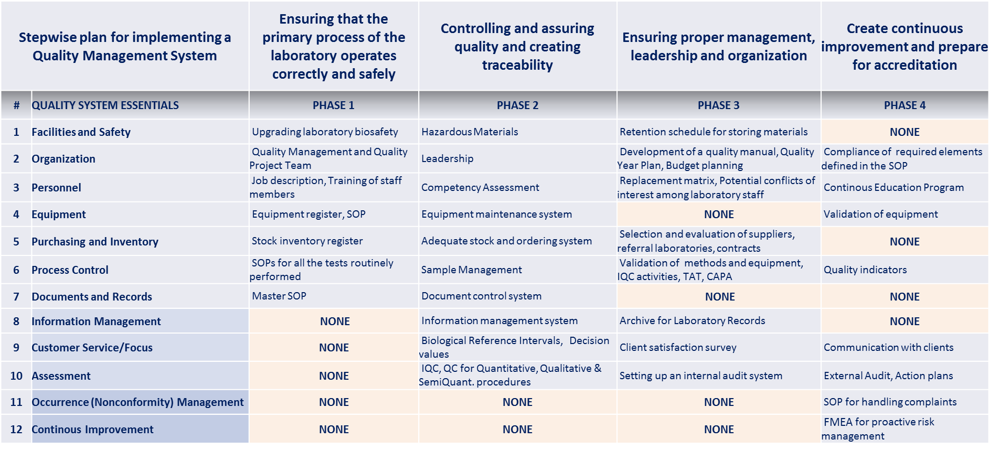
Focus of Phases of the LQSI Tool

Slide 15
SLIPTA tiers of recognition of laboratory quality management

Slide 16
Sections and points in the SLIPTA checklist

Slide 17
SLIPTA tiers of recognition of laboratory quality management

Slide 18
SLIPTA Laboratory status designations

Slide 19
Criteria and Checklist

Slide 20
Improved Quality = Increased Productivity at Lower Cost
There is always a need for continuous evaluation of the reliability of the laboratory work.

Slide 21
https://de.slideshare.net/drgomibasar/quality-control-in-clinical-laboratory

Slide 22
https://de.slideshare.net/drgomibasar/quality-control-in-clinical-laboratory

Slide 23
https://de.slideshare.net/drgomibasar/quality-control-in-clinical-laboratory

Slide 24
Quality Control
An analytical run has met specifications if the quality control samples are within pre-defined precision levels around a set mean – they are precise.
These precision levels are set using statistical control theory. For repeated measurements of the same material the precision of these results can be obtained by calculating their Standard Deviation.
Statistical control theory then provides rules which are applied to the results of the quality control samples to identify if a result lies outside of what is statistically likely.

Slide 25
Quality Assurance vs Quality Control
Quality Assurance | Quality Control
An overall management system to guarantee the integrity of data. | A series of analytical measurements used to assess the quality of the analytical data.
The “System” | The “Tools”
Source: Tony Badrick, 2013

Slide 26
External Quality Assurance (EQA)
An External Quality Assurance (EQA) or Proficiency Testing (PT) program is a program in which multiple samples are periodically sent to members of a group of laboratories for analysis and/or identification, in which each laboratory’s results are compared with those of other laboratories in the group and/or with an assigned value and reported to participating laboratories.
Such a program may also compare an individual’s results with their peer group. Participation in external quality assessment (EQA) is a mandatory requirement for meeting acceptable laboratory performance standards and extends beyond the analytical aspects of laboratory testing into all areas of laboratory function.
Source: Tony Badrick, 2013

Slide 27
Difference between Quality Control and EQA
Quality Control ensures there is consistent imprecision.
EQA can identify bias problems from a method/ manufacturer group.
If there is a traceable target then EQA can identify true bias.
Source: Tony Badrick, 2013

Slide 28
Definition of errors and mistakes
In laboratory practice many non-conforming results may appear. These results are divided in two major categories:
Errors
Non-conforming results with “statistical meaning”. This category includes all the “wrong” laboratory measures due to non-human action.
Mistakes
Non-conforming results with “no statistical meaning”. This category contains all the human errors e.g. mixing up samples.
Source: Tony Badrick, 2013

Slide 29
Error
QC systems are designed to detect error by using QC rules!
There are two types of error we can detect:
Systematic error or bias
Random error or imprecision
Source: Tony Badrick, 2013

Slide 30
Types of laboratory errors and mistakes -1
Another classification of errors and mistakes is based on the time and the stage they appeared in laboratory practice.
The pre-analytical stage encompasses all the procedures which are take place before the analysis of the patients’ samples on the automated analyzers (e.g. blood drawing, sample transportation, centrifugation, dilutions etc.).
2. The analytical stage includes the analytical methods.
3. The post-analytical stage refers to transmission of data from analyzers to the LIS, validation of results that have been produced and posting of the results to physicians or patients.
Source: Tony Badrick, 2013

Slide 31
Types of laboratory errors and mistakes -2
According to the previous classification, errors and mistakes are divided in three corresponding categories:
pre-analytical,
analytical,
post-analytical.
The majority of pre-analytical and post-analytical outliers are mistakes in contrary to analytical outliers which are considered as errors.
Source: Tony Badrick, 2013

Slide 32
Types of laboratory errors and mistakes -3
Common pre-analytical errors
1. Inappropriate specimen (e.g., wrong specimen-anticoagulant ratio)
2. Wrong anticoagulant (e.g. sodium citrate in place of EDTA)
3. Improper conservation method
4. Inappropriate patient’s preparation (e.g. wrong diet)
5. Mistakes in patients’ identification
P. Karkalousos, A. Evangelopoulos; www.intechopen.com

Slide 33
Types of laboratory errors and mistakes -4
Common analytical errors
1. Expired reagents which may lead to erroneous results
2. Expired controls or calibrators
3. Calibration curve time-out elapsed
4. Failure in sampling system
5. Failure in aspiration system of reagents
6. Changes in analyzer’s photometric unit / flow cell / measuring unit
7. Any other analyzer’s failure
P. Karkalousos, A. Evangelopoulos; www.intechopen.com

Slide 34
Types of laboratory errors and mistakes -5
Common post-analytical errors
1. Wrong matching between sample and laboratory’s files
2. Wrong copy of results from the analyzer’s report to the laboratory report (in cases of manual transfer)
3. Delay in delivering the results to the physicians, clinics or patients
4. Loss of the results
P. Karkalousos, A. Evangelopoulos; www.intechopen.com

Slide 35
Quality Control - QC
The QC procedures that are used in clinical chemistry involve the analysis of control materials and the plotting of their results on QC charts. QC rules are then applied to ensure that analysers are performing according to specifications.
QC ensures an assay is performing according to specifications by running quality control specimens routinely with each “run” of patient samples.
Source: Tony Badrick, 2013

Slide 36
Wikipedia, 23.02.2018

Slide 37
Quality Control
QC is a procedure that is used to monitor analytical measurements and evaluate when medically important errors have occurred. There are three purposes of QC:
To monitor the accuracy and precision of the complete analytical process,
2. To detect immediate errors that occur due to test-system failure, adverse environmental conditions, and operator performance,
3. To monitor over time the accuracy and precision of test performance that may be influenced by changes in test system performance, environmental conditions and variance in operator performance.
Source: Tony Badrick, 2013

Slide 38
Difference between Quality Control and EQA
QC procedures ensure that results for a run or batch are precise and fit for use.
EQA allows a laboratory to ensure that the results of its assays are consistent with other laboratories. As the EQA assigns both the target values and values for allowable performance they therefore test both the Accuracy and the Precision of the laboratory.
Source: Tony Badrick, 2013

Slide 39
Imprecision and Accuracy
Precision is the agreement between replicate measurements and is measured by the standard deviation of the replicates. Imprecision is caused by increased random error.
Accuracy is agreement between the best estimate of quality (mean) and its true value. Inaccuracy is caused by increased systematic error.
Source: Tony Badrick, 2013

Slide 40
Precise and Accurate
www.austincc.edu/mlt/chem/QC_QA_Stat_2013_STUDENT.ppt

Slide 41
Precision and Accuracy
Precise and inaccurate
Imprecise and inaccurate
Systematic Error
Random Error
www.austincc.edu/mlt/chem/QC_QA_Stat_2013_STUDENT.ppt

Slide 42
Causes of Random Error - 1
Matrix interference – there is interference from another component in the quality control sample.
Mechanical variation – there is fluctuation in detectors, light sources, monochromators, dispensing systems, aspiration systems, mixers or laundering systems.
Electrical interference – there is random electronic problem with the instrument.
Variation in reagent quality.
Variation in Calibrator consistency.
Source: Tony Badrick, 2013

Slide 43
Causes of Random Error - 2
Inconsistent Reagent Preparation & Handling
Reagent deterioration / contamination
Lack of instrument maintenance
Intermittent dripping – sample / reagent probes
Intermittent Electronic Problems (e.g.,) – Sticky solenoid valves, shear values
Scratched Reagent Mixers
Source: Tony Badrick, 2013

Slide 44
Causes of Systematic Error
Quality control material not prepared appropriately – too dilute or concentrated or a new batch of quality control material is being used.
Reagent lot bias – a new reagent lot has a different background colour.
Calibration – the method has been recalibrated with calibrators material that has deteriorated from when freshly prepared.
Source: Tony Badrick, 2013

Slide 45
Method Bias and Systematic Error
A certain level of Systematic Error will be inherent to a method causing a consistent deviation form the true value.
This leads to Method Bias where there is a constant difference between results from a particular method and results form other methods. This Method Bias is caused by:
Differences in the standardization and traceability of the calibrator used in different methods,
Types of calibrators used (Serum, Aqueous, Frozen, Freeze dried),
Interferences to the method (Bilirubin, Lipaemia, Haemoglobin, Drugs).
But Systematic Error in Quality Control is an additional error to this Method Bias.
Source: Tony Badrick, 2013

Slide 46
Designing a QC System
The laboratory shall document its quality control plan in detail, including the levels of quality control materials each day, frequency of performing QC, types of QC materials and the QC acceptance criteria customized for each examination procedure based on that procedure’s capabilities.
Acceptable ranges (confidence limits) must be defined for internal quality control material. Where acceptable ranges are set to limits other than ± 2SD based on current analytical performance, the rationale for the limits should be documented.
(Supplementary Requirements for accreditation in the field of Medical Testing, NATA)
Source: Tony Badrick, 2013

Slide 47
Quality Control Sera
Quality Control samples are substances that are inserted into the run alongside the test materials and subjected to exactly the same treatment.
A control material must contain an appropriate concentration of the analyte, and a value of that concentration must be assigned to the material.
Control materials act as surrogates for the test materials and must therefore be representative, i.e., they should be subject to the same potential source of error.
To be fully representative, a control material must have the same matrix in terms of bulk composition, including minor constituents that may have a bearing on accuracy.
Control materials must be adequately stable over the period of interest.
Source: Tony Badrick, 2013

Slide 48
QC Statistical rules
Statistical process control is a set of rules that is used to verify the reliability of patient results based on statistics calculated from the regular testing of control materials.
Westgard rules and Levey-Jennings charts are the statistical tools typically used by clinical labs.
The most fundamental statistics used by the laboratory are the mean [x] and standard deviation[s].
The mean, or average, is the sum of the control values divided by the total number of values.
The standard deviation measures how far, on average, the numbers are from their mean.
https://www.ccs.gr/products/qc/

Slide 49
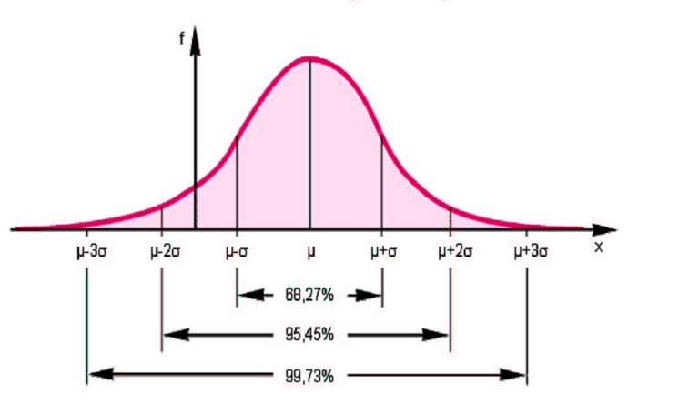
http://www.hit-karlsruhe.de/hit-info/info-ws14/WS14_Evaluation%20Abstandsmessung/standdertechnik.html

Slide 50
Setting the Mean and SD of a new batch of QC materials (CLSI)
Over a 20 days period, assay one set of new QC material on each on each day along with the existing QC materials.
After the runs are accepted based on the existing QC materials, calculate the mean, standard deviation (SD) and coefficient of variance (%CV) for the new QC material.
Prepare a tentative QC chart for the analyte. Set mean ± 2SD, the 95% confidence limit, as the temporary target ranges, which should be less than the mean ± ALE.
Ideally, the new lot of QC material should overlap with the existing lot of QC for at least 20 batches of assays.
Source: Tony Badrick, 2013

Slide 51
General guidelines for planning and design of QC procedures (CLSI)
The essential steps for planning a statistical QC procedure are as follows:
Define the quality requirements for the test.
Determine method precision an bias.
Identify candidate QC procedures.
Predict QC performance.
Set goals for QC performance.
Select and appropriate QC procedure
Source: Tony Badrick, 2013

Slide 52
Frequency of QC - 1
Although minimum regulatory standards exist for determining QC testing frequency, decision regarding when and how to run QC samples are not standardized.
Most QC testing strategies test control samples at fixed time intervals, often placing the same samples in the same position on the instrument during subsequent QC events and leaving large gaps of time when control samples are never run, yet patient samples are being tested.
An analytical run is generally defined by CLIA as an 8 hour to 24 hour interval during which control materials must be analyzed.
Source: Tony Badrick, 2013

Slide 53
Frequency of QC - 2
Strategies for QC testing Schedules:
Strategy 1: QC events scheduled at fixed time intervals.
Strategy 2: QC events randomly scheduled within fixed time intervals.
Strategy 3: QC events scheduled at random intervals.
Strategy 4: QC events scheduled at a random interval, followed by a series of n QC events scheduled at fixed intervals.
Strategy 5: The average interval between QC events was set at eight hours for all of the evaluated scheduling strategies.
Source: Tony Badrick, 2013

Slide 54
How to Implement a QC Program
Establish written policies and procedures
Assign responsibility for monitoring and reviewing.
Train staff.
Obtain control materials.
Collect data.
Set target values (mean, SD).
Establish Levey-Jennings charts.
Routinely plot control data.
Establish and implement troubleshooting and corrective action protocols.
Establish and maintain system for documentation.
Source: Tony Badrick, 2013

Slide 55
Control Rules
The laboratory uses control rules to assess if an analytical run has performed according to specifications.
The laboratory assesses this on the basis of repeated measurements of quality control material and comparing these against statistical rules.
Source: Tony Badrick, 2013

Slide 56
Quality Control
Each laboratory will have a quality control system which consists of quality control material, quality control rules and a process to follow when rules alert the operator to a failure or a warning.
Quality control materials will often consist of multiple samples containing analytes at different concentration levels.
Quality control rules are usually different for different laboratories.
Source: Tony Badrick, 2013

Slide 57
Simple Quality Control Rule
As an example of how these quality control rules work consider the 1_{2s} rule which rejects an analytical run (or warns of analytical problems) when 1 control observation exceeds the 2s control limit (2 standard deviations from the mean).
If a quality control sample is measured many times the mean and standard deviation of these measurements can be calculated.
Then 95% of all measurements will lie writhing the range mean +/- 2SD.
This means that 19 of 20 results should fall within this range.
Source: Tony Badrick, 2013

Slide 58
James Westgard
https://de.slideshare.net/drgomibasar/quality-control-in-clinical-laboratory

Slide 59
Clin. Chem. 27/3, 493-501 (1981)

Slide 60
https://de.slideshare.net/drgomibasar/quality-control-in-clinical-laboratory

Slide 61
https://de.slideshare.net/drgomibasar/quality-control-in-clinical-laboratory

Slide 62
https://de.slideshare.net/drgomibasar/quality-control-in-clinical-laboratory

Slide 63
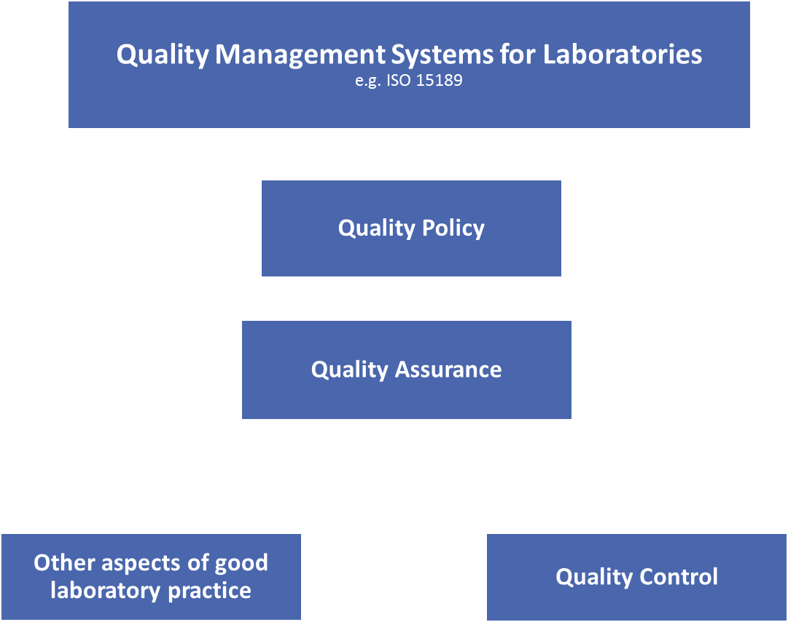

Slide 64
BACKUPS

Slide 65
Phases of the LQSI Tool

Slide 66
Phases of the LQSI Tool

Slide 67
Phases of the LQSI Tool

Slide 68
Phases of the LQSI Tool

