Slide 1
A Roadmap for EQA Programme
design and implementation
Annette Thomas
Chair IFCC C-AQ
www.weqas.com

Slide 2
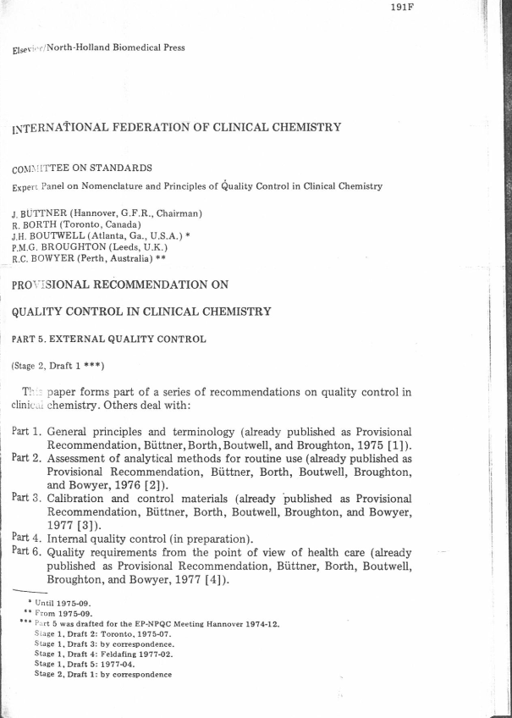
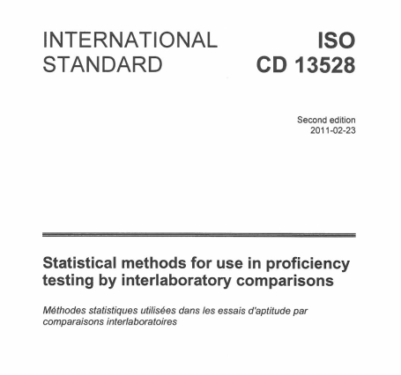
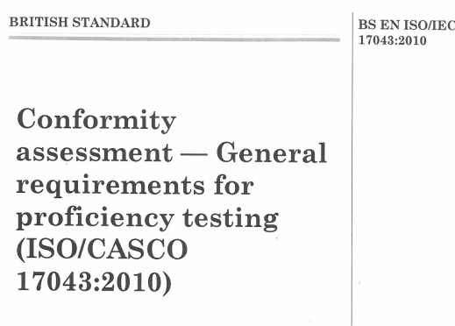
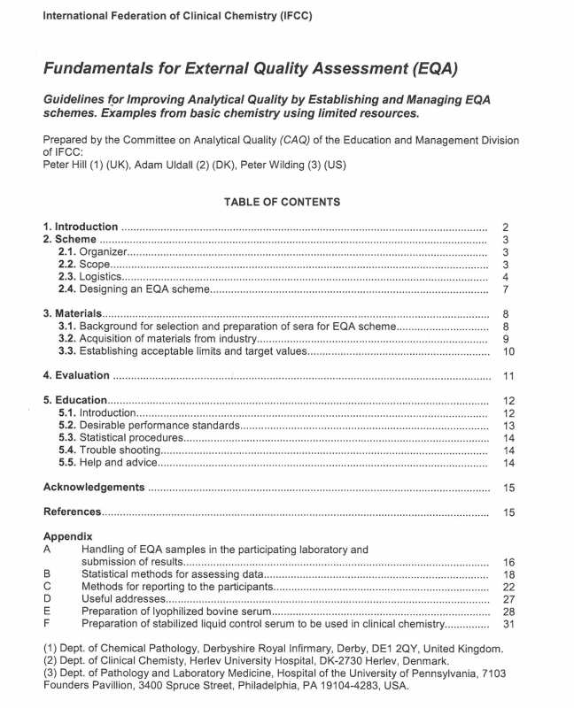
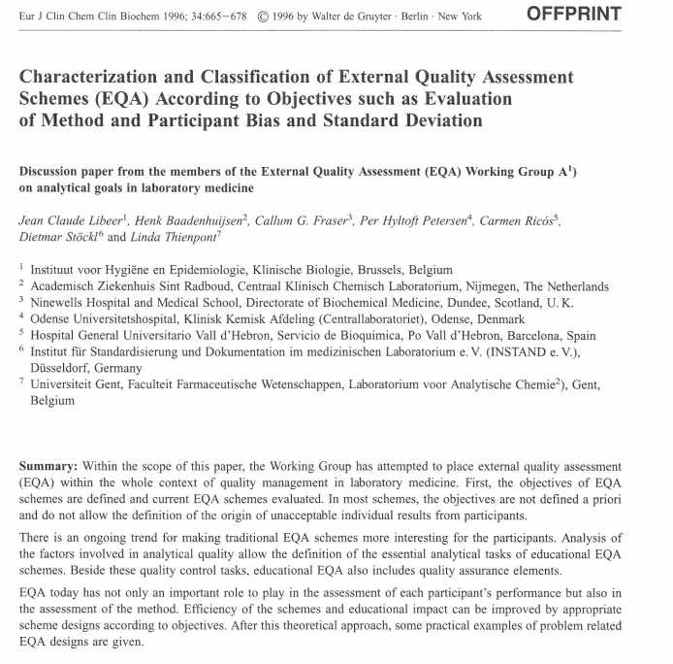

Resources - http://www.ifcc.org/media/335752/IFCC%20Resource%20table_Version_2015_12_15.pdf
International Standards
IFCC
EQALM

Slide 3
Types of EQA Schemes
Wide variation between EQA Programmes and providers. Objectives of what you want to achieve should form the basis of your EQA plan.

Slide 4
Types of EQA Schemes – which one are you ?
PT, EQA or EQAP?
Commercial
Not for profit
Linked to professional body
Regulatory
Scope
Broad Scope - All disciplines
Narrow Scope - Discipline specific
Limited scope – Specialist
Accredited to ISO 17043
Yes
No?

Slide 5
Expectations of EQA Provider
Competent Provider
Accredited to ISO 17043
Clinically relevant
Distribution frequency
Evidence of reproducibility
Cover clinically appropriate range
“Blinded”
Commutable materials
Challenging samples
Variable across Schemes (EQALM study 2009) *
Where EQA used to assess IVDs, minimum of 6 distributions p.a. (BS EN 14136:2004)
For core tests - monthly
Clinically relevant
Range and number of samples
Clinically relevant performance criteria
Based on clinical outcomes
Based on biological variation
Working towards
Has QMS
Scheme designed and overseen by appropriately competent professionals
Reporting to Professional body / Regulatory body.
Education
Post-marketing surveillance
Training
Helpline
Pre analytical
Post Analytical
Alerts manufacturers
Alerts competent authority
Alerts laboratories
Alerts professional bodies
Clinical Scientist or medically qualified
Mechanism for identification and reporting of Persistent Poor performance issues
Independent Scientific or Medical Advisory group / National body.
* A Thomas, Accred Qual Assur (2009) 14: 439-444

Slide 6
The roadmap
Stage 1: Why your doing it and Who’s going to do What?
Stage 2: What you need to consider – the thinking and talking process
Stage 3: Practical Evaluation stage – what you need to do
Stage 4: The “provisional” design – your best guess
Stage 5: The Pilot – the testing
Stage 6: Collecting the evidence , forms and documentation
Stage 7: The “final” design
This document is intended to serve as a starting point for the development of a new EQA Scheme. It is intended to be used as a guide and checklist for the organisation to ensure harmonisation of EQA schemes taking into consideration the planning requirements in ISO17043. The checklist process is to ensure that the Scheme organiser has considered all the essential requirements relating to “fitness for purpose” of a Scheme i.e. statistical design, appropriateness of material – both matrix and clinical range, frequency, and evaluation criteria.

Slide 7
Stage 1: Why your doing it and Who’s going to do What?
AREA | Examples of what to consider
EQA SCHEME AIM specify analyte(s)/field of application | What analytes do you want to cover? Is this an analytical performance assessment or does it cover other processes? Is it educational?
SCHEME CO-ORDINATOR | Who is going to take overall responsibility for clinical and scientific direction and do they have the expertise in this area?
SCHEME STAFF | How many staff do I need and what grade? Do I need any admin staff, biomedical scientists, support staff or statistician?
STEERING COMMITTEE / Advisory Group / National Professional body FOR ENDORSING SCHEME | What support and advice can I get? Can I get support from the professional body to define the acceptance criteria / act as advisors/ interpretation etc.?
ACTIVITY TO BE SUBCONTRACTED | What can I do and what do I need to subcontract? Consider any material production, testing or statistical analysis that could be subcontracted.
COMPETENCE OF SUBCONTRACTOR (S) | e.g if using commercial material is the supplier certified to ISO 13485 for that product? Is the testing lab accredited?
Resource required | Testing equipment/ material. How is funding provided for the pilot? Is it free ? What information / resource is available from the manufacturers for a pilot? Do I have a mechanism in place to charge the participants? Do I need to invest in additional IT equipment/ software or printers?

Slide 8
Stage 2: What you need to consider – the thinking and talking process
Stakeholders’ interests should be considered in developing a plan - National Professional body, users of the service and in the case of new analytes, the Manufacturers. The Scheme must be “fit for purpose” and where possible provide stable commutable material with the appropriate concentration of analyte(s) that spans the clinical range and fulfils a role in identifying poor methods/ users to ensure a safe and quality Pathology service.
The following areas should all be considered beforehand:
Area | Process
NUMBER OF PARTICIPANTS LIKELY TO BE INCLUDED IN SCHEME AND TYPE OF SITES | How many participant numbers am I likely to get? What sort of sites do I need to include? - laboratories, clinics, POCT sites, GP’s. Need to also consider amount of material that is able to be prepared at one time (available equipment, available storage on site, staffing etc)
CRITERIA PARTICIPANTS ARE REQUIRED TO MEET BEFORE JOINING SCHEME | Consider need for storage facilities and in the case of POCT – do they need training on kit/ how to undertake EQA material/ use of website etc.
TYPE AND SOURCE OF MATRIX MATERIAL | What is the preferred matrix for that test? Is there a recommended sample type for patients i.e. anticoagulant: EDTA plasma, heparin, serum, whole blood. Does the sample need refrigerating / freezing / protease inhibitors/ acidification? Are there going to be issues regarding available material? Will I need to “spike in” analytes? Look at options – chemicals/ extracts / recombinant proteins. Are there commutability issues? Source material/ suppliers.
HOW/WHERE IS THIS MATERIAL IS TO BE OBTAINED | Commercial suppliers, donations from patients or volunteers, note ethical approval may be required for some material etc.

Slide 9
Stage 2:
AREA | PROCESS
IDENTIFY THE CLINICAL SIGNIFICANCE OF THE TEST(s) YOU WANT TO EQA | Consider what the tests are being used for i.e, diagnosis, monitoring, screening - rare diseases, routine screening.
RANGE TO BE COVERED BY SCHEME (UNITS) | How is the test being used and what analytical range do I need to cover ?- do I need to consider range in healthy and disease states? Look at the kit/analysers on the market with regards to analytical range, sensitivity, cut-offs, and decide on what you need to cover. The range required may impinge on material availability – you may have to compromise - see above
EQUIPMENT / KIT / CONSUMMABLES NEEDED | Consider where and how you are going to evaluate the material. Is it going to be undertaken in-house or subcontracted? Can the method be adapted for your existing equipment? Is the test available from one or more manufacturers? Can one method be used to evaluate the material or will a range of methods need assessing? List -Analysers, kits, QC ,to be able to run tests in-house ,consumables (including amounts required) in preparation / evaluating the material.
POTENTIAL MAJOR SOURCES OF ERROR | Consider potential sources of error e.g. Matrix effects - commutability / not sensitive to errors/ too sensitive / interferants. Pre- analytical sample handling, analyte unstable in certain conditions, correct storage, different units, different reference ranges, different sensitivity and cut-off ,experience of staff, correct testing procedure used.

Slide 10
Range covered for each analyte – pilot DOA Scheme
RANGE TO BE COVERED BY SCHEME (UNITS) | How is the test being used and what analytical range do I need to cover ?- do I need to consider range in healthy and disease states? Look at the kit/analysers on the market with regards to analytical range, sensitivity, cut-offs, and decide on what you need to cover. | Range based on analytical range of the methods, “cut off” for reporting positive by screening assay and the European workplace testing threshold
Notes:
Over 60 sites were recruited to take part in the study. Each site was sent 3 samples per month with negative and positive samples covering 16 drugs.

Slide 11
Stage 3: Practical Evaluation stage – what you need to do
The following areas should be thoroughly evaluated, well documented and any outcome evidenced.
Area for evaluation | Process | Evidence for decision
Sample Commutability and Appropriate Clinical (analytical) Range | From 2 –Have you identified the right source of material and its availability? Is the material available from patients with disease or will some samples need to be spiked to enhance range? If endogenous patient samples are not used then the matrix must be checked for commutability. It may be useful to evaluate material from different suppliers if available. Undertake a series of experiments to look at endogenous v spiked / with and without preservatives etc. All work should be documented.
Stability of material | Stability requirements must be carried out at a range of temperatures and time-frames. Short term stability will emulate dispatch and transport stage and long term stability to ascertain optimum storage conditions. Consider temperature accelerated stability for assessment of long term stability.
Homogeneity of material | Example of homogeneity testing protocol is described in ISO 13528.

Slide 12
Commutability – pilot POCT Creat
Sample Commutability and Appropriate Clinical (analytical) Range | Have you identified the right source of material and its availability? Is the material available from patients with disease or will some samples need to be spiked to enhance range? If endogenous patient samples are not used then the matrix must be checked for commutability. It may be useful to evaluate material from different suppliers if available. Undertake a series of experiments to look at endogenous v spiked / with and without preservatives etc. All work should be documented. | Samples will need to be spiked to provide good range. Commutability studies showed that “spiked samples” and patient samples in agreement

Slide 13
Short Term Stability - pilot DOA
Stability of material | Stability requirements must be carried out at a range of temperatures and time-frames. Short term stability will emulate dispatch and transport stage. | Stable for 13 days at room temperature
Notes:
Three of the pools were analysed by LC-MS/MS and assessed for their stability at 4°C, ambient and at -20°C.
Good stability was observed for the majority of analytes, although a decrease of -18% was observed for the extended stability at -20° C for amphetamine and methamphetamine (Figure 1c) which was not confirmed from the participant data (Figure 1d).

Slide 14
Short Term Stability - pilot POCT Creatinine
Stability of material | Stability requirements must be carried out at a range of temperatures and time-frames. Short term stability will emulate dispatch and transport stage. | Stable for 21 days at room temperature

Slide 15
Homogeneity – pilot POCT creat
 |  | Homogeneity
Test: POCT Creatinine
Batch no: 031014/8 | Pool 81 |  |  | Pool 82 |  |  |  | Pool 83 |  |  |  | Pool 84
 | Result a | Result b | Sample Ave | Result a | Result b | Sample Ave |  | Result a | Result b | Sample Ave |  | Result a |  | Result b | Sample Ave
Sample 1 | 57 | 66 | 61.5 | 94 | 139 | 116.5 |  | 129 | 202 | 165.5 |  | 236 |  | 262 | 249
Sample 2 | 65 | 57 | 61 | 93 | 127 | 110 |  | 176 | 174 | 175 |  | 225 |  | 278 | 251.5
Sample 3 | 84 | 77 | 80.5 | 140 | 130 | 135 |  | 164 | 185 | 174.5 |  | 254 |  | 266 | 260
Sample 4 | 60 | 52 | 56 | 103 | 108 | 105.5 |  | 164 | 182 | 173 |  | 258 |  | 259 | 258.5
Sample 5 | 55 | 52 | 53.5 | 95 | 101 | 98 |  | 171 | 181 | 176 |  | 232 |  | 290 | 261
Sample 6 | 45 | 68 | 56.5 | 93 | 168 | 130.5 |  | 194 | 165 | 179.5 |  | 234 |  | 271 | 252.5
Sample 7 | 44 | 79 | 61.5 | 110 | 105 | 107.5 |  | 167 | 172 | 169.5 |  | 217 |  | 254 | 235.5
Sample 8 | 52 | 80 | 66 | 80 | 133 | 106.5 |  | 179 | 196 | 187.5 |  | 215 |  | 275 | 245
Sample 9 | 50 | 74 | 62 | 124 | 126 | 125 |  | 154 | 135 | 144.5 |  | 258 |  | 280 | 269
Sample 10 | 59 | 77 | 68 | 110 | 160 | 135 |  | 101 | 171 | 136 |  | 240 |  | 279 | 259.5
General Average | 62.6 |  |  | 116.9 |  |  |  | 168.1 |  |  |  | 254.1
Within Sample SD (SD _{diff}) | 13.6 |  |  | 26.7 |  |  |  | 25.1 |  |  |  | 27.6
SD of sample ave | 7.6 |  |  | 13.4 |  |  |  | 15.9 |  |  |  | 9.5
1 Between sample SD | 7.6 |  |  | 13.4 |  |  |  | 15.9 |  |  |  | 9.5
enter expected SD for this level | 9.4 |  |  | 17.5 |  |  |  | 25.2 |  |  |  | 38.1
2 0.3*SD | 2.8 |  |  | 5.2 |  |  |  | 7.5 |  |  |  | 11.4
SD² _{allow} | 7.9 |  |  | 27.7 |  |  |  | 57.2 |  |  |  | 130.8
3 √C | 14.2 |  |  | 27.8 |  |  |  | 27.3 |  |  |  | 31.9
 |  |  | Between sample SD (1) must be < 0.3 x SD (2) or √c (3)
 |  |  | SD ² _{allow} = (0.3 x SD)² |  |  |  |  | c = 1.88*SD² _{allow} + 1.01*(within sample SD)²
Homogeneity of material | Example of homogeneity testing protocol described in ISO 13528. For homogeneity you need to assess the within and between vial imprecision. The between vial should be within an agreed acceptance criteria. | Within sample SD wider than between sample SD. Variation is therefore due to method and not vial variability.

Slide 16
Stage 4: The “provisional” design
AREA | PROCESS
Frequency of distributions | Identify optimum frequency This will depend on the frequency and number of tests being performed by the users, the rarity of the investigation, and the test utilisation. e.g. For HbA1c consider at least 3 monthly to emulate patient monitoring. Where EQA is used to assess IVDs, minimum of 6 distributions p.a. (BS EN 14136:2004).
Number of Samples | Identify optimum number of samples. Number of samples per distribution will depend upon how that test is utilised. e.g is the linearity important? Is it important to check the full concentration range? Is the assessment of intralaboratory precision important necessitating multiple samples?
Statistical analysis to be used | Is it quantitative or qualitative? Consider what statistical procedures may be appropriate? i.e. Gaussian distribution using calculation of mean, standard deviation and coefficient of variation. What outlier procedures to use? Consider examples in ISO 13528 using robust statistical models however simpler models may also be appropriate (IFCC Fundamentals for EQA). Will it require bespoke software? Can it be done in Excel?
Paper or web entry | Consider how the results are going to be returned. Telephoned/ fax/ in the post/ on-line/ e-mail.
Report format and turn-around time | Consider complexity of analysis. Should it include interpretation? Does it need input from an expert advisor ? Does it include an educational exercise? Does it include data from a reference laboratory? Consider turn around time : this will depend on complexity and frequency of Scheme. Generally <10 days for standard automated process.
Target value: Reference values / Reference methods / participants results | Do I need to use these or can I use the returned results as a target? Identify the “gold standard” methods for the measurements of the specific analytes and if reference values are to be assigned for the samples consider how they will be used. Identify any issues of method bias compared with a reference method.
Evaluation Criteria | How am I going to determine the performance specification? Are there any National or International criteria I can use? How do I deal with incorrect units and transcribed results? Do I exclude them?

Slide 17
Stage 5: The Pilot
Once the material has been evaluated and found suitable for use and you have a provisional design in mind, the next stage is to conduct a series of Distributions as a Pilot to look at how the Scheme performs.
The following areas should be explored and evaluated during the Pilot. During the pilot, different sample types, ranges, storage conditions, and other variables may be tested. Make sure that your pilot is representative of the range of methods / instruments in use.
You should consider not penalising participants during the Pilot Stage until all the variables have been fully investigated.
Area | Process | OUTCOME
Method performance | Identify any differences between methods – bias, imprecision, sensitivity, specificity. Identify analyser platform specific issues as above. A method classification can be drawn up based on the above.
Storage | Dependent on stability experiments from Stage 3. The length of the batch prepared also has to consider volume of specimens and available storage on EQAS site and facilities of end user. Consider using the pilot to assess short/ long term stability
Packaging and posting | Describe how material is to be distributed. This will depend on stability at different temperatures from Stage 4. Needs to conform to guidelines : Guidance on Regulations for the Transport of Infectious substances 2013-2014, IATA packing instruction number 954, IATA Packaging Instruction 650 Consider label for package detailing unpacking and sample storage conditions.

Slide 18
Method Performance / Interferences / Specificity of Methods – pilot DOA
Amphetamine / Methamphetamine / MDMA
It was identified early in the pilot that a number of immunoassay methods for amphetamines also measured methamphetamine and MDMA. Methamphetamine was added to a base urine to a concentration of 1500 ug/L, and of the 14 immunoassay results received, 9 users reported positive result for amphetamine. A separate analyte called ‘amphetamines group screen’ was set up which took into account the total amount of amphetamine, methamphetamine and MDMA in the sample for interpretation purposes.
Benzodiazepines
For the benzodiazepine both Oxazepam and Temazepam were used. Negative results were observed for the Alere Triage for Oxazepam at a target concentration of 400 µg/L, however positive results were observed for Temazepam at the same concentration.. The method has low specificity for Oxazepam and requires x10 fold increase in concentration to give a positive result.
Method performance | Identify any differences between methods – bias, imprecision, sensitivity, specificity. Is it due to the sample matrix? Identify analyser platform specific issues as above. A method classification can be drawn up based on the above.

Slide 19
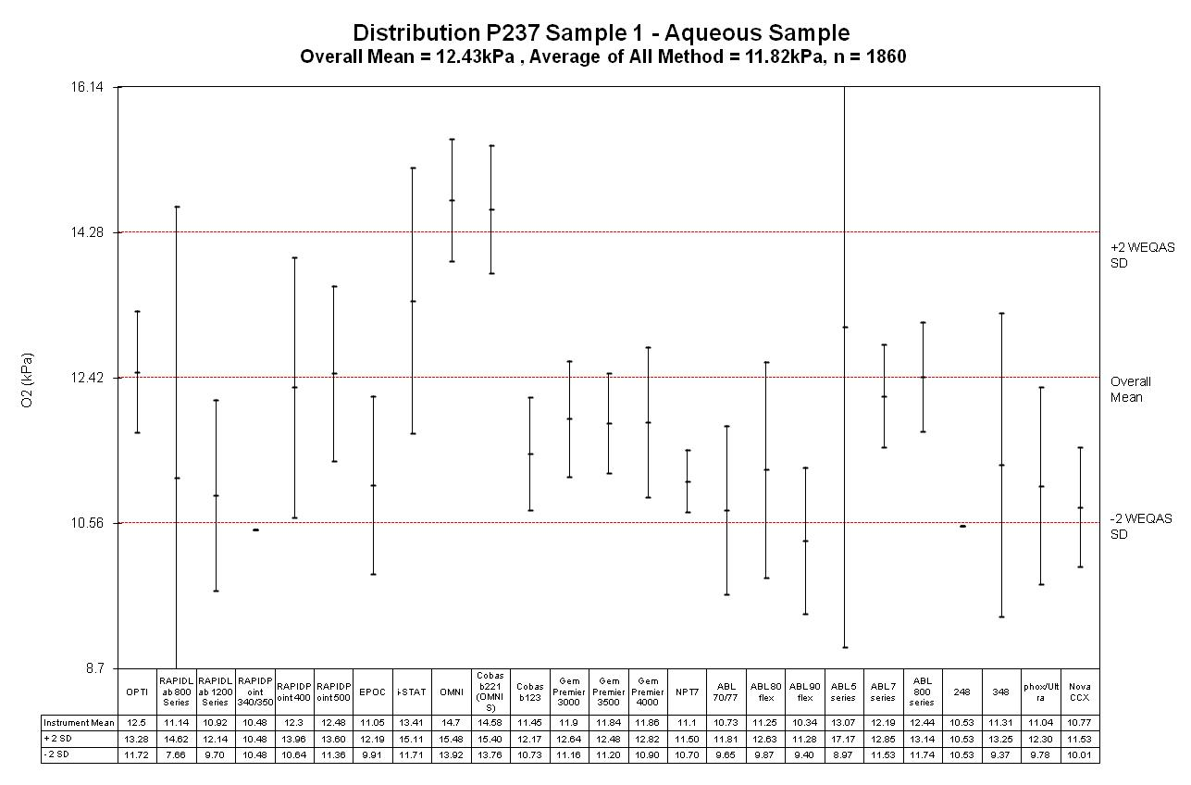
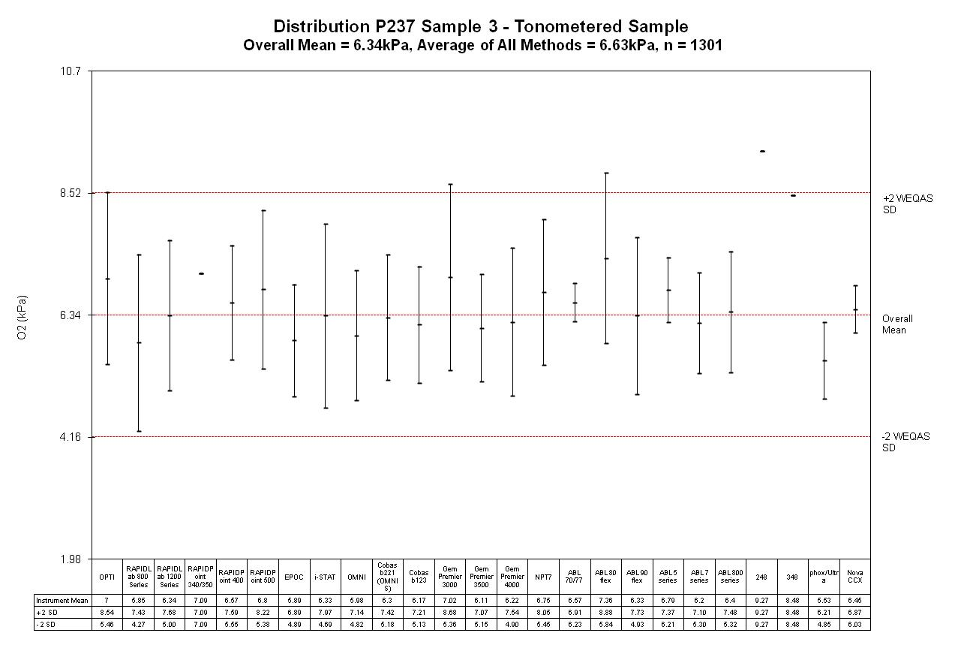
Method performance | Identify any differences between methods – bias, imprecision, sensitivity, specificity. Is it due to the sample matrix? Identify analyser platform specific issues as above. A method classification can be drawn up based on the above.
Aqueous EQA material
Commutable whole blood EQA material
Roche Omni analyser

Slide 20
Storage – pilot POCT Creat
Storage | Dependent on stability experiments from Stage 3. The length of the batch prepared also has to consider volume of specimens and available storage on EQAS site and facilities of end user. Consider using the pilot to assess short/ long term stability

Slide 21
Storage – pilot DOA
Long term Stability assessed during pilot.
Storage | Dependent on stability experiments from Stage 3. The length of the batch prepared also has to consider volume of specimens and available storage on EQAS site and facilities of end user. Consider using the pilot to assess short/ long term stability | Stable for 10 months @ -20⁰C
Notes:
Three of the pools were analysed by LC-MS/MS and assessed for their stability at 4°C, ambient and at -20°C.
Good stability was observed for the majority of analytes, although a decrease of -18% was observed for the extended stability at -20° C for amphetamine and methamphetamine (Figure 1c) which was not confirmed from the participant data (Figure 1d).

Slide 22
Stage 5: The Pilot
Area | Process | OUTCOME
Instructions for sampling preparation handling / testing. | This should include temp/storage/time of testing /mixing /reconstitution of the material. Results should be reported to EQA provider in same way as patient samples [units, sig figs, decimal places etc, not undertaken if sample haemolysed, over range etc.] Consider adding advice for participants such as : EQA samples should be treated as patients’ samples.
Return window for results | Did everyone return results within my original time window? How many couldn’t ? Do I need to offer a longer time period? This needs to be balanced with providing feedback on performance in a timely manner.
Statistical analysis to be used | What does the data look like? Does it require an alternative non-parametric model? Are conventional statistical procedures appropriate? Is it too time consuming to be done in Excel? Will it require bespoke software?
Report format and turn-around time | Will the report fit into a standard automated format? Does the format and TAT need modifying based on my experience with the pilot?
Target values | Are there any issues in using the participants returned data to establish the target? Can I use the overall mean (after outlier exclusion) or will I need to use method mean due to method biases.
Evaluation Criteria | What was the performance like? Consider developing a precision profile for each analyte during the pilot and comparing with any National or International criteria ?

Slide 23
Target values used in Quantitative EQA
Loss of information for Assessment of accuracy
Reference values
Gold standard
Gravimetric
Overall mean / median
Used if no ref and data Gaussian.
Method mean / median
Peer group assessment only and should only be used if n>8
Analyser mean
Peer group assessment only.
Target values | Are there any issues in using the participants returned data to establish the target? Can I use the overall mean (after outlier exclusion) or will I need to use method mean due to method biases.

Slide 24
Results
Analyte | Gravimetric | LC-MS/MS | Recovery %
Amphetamine (ug/L) | 3000 | 2936 | 97.9
Cannabis (ug/L) | 300 | 227 | 75.7
Opiate (Morphine) (ug/L) | 5000 | 5483 | 109.7
Benzodiazepine (ug/L) | 800 | 749 | 93.6
Cocaine (ug/L) | 800 | 842 | 105.3
Methadone (EDDP) (ug/L) | 600 | 720 | 120.0
Methamphetamine (ug/L) | 3000 | 3193 | 106.4
6-Acetylmorphine (ug/L) | 30 | 25 | 83.3
Buprenorphine (ug/L) | 30 | 31 | 103.3
Ketamine (ug/L) | 3000 | 2786 | 92.9
Barbiturates (ug/L) | 800 | 820 | 102.5
MDMA (ug/L) | 2500 | 2766 | 110.6
Phencyclidine (ug/L) | 73.4 | 78* | 106.3
Traceability
Good agreement was observed between the ‘gravimetric’ weighed in target and the LC-MS/MS data for the majority of analytes, however a decreased recovery of 76% and 83% was observed for cannabis and acetylmorphine respectively.
Target values | Are there any issues in using the participants returned data to establish the target? Can I use the overall mean (after outlier exclusion) or will I need to use method mean due to method biases. | Can use gravimetric for all analytes apart from cannabis and acetylmorphine

Slide 25
Determine your Performance specifications.

Slide 26
Analytical goal
Hierarchy
Model 1
Model 2
Model 3
Analytical goals based on clinical outcomes
Analytical goals based on biological variation
“State of the art” - Interlaboratory variation
What we need but data not readily available
Data available but not always achievable
What we can achieve but may not be “fit for purpose”
Data from outcome studies
Improvements in methods / technology
Notes:
The statistical analysis is identical to that used in the WEQAS General Clinical Chemistry Scheme. For each sample the participant overall mean and standard deviation is calclated for each analyte. Results outside +/- 2SD from the mean are excluded and a new mean is recalculated. Each laboratory’s results are compared with these target values using linear regression analysis to give a measure of systematic error.
For each analyte, different analysers are also grouped into analyser specific method groups and the mean and standard deviation calculated.
The Standard Deviation Index is used for scoring, where SDI= (lab result - method mean) / WEQAS SD at that level. For each analyte over the five samples an average SDI is calculated to ginve an analyte SDI. For each laboratory section an average is calculated from the sum of all the analyte SDIs to give a section SDI. For the whole labortatory, theaverage of all analyte SDIs in all sections is calculated to give the laboratory SDI. The average SDI for all laboratories submitting results for that distribution is also given.

Slide 27
Performance Specification – pilot DOA
Evaluation Criteria | What was the performance like? Consider developing a precision profile for each analyte during the pilot and comparing with any National or International criteria ? | Precision profile developed will be used. No National criteria. No Model 1 or model 2 criteria.
Notes:
The quantitative results were compared with the gravimetric values and the performance specification calculated from precision profiles established during the pilot (Figures 3a & 3b). Uncertainty of the gravimetric value was calculated from the Guide to the Expression of Uncertainty in Measurement (GUM).

Slide 28
Performance specification – pilot DOA
Qualitative
“Cut offs” selected are achievable for the majority of methods.
Notes:
Assessment of the qualitative results were based on the cut-offs in Table 1 and reflect those used by the majority of participants in the UK, and are higher than the European Guidelines for Workplace Drug Testing. Examples of the performance of the methods providing qualitative results (pos or neg) are shown in Figures 2a and 2b.

Slide 29
Performance specification – pilot poct creat
Evaluation Criteria | What was the performance like? Consider developing a precision profile for each analyte during the pilot and comparing with any National or International criteria ? | Performance spec for creatinine using Model 2 is 8.4%. This is unachievable for POCT devices. Precision profile developed will be used.

Slide 30
Your Report

Slide 31
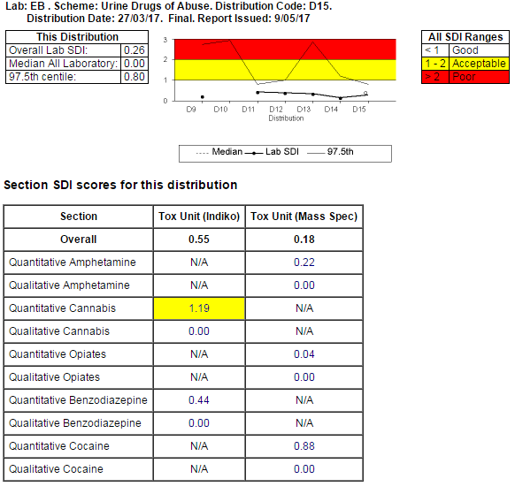
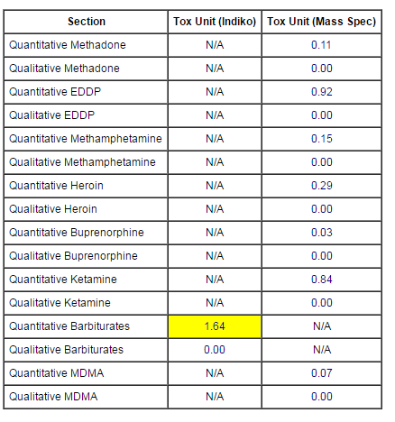
Typical report

Slide 32
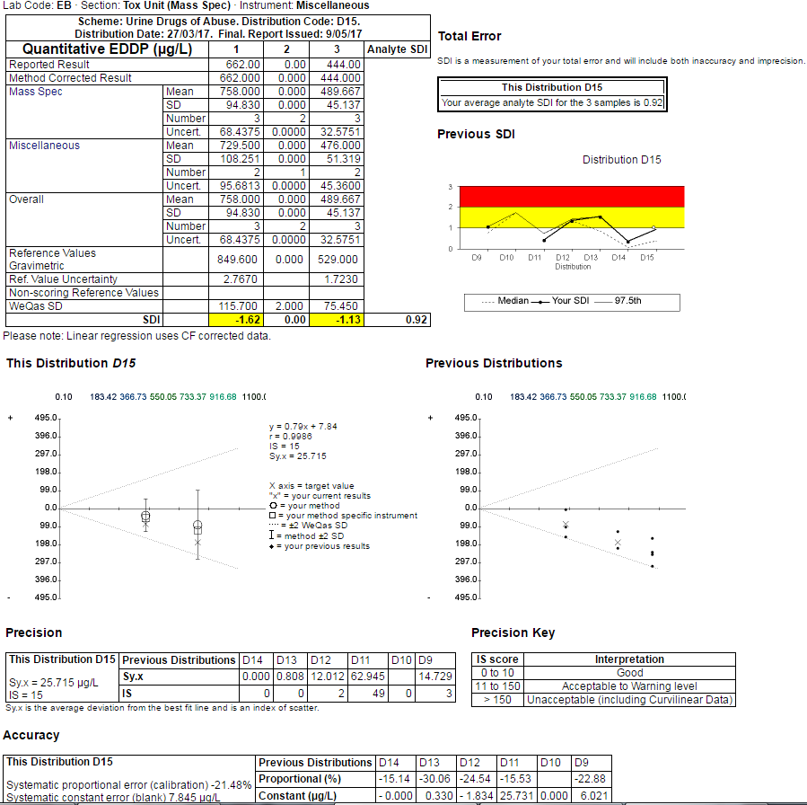

Slide 33
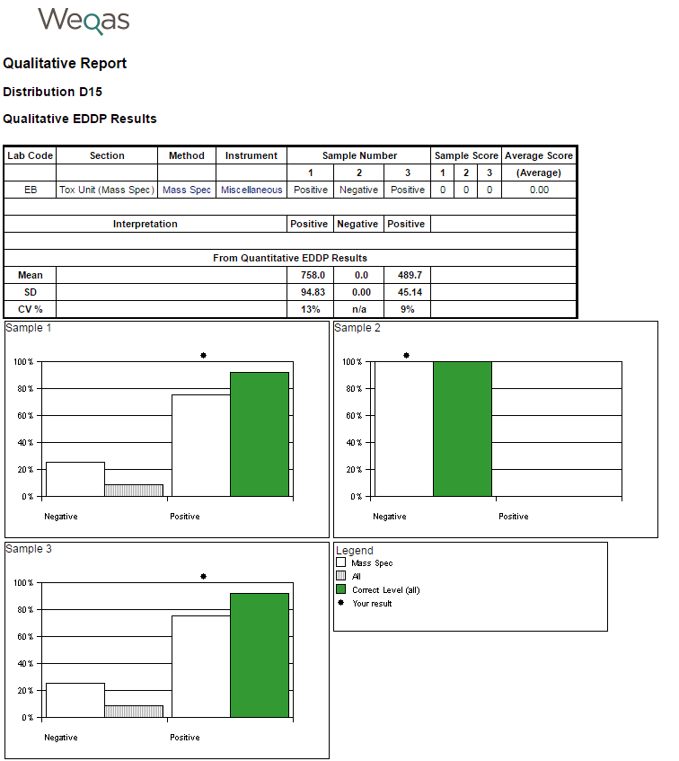
Typical Qualitative report

Slide 34
All evidence, documents and forms listed may differ between the designs of the EQA schemes. The tables below list the ones generally required: some schemes may require less or more.
Stage 6 - collecting the evidence, forms and documentation
Evidence gathered in Sections 3,4 &5
Background research | Keep all references, kit inserts, papers, sources of information (Section 3)
Preliminary development work | All data from practical evaluation stage including log books (section 4).
Stability experiments | All data from stability experiments including hard copies (section 4).
Participant results | Reports and Summary data during pilot phase (Section 5).
Participant feedback | Print comments from questionnaires, surveys, telephone logs, e-mail from participants’.

Slide 35
Stage 6 - forms and documentation needed
Forms and documents required
Method Questionnaire | Analyser/ kits used and methods
Instructions to participant | How, where and for how long to store sample before assay and if there are specific instructions on how to use the material.
Example of return sheet | How results are returned (section 5)
Example of storage label (if used). | e.g. Store at -20°C on receipt / protect from light on opening.
Consent form for volunteers, if material is donated from clinics. | e.g. patient blood donations from clinics
Material preparation Approval form | To include e.g. serum certificates, chemical certificates, calculation sheets, sterility results, test results
Material dispensing Approval form | To include e.g. labelling and dispensing sheets, homogeneity and stability data.
SOP for Preparing the material for the Scheme | If prepared in “house” – full procedure
Organisation and design of the scheme | This can be described in a ‘Scheme Guide” to include sample type, frequency, statistical analysis
Vertical Audit report of the Scheme | Audit the process during the pilot and address any issues before proceeding to a full roll out.
Method Verification data of any new methods or equipment used in Scheme development / stability testing / homogeneity testing or target value assignment | Any testing undertaken “in house” or by a third party “subcontractor” must comply with ISO 15189 or 17025 and for reference laboratories ISO 15189.

Slide 36
Stage 7: The “final” design
AREA | PROCESS
NUMBER OF PARTICIPANTS LIKELY TO BE INCLUDED IN SCHEME AND TYPE OF SITES | 100 participants - laboratories, private and state.
INSTRUCTIONS FOR PARTICIPANTS AND INFORMATION FROM PARTICIPANTS. | Need to provide instructions for reconstitution, stability of material, storage conditions how to use the material and where to send their results. Method information and number of instruments need to be provided by participant.
TYPE AND SOURCE OF MATRIX MATERIAL | Commercial Lyophilised material – stable for 1 year at 4⁰C.
Frequency of distributions | Once a month
Number of Samples | 2 samples to cover analytical range over 12 months.
Statistical analysis to be used and type of report | Calculation of mean, standard deviation and coefficient of variation. Outlier process – simple: excluding results > 3 SD from calculation of target. Simple SDI score / Histogram of all results in Excel.
Paper or web entry | Telephoned/ fax/ in the post/ e-mail.
Report format and turn-around time | Consider turn around time : <20 days for.
Target value: Reference values / Reference methods / participants results | Peer review using Method mean
Evaluation Criteria | Performance criteria based on state of the art. Review periodically.

Slide 37
Scheme design - DOA
Frequency : Monthly, 2 weeks to return results
Samples: 3 (2.0 ml)
Material: fresh filtered urine with drug metabolites added
Assessment: analytical performance against gravimetric, assessment at “cut off” levels, Quantitative and Qualitative
Sites: Laboratory and POCT sites
Number of participants: 60 in pilot
Method Groups:
Immunoassay
    Siemens Advia Chemistry
    Abbott Architect
    Beckman AU400/600/640/680
    Roche Cobas C Module
    Thermo Scientific Indiko Plus
    Roche Integra
Mass Spec
PoCT devices
    Surescreen Multipanel
    Alere Triage
    Alere DrugScreen Test Panel
    Synergy Multidrug RapidTest Cup
    DXpress Reader

Slide 38
Scheme design - DOA
STORAGE AND STABILITY
Unopened samples are stable for two (2) weeks in a refrigerator at 2-8°C.
Samples stored at 2-8°C prior to analysis must be brought to room temperature and assayed within 1 hour.
PROCEDURE
The samples should be treated the same as patient specimens and run in accordance with the instructions accompanying the test system being used. Results returned via web.
RANGE COVERED
Analyte | Approx Range (µg/L)
Amphetamine | 0 – 3000
Cannabis | 0 - 150
Opiate | 0 - 3000
Benzodiazepine | 0 - 1000
Cocaine | 0 - 1000
Methadone | 0 - 1000
EDDP | 0 - 1000
Methamphetamine | 0 - 3000
Heroin | 0 - 50
Buprenorphine | 0 - 50
Ketamine | 0 - 3000
Barbiturates | 0 - 1000
MDMA | 0 – 3000
Phencyclidene | 0 – 100
Tricyclic Anti-Depressants | 0 - 3000
PERFORMANCE SPECIFICATION
Weqas SD calculated from precision profile. TEa = Target ± 2 x Weqas SD.
Statistical analysis
Statistical methods that are robust to outliers complying with ISO 13528:2015. The overall and method Robust means and standard deviations are calculated using Algorithm A with iterated scale. Target value = gravimetric.
For each analyte at each sample point the standard deviation index (SDI) is calculated. This is calculated as: (laboratory result – target value) / Weqas SD.
REPORTS manager, standard, simple, “end of batch”. Available to download within 7 working days after the "return by" date.
SDI < 1 | Good - all points within ± 1 SD
SDI 1 – 2 | Acceptable
SDI > 2 | Unacceptable - Laboratory needs to evaluate the analyte

Slide 39
EQA and Laboratory in partnership
Part of Quality Improvement
Should not be viewed as a pass/fail exercise
Educational – troubleshooting, recommendations of best practice
Identify poor methods
Provide training and help

Slide 40
Key elements of National EQA
Competent Authority
Manufacturer
Professional / Regulatory body
EQA Provider
Laboratory
Method performance evaluation
Post market vigilance
Participant Performance evaluation
Quality improvement
Continuous Education
Harmonisation of results
Harmonisation of processes
Audit and recommendations

Slide 42
General considerations for accreditation
General Policies | Records
Legal entity of EQA provider | Legal framework, SLA with any partners, governance.
Management structures | Organisational charts, Advisory structure, Job descriptions
Code of Conduct and Confidentiality Code of Practice | [Confidentiality Code of Practice, Standards of behaviour framework policy, Counter Fraud And Corruption Policy, Data Protection and IT Security Policy, Equality, Diversity and Human Rights Policy, Health And Safety Policy, Statutory Registration Policy, Code of Conduct, Information Governance]. Evidence that staff have read them.
Quality management system | All policies, procedures, instructions, Quality Policy, Quality Manual, Quality objectives and plans, Quality and Accreditation Committee minutes
Document control | Structure, Document approval and issue Document changes , External documents, Public Documents and Marketing material.
Review of requests , tenders and contracts | The terms of enrolment, the repertoire of services and any deviation.
Subcontracting services | Description of scope, validation questionnaire, supplier assessment, supplier approval process and forms, user requirement specification and response.
Purchasing Services and supplies | Supplier assessment, evaluation of goods, supplier approval, specifications
Service to the customer | Feedback, customer satisfaction surveys, face to face meetings, e-mails, telephone logs.
Complaints and appeals | Complaint and appeals procedure, Client communication log, Monitoring client queries and complaints

Slide 43
General considerations for accreditation
General Policies | Records
Control of nonconforming work | Review of Complaints, management reviews, internal and external audits, QC, EQA, risk assessment, Documentation and communication of N/Cs
Improvement | Quality and Accreditation Group minutes, quality objectives, audits, corrective and preventative actions, management minutes, steering Committee meetings, staff meetings and management review.
Corrective Action / Preventative action | Risk assessments, Root cause analysis, documentation of CA/ PA, tend analysis, follow up audits.
Control of records | Paper or electronic media, policy for control of records including indexing, retrieval and disposal, electronic back up procedure,
Audits | Auditor training records, schedule, records of audits
Management review | The suitability of policies & procedures, Reports from Management & Supervisory personnel, Audits, CA/PA, Assessments by external bodies , EQA performance reviews, Business plan, Customer, feedback, Complaints and appeals, Quality improvement.

Slide 44
General considerations for accreditation
General Policies | Records
Personnel | Qualifications, competences and Grades of staff authorized to perform set tasks, Job descriptions, staff records, Appraisal records.
Training and Competency policy | Training and competency records. Training programme. CPD. Contractor training.
Equipment , accommodation and environment | Health and Safety, Environmental Policies H & S training, Risk assessments, temperature logs, security procedure, premises maintenance log., equipment lists, equipment maintenance.
May also need to comply with ISO 15189 / 17025 for testing
Methods and method validation | Equipment evaluation reports
Management of reagents, calibration and quality control material | Storage records, calibrator traceability, control records.
Traceability | CRM certificates
Quality Assurance | IQC, EQA records

Slide 45


